Slide 1
PARAFC analysis of fluorescence spectra measured in turbid and non- hydrolyzable media
Lyes Lakhal
Institut Polytechnique LaSalle Beauvais
Rue Pierre WAGUET
BP 30313
F-60026 BEAUVAIS Cedex, France.
Workshop on Tensor Decompositions and Applications, 2010
Sept. 13-17, 2010, Monopoli, Bari, Italy

Slide 2
The problem posed with experience
Solutions composition
Deionized water
Hemoglobin : Light absorber
Intralipid* : Light scatterer
2 Polycyclic Aromatic Hydrocarbons : Fluorescent compounds
- 9,10-Bis(phenylethynyl)anthracene (BPEA)
- 9,10-Diphenylanthracene (DPA)
*Intralipid is an emulsion of soy bean oil, egg, phospholipids and glycerin.
Notes:
Let’s pose the problem with an experience.
We have prepared a set of solutions by mixing hemoglobin, Intralipid (particules diffusantes) and 2 HAP (fluorophores).
Fluorescence EEMs were then collected with front face mode, stacked to form a three way array and fitted with PARAFAC model.

Slide 3
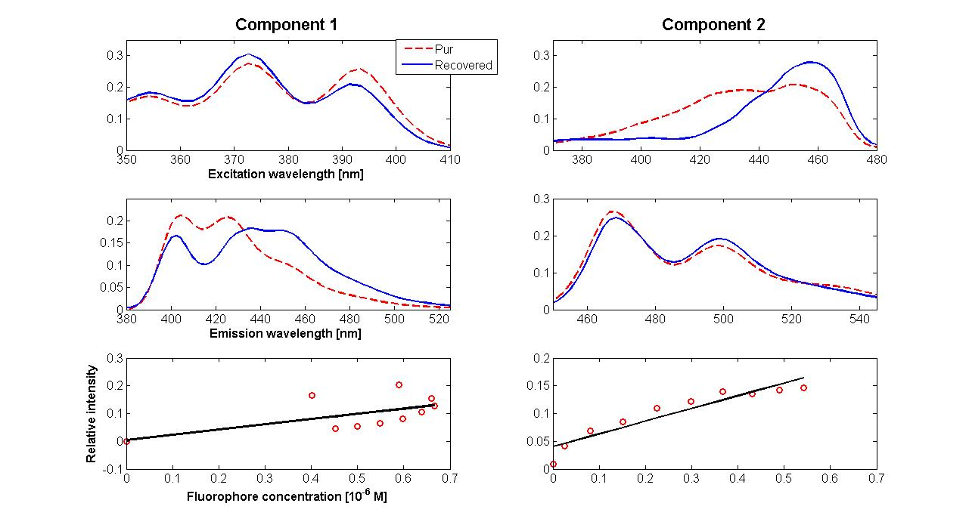
PARAFAC Analysis
Notes:
Looking at the shape of the recovered profiles,
one should become aware of the danger of fitting the PARAFAC model to a three-way fluorescence array without being certain that it is really trilinear.
The profiles obtained look correct. However, the PARAFAC model does not allow for the identification of the two fluorophores.
In real applications, components 1 and 2 might have been identified as other fluorophores
An other effect induced by scattering and absorption is the loss of linearity between the emitted fluorescence and
the concentrations.

Slide 4
Conclusions
PARAFAC loadings are not reliable source of chemical information because distorted by absorption and scattering effects.
Quantification and identification of fluorophores involves removing these effects.
Notes:
After having posed the problem, let’s describe briefly the light propagation in random media.

Slide 5
Optical parameters
Absorption parameter μ_{a} : the probability per unit path length of a photon being absorbed.
Scattering parameter μ_{s} : the probability per unit path length of a photon being scattered.
Anisotropy factor g : the mean value of the cosine of the photon scattering angle.
Photons mean free path : the mean distance the photons travel before getting scattered or absorbed. Equals to (μ_{a} + μ_{s})⁻¹.
Notes:
When light interacts with random medium, it is either absorbed or scattered in various proportions depending
on the optical properties of the medium.
These optical properties are mainly quantified with three parameters.
The absorption parameter mua gives the probability per unit path length of a photon being absorbed and depends
on the composition of the medium
the scattering coefficients mus gives the probability per unit path length of a photon being scattered. This parameter
depends on the microstructure of medium
The anisotropy factor g, is defined as the mean value of the cosine of the photon scattering angle. It depends on the form, size and orientation of the particles.

Slide 6
Model of light transport
Monte Carlo method (MC) is the standard to quantify the optical properties.
A photon package is injected into medium, and moves in straight lines between successive interactions until it exits the medium or is terminated through absorption.
By repeating this process for a large number of photon packages, the net distribution of all the photon paths yields an accurate approximation to reality.
Notes:
Monte Carlo method is often considered the standard for calculating photon propagation in absorbing and scattering media.
A photon package is injected into medium, and moves in straight lines through tissue between successive interactions until it exits the medium or is terminated through absorption.

Slide 7
Random sampling
The random walk simulated by sampling the probability distributions of 2 variables :
- The step size s,
- The deflection angle of scattering θ.
These probability distributions depends on the optical parameters.
Scattering
s
θ
Notes:
The random walk that photon package makes as it travels within the medium is simulated by

Slide 8
Recording of results
Results recorded as absorbed, reflected or transmitted fractions.

Slide 9
Determination of optical parameters
Signal measurements with integrating sphere set up.
Resolution of the inverse problem by comparing measured signals with signals predicted by MC code.
Notes:
The method for determination of optical parameters consists of
signal measurements with integration sphere setups
and
the resolution of the inverse problem based on MC modeling of the signal.

Slide 10
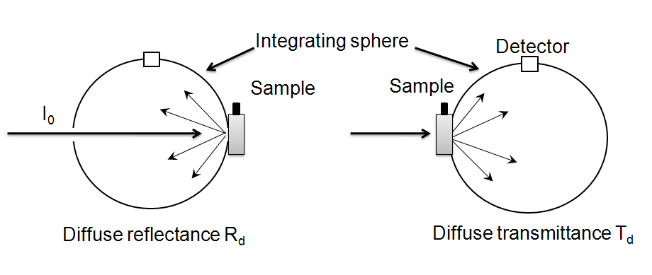
Integrating sphere set up
Notes:
An integrating sphere set up is used to collect the photons in nearly all directions and redistribute them uniformly over the inner surface of the sphere, which is of high reflectivity and surface roughness.
A light detector picks up a small portion of the integrated light irradiance in the area ratio of the total inner surface of the sphere to that of the detector.
The diffuse reflectance Rd and diffuse transmittance Td are measured with the sphere.

Slide 11
Measurement of collimated transmittance T_{c}
Sample
R_{d}
T_{d}
Detector
I₀
T_{c}
A spatial filtering setup
T_{c}
Beer Lambert law
μ_{t} = μ_{a} + μ_{s}
Notes:
A spatial filtering setup is used
to measure the collimated transmittance Tc.
This signal is used to estimate the attenuation coefficient mua + mus from
the Beer-Lambert law

Slide 12
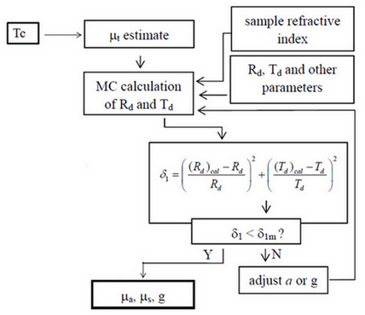
Inverse problem
The albedo a = μ_{s}/μ_{t}
a = albedo,
a = μ_{s}/(μ_{a} + μ_{s})
Notes:
An algorithm was written to solve the inverse problem.
Il is based on the non linear optimization method of Nelder and Mead
and
works by guessing the values of the albedo a and the anisotropy factor g
until MC simulations predict the measured values of diffuse reflectance and diffuse transmittance.
through iterations until a squared error function
Monte Carlo simulations were run to obtain calculated diffuse reflectance and diffuse transmittance by simulating the photon transportation inside the sample.
is reduced to a threshold, i.e., δ < δm, where δm is consistent with the total experimental errors in the Rd and Td measurements.

Slide 13
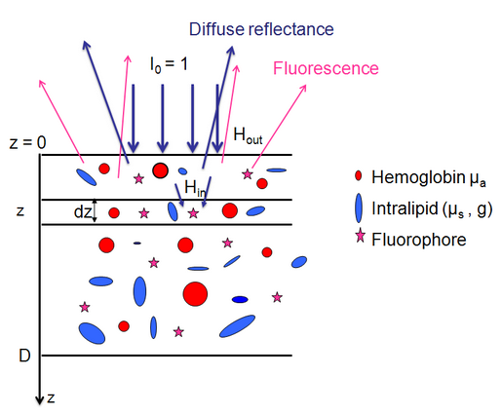
Modeling the fluorescence signal
A turbid sample can be treated as a dilute solution if its thickness is small compared to the photon mean free path.
Notes:
The effects of absorption and scattering on fluorescence spectra can be described mathematically
by recognizing that a turbid sample can be treated as a dilute solution if its thickness
is small compared to the photon mean free path.
Consider a finite homogeneous turbid medium with a spatially uniform distribution of fluorophores
and illuminated with a collimated beam of a unit power.
Dividing a turbid sample of thickness D, into a number of thin layers of thickness dz along the optic axis
allows the contribution to the fluorescence, dEEMmes, collected from the front surface
of a thin layer, thickness dz, located at depth z, to be calculated as

Slide 14
Fluorescence in turbid media
For a thin layer, thickness dz, located at depth z
λ_{ex} excitation wavelength,
λ_{em} emission wavelength,
(C_{f},ε_{f},Φ_{f}) concentration, molar extinction coefficient and fluorescence quantum yield
H_{in} describes the fraction of the incident excitation light which reaches the layer dz,
H_{out} the fraction of fluorescence emanating from dz and reaching the front surface.

Slide 15
Fluorescence in turbid media
The total EEM detected at front surface,
In the case of uniform distribution of fluorophores, the summation can be taken outside the integral
Intrinsic EEM
Transfer function (TF)
Notes:
The total EEM emitted from the front surface of a sample is given by integrating
over the turbid sample thickness:
The summation can be taken outside the integral assuming a uniform distribution
of fluorophores within the sample yielding:
Thus, the measured EEM is related to the intrinsic EEM by a wavelength depend transfer function.

Slide 16
Consequence
This fundamental result provides the key to recovering the "true" or intrinsic EEM which is bilinear from the measured EEM at the medium surface under 2 conditions :
- The data not very noisy
and obviously
- TF ≠ 0
Notes:
The total EEM emitted from the front surface of a sample is given by integrating
over the turbid sample thickness:
The summation can be taken outside the integral assuming a uniform distribution
of fluorophores within the sample yielding:
Thus, the measured EEM is related to the intrinsic EEM by a wavelength depend transfer function.
This fundamental result provides the key to recovering the "true" or intrinsic EEM
which is bilinear from the measured EEM at the medium surface under 2 conditions :
The signal to noise

Slide 17
TF evaluation model : why Monte Carlo ?
The model to be used must incorporate the particular optical characteristics associated with biomaterials :
No restriction on the ratio of scattering to absorption, since this ratio in biomaterials varies from nearly zero to large values .
No restrictions on the scattering anisotropy, since light scattering in biomaterials tends to be strongly forward peaked.
Modeling excitation and emission process in biomaterials equivalent to solving the full Radiative Transport Equation (RTE) [Ishimaru 1997] [Wang and Wu 2007].
No analytic solutions available , accurate solutions based only on MC methods [Wilson and Adam, 1983] [Prahl et al., 1989].
Notes:
Let’s describe the simulation of fluorescence excitation and emission processes
with MC model.

Slide 18
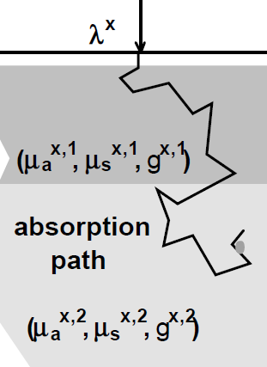
First simulation
Gives the absorption of the excitation light within the medium A(r, z, λ_{ex})
1 millions photons launched per (λex, λem)
The one - dimensional photon absorption function
Notes:
The first simulation deals with the excitation light traveling from the surface to the fluorophore.
It gives …..
The input parameters in this simulation are the optical parameters at the excitation wavelength.

Slide 19
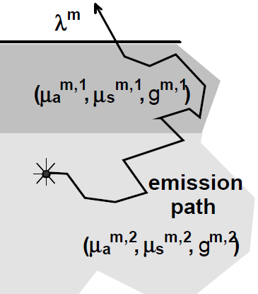
Second simulation
Gives the distribution of the fluorescence on the surface E(r, z, λ_{ex})
The one-dimensional photon fluorescence function
Notes:
The second simulation is dealing with the emitted fluorescence photon traveling from the fluorophore to the surface.
The scored quantity the distribution of the fluorescence on the surface E(r, z, λ_{ex}), defined as the number of photons per unit surface emitted.
The input parameters for these simulations are the optical parameters at the emission wavelength.

Slide 20
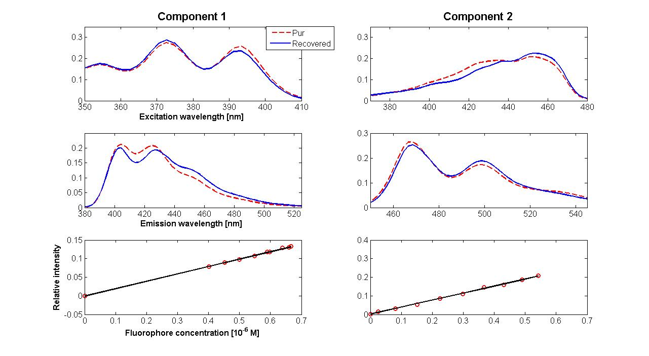
Experimental validation
Notes:
Using this formalism, the data from synthetic solutions shown in the beginning were corrected for absorption and scattering
and fitted with PARAFAC.
Visual comparisons of spectra show that there is very a good agreement between the spectra recovered by PARAFAC and pur spectra.
On other hand, the linear fit shown here clearly demonstrates that the recovered intrinsic fluorescence varies linearly with increasing concentration of fluorophores.

Slide 21
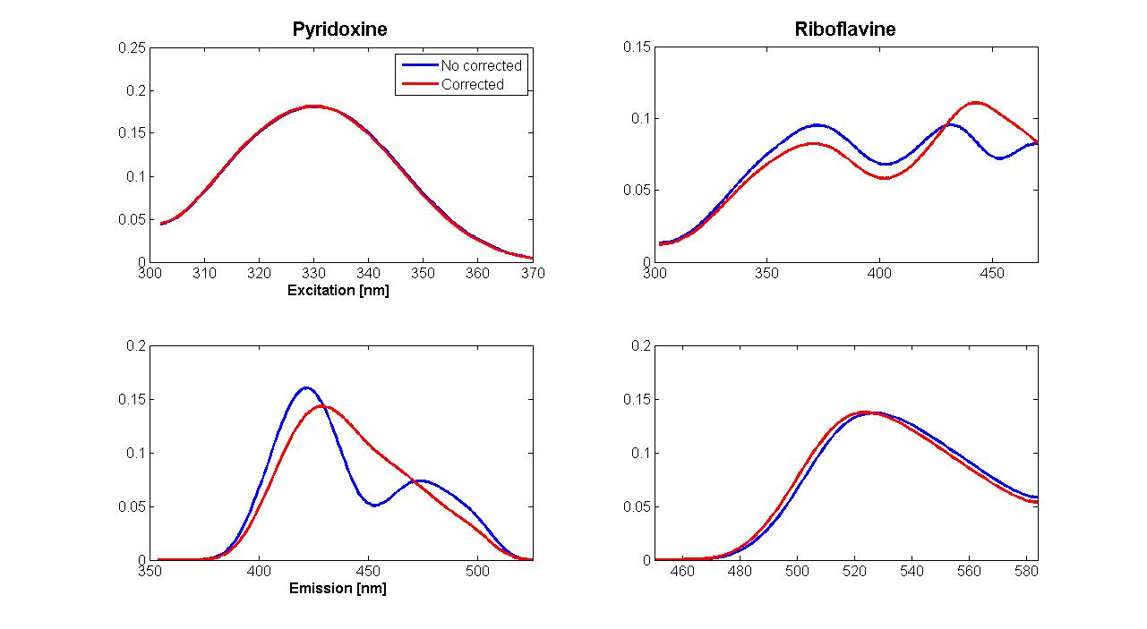
An example : Characterization and quality control of cereal products
Carotenoids
Carotenoids
Notes:
Using this formalism, the data from synthetic solutions shown in the beginning were corrected for absorption and scattering
and fitted with PARAFAC.
Visual comparisons of spectra show that there is very a good agreement between the spectra extracted by PARAFAC and those obtained from pure component solutions.
The linear fit shown here clearly demonstrates that the recovered intrinsic fluorescence varies linearly with increasing concentration of fluorophores. The value of correlation factor is 98 % and 96% for the component 1 and 2 respectively.

Slide 22
An example : Characterization and quality control of cereal products
Concentrations in ppm were determined chemically with High Performance Liquid Chromatography.
Notes:
Using this formalism, the data from synthetic solutions shown in the beginning were corrected for absorption and scattering
and fitted with PARAFAC.
Visual comparisons of spectra show that there is very a good agreement between the spectra extracted by PARAFAC and those obtained from pure component solutions.
The linear fit shown here clearly demonstrates that the recovered intrinsic fluorescence varies linearly with increasing concentration of fluorophores. The value of correlation factor is 98 % and 96% for the component 1 and 2 respectively.

Slide 23
An example : Characterization and quality control of cereal products
Notes:
Using this formalism, the data from synthetic solutions shown in the beginning were corrected for absorption and scattering
and fitted with PARAFAC.
Visual comparisons of spectra show that there is very a good agreement between the spectra extracted by PARAFAC and those obtained from pure component solutions.
The linear fit shown here clearly demonstrates that the recovered intrinsic fluorescence varies linearly with increasing concentration of fluorophores. The value of correlation factor is 98 % and 96% for the component 1 and 2 respectively.

Slide 24
Thank you for your intention

