Slide 1
DSP-CIS
Part-III : Optimal & Adaptive Filters
Chapter-9 :
Square Root and Fast RLS Algorithms
Marc Moonen
Dept. E.E./ESAT-STADIUS, KU Leuven
marc.moonen@kuleuven.be
www.esat.kuleuven.be/stadius/

Slide 2

Part-III : Optimal & Adaptive Filters
Chapter-7
Optimal Filters - Wiener Filters
        Introduction : General Set-Up & Applications
        Wiener Filters
        Adaptive Filters - LMS & RLS
        Least Means Squares (LMS) Algorithm
        Recursive Least Squares (RLS) Algorithm
        Square Root & Fast RLS Algorithms
        Square Root Algorithms
        Fast Algorithms
      Kalman Filters
        Introduction – Least Squares Parameter Estimation
        Standard Kalman Filter
        Square-Root Kalman Filter
Chapter-8
Chapter-9
Chapter-10

Slide 3
Recap 1/5

Slide 4
Recap 2/5

Slide 5
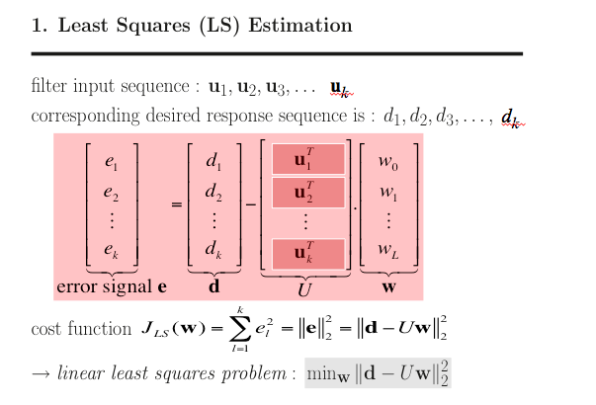
Recap 3/5

Slide 6
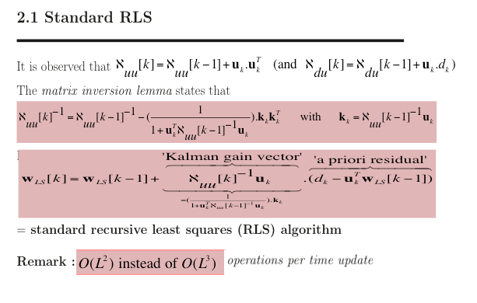
Recap 4/5

Slide 7
Recap 5/5
Computational Complexity:
Standard RLS algorithm has O(L²) computational complexity per update
In Chapter-9, will present ‘Fast RLS’ algorithms with O(L) computational complexity
Numerical Analysis/Stability:
Standard RLS algorithm has been shown to have unstable quantization
error propagation (in low-precision implementation)
In Chapter-9, will present ‘Square-Root RLS’ algorithms which are shown to be perfectly stable numerically

Slide 8
Part-III : Optimal & Adaptive Filters
Chapter-7
Optimal Filters - Wiener Filters
        Introduction : General Set-Up & Applications
        Wiener Filters
        Adaptive Filters - LMS & RLS
        Least Means Squares (LMS) Algorithm
        Recursive Least Squares (RLS) Algorithm
        Square Root & Fast RLS Algorithms
        Square Root Algorithms
        Fast Algorithms
      Kalman Filters
        Introduction – Least Squares Parameter Estimation
        Standard Kalman Filter
        Square-Root Kalman Filter
Chapter-8
Chapter-9
Chapter-10

Slide 9
Square Root RLS Algorithms
Standard RLS algorithm has been shown to have unstable quantization error propagation (in low-precision implementation)
i.e. when an infinite precision version is run next to a finite precision version (both fed with the same input signals), then after xx iterations the finite precision version produces results (far) away from the infinite precision results
Better (‘square root’) algorithms are based on orthogonal transformations and ‘QR decomposition’
Starting point is again least squares (LS) estimation…

Slide 10

Least Squares & RLS Estimation
square * rectangular rectangular * square

Slide 11
Least Squares & RLS Estimation

Slide 12
Least Squares & RLS Estimation
(**) orthogonal transformation preserves norm
triangular
backsubstitution
This is a numerically better way of computing the LS solution, better than

Slide 13
Square Root RLS Algorithms
PS: This (= QRD + backsubstitution) is also the way Matlab™
solves LS problems ( cfr “x=A\b” or “x=mldivide(A,b)” )
Now back to
recursive least squares (RLS) estimation…
This will be based on ‘recursive QRD’, i.e.
‘QRD-updating’

Slide 14
Least Squares & RLS Estimation
k-1

Slide 15
Least Squares & RLS Estimation

Slide 16
Least Squares & RLS Estimation
=‘triangular backsubstitution’

Slide 17
Least Squares & RLS Estimation
Will now look into the details of how the Q[k] can be constructed

Slide 18
Least Squares & RLS Estimation

Slide 19
Least Squares & RLS Estimation
[k]
3-by-3 example

Slide 20
Square Root RLS Algorithms
A graphical representation (i.e. a ‘realization’) of the QRD updating process is presented in the next slide
This is also referred to as a ‘signal flow graph’ (SFG)
The SFG in the next slide will be further developed in later slides, and also used explicitly for the (graphical) derivation of a ‘fast’ RLS algorithm (p.27)

Slide 21
Least Squares & RLS Estimation
u[k] u[k-1] u[k-2] u[k-3] d[k]
4-by-4 example
*

Slide 22
Square Root RLS Algorithms
Residual Extraction
So far, the “star“ (*) in the update equation (also appearing at the bottom of the SFG) has not been considered/defined/used
It will turn out that this “star” can be used to compute least squares residuals
(without explicitly computing the least squares filter vector!)

Slide 23
Least Squares & RLS Estimation
Hence ε is geometric mean of
a posteriori & a priori residual

Slide 24
Least Squares & RLS Estimation
u[k] u[k-1] u[k-2] u[k-3] d[k]

Slide 25
Least Squares & RLS Estimation
u[k] u[k-1] u[k-2] u[k-3] d[k]

Slide 26

Least Squares & RLS Estimation

Slide 27
Part-III : Optimal & Adaptive Filters
Chapter-7
Optimal Filters - Wiener Filters
        Introduction : General Set-Up & Applications
        Wiener Filters
        Adaptive Filters - LMS & RLS
        Least Means Squares (LMS) Algorithm
        Recursive Least Squares (RLS) Algorithm
        Square Root & Fast RLS Algorithms
        Square Root Algorithms
        Fast Algorithms
      Kalman Filters
        Introduction – Least Squares Parameter Estimation
        Standard Kalman Filter
        Square-Root Kalman Filter
Chapter-8
Chapter-9
Chapter-10

Slide 28
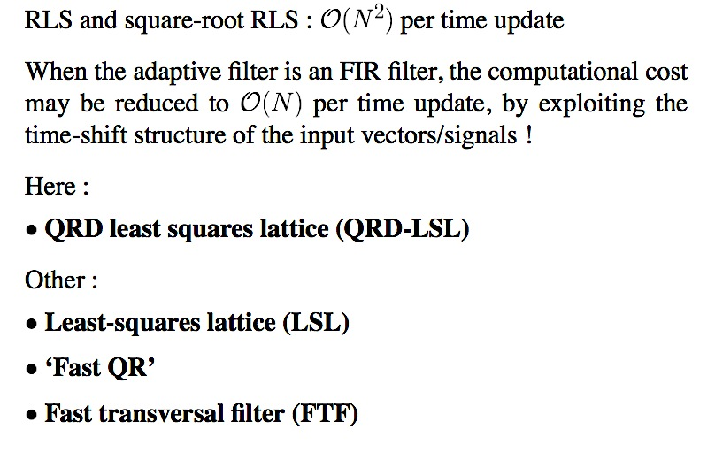
Fast RLS Algorithms
Will consider/derive 1 ‘fast’ algorithm here:

Slide 29
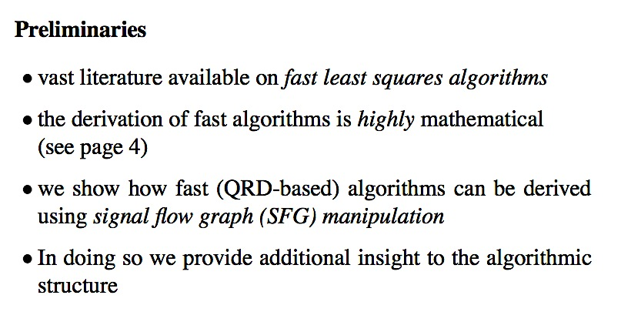
Fast RLS Algorithms
32)

Slide 30
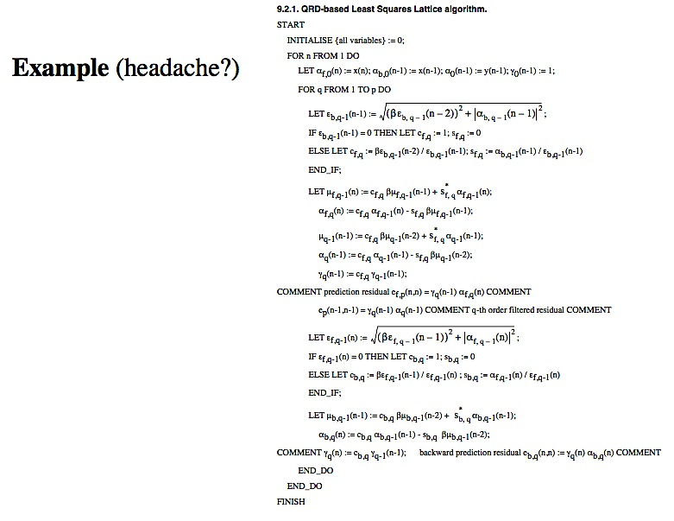
Fast RLS Algorithms
See p.39 for a signal
flow graph of this

Slide 31
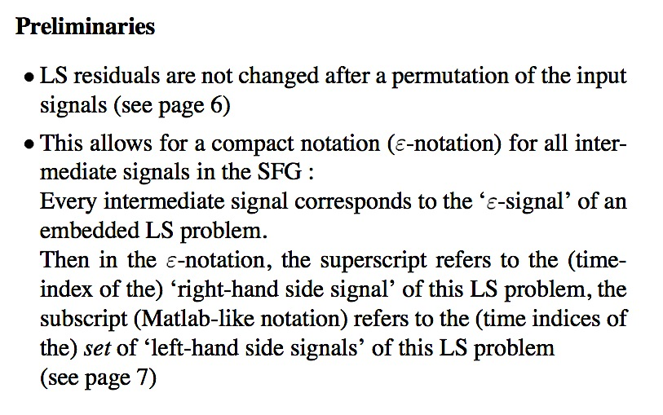
Fast RLS Algorithms
32)
33)

Slide 32
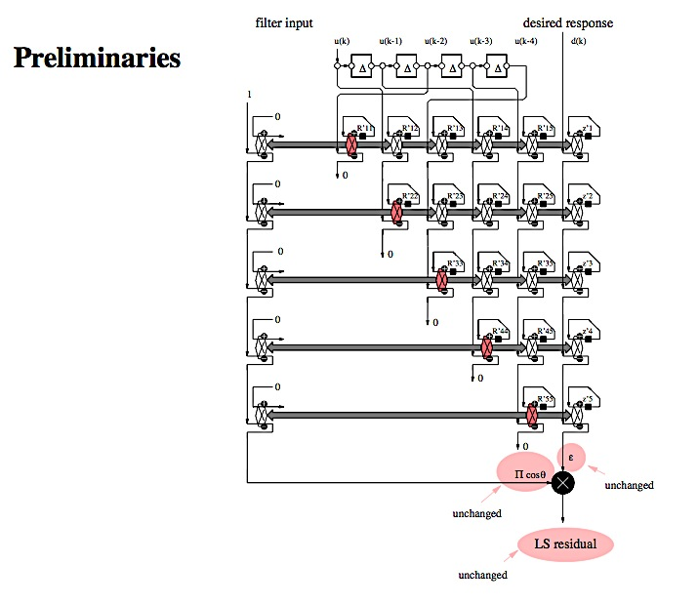
Least Squares & RLS Estimation

Slide 33
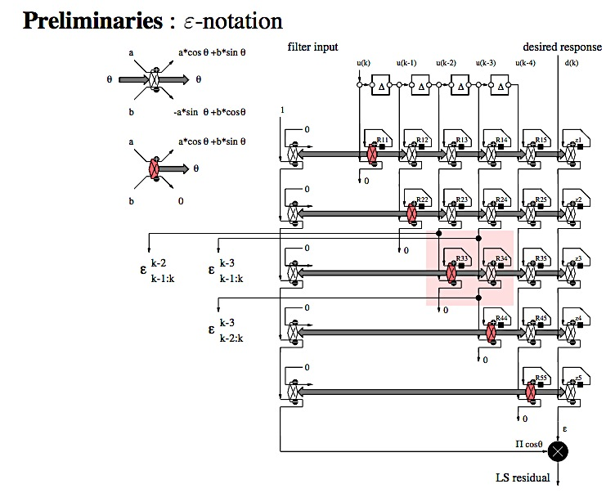
Least Squares & RLS Estimation

Slide 34
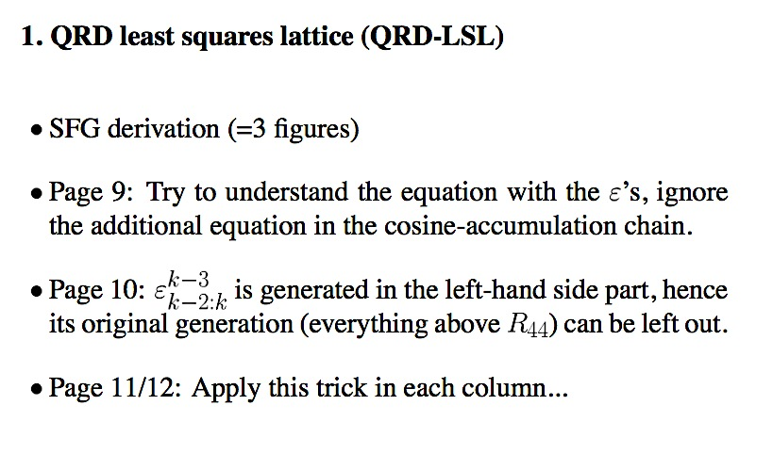
Fast RLS Algorithms
35:
36:
37 :

Slide 35
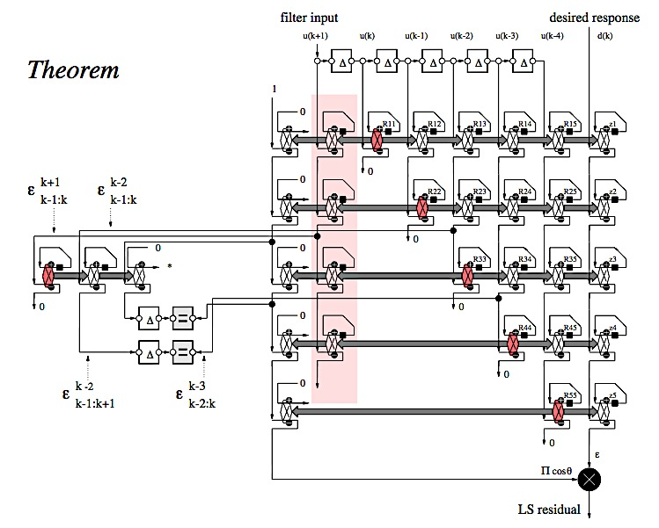
Least Squares & RLS Estimation
A
B
C
D
E
B
A
C
D
E

Slide 36
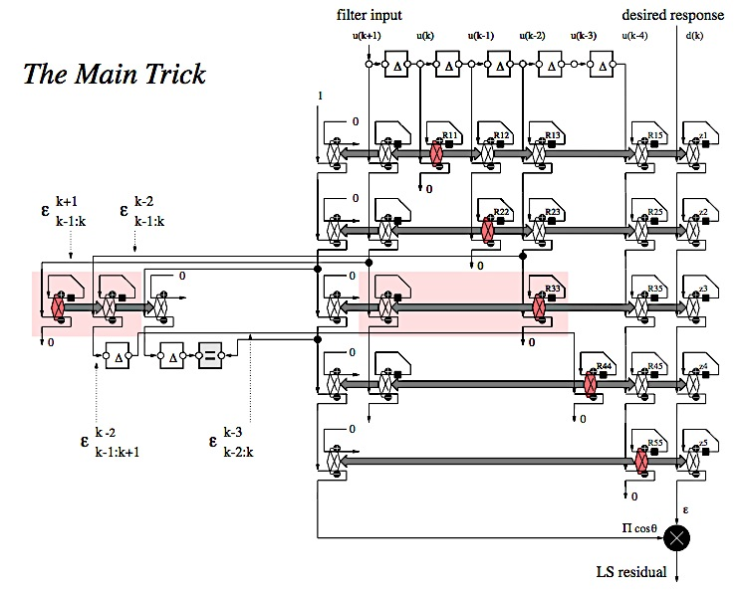
Least Squares & RLS Estimation

Slide 37
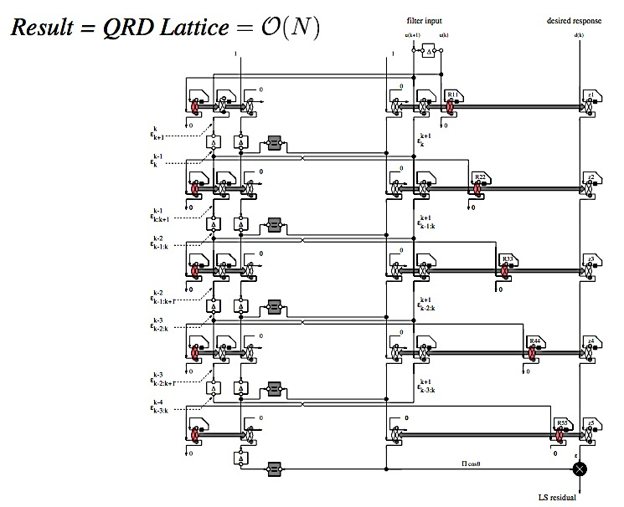
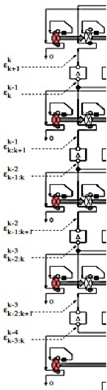
Least Squares & RLS Estimation
“n-th layer”

Slide 38
Fast RLS Algorithms
Number of ‘layers’ = filter order L +1
Six rotations per layer, four multiplications per rotation, hence overall complexity is ≈24(L+1)
(compare to LMS & (standard) RLS)
Each layer has the same structure (see next slide) Epsilon’s correspond to forward and backward prediction problems applied to input signal u[k] By multiplying epsilon’s with cosine-products true forward (f) and backward (b) residuals are obtained Prediction order is increased when going from one layer to the next lower layer

Slide 39
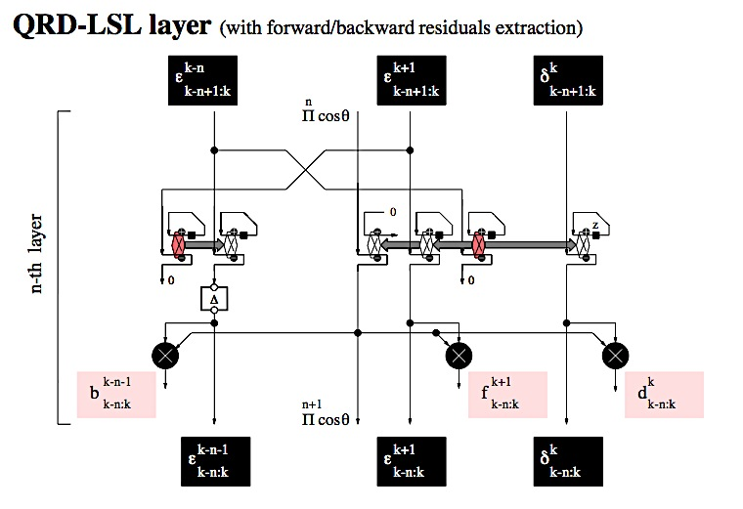
Least Squares & RLS Estimation

Slide 40
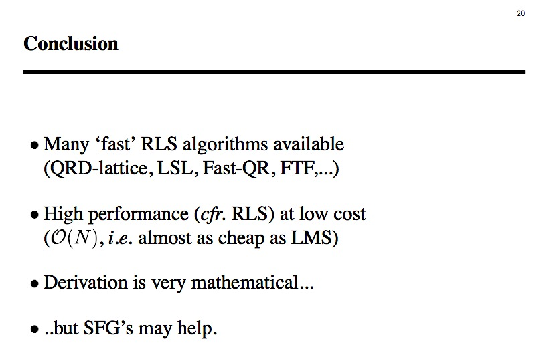
Least Squares & RLS Estimation

