Slide 1
DSP-CIS
Part-III : Optimal & Adaptive Filters
Chapter-8 : Adaptive Filters – LMS & RLS
Marc Moonen
Dept. E.E./ESAT-STADIUS, KU Leuven
marc.moonen@kuleuven.be
www.esat.kuleuven.be/stadius/

Slide 2

Part-III : Optimal & Adaptive Filters
Chapter-7
Optimal Filters - Wiener Filters
        Introduction : General Set-Up & Applications
        Wiener Filters
        Adaptive Filters - LMS & RLS
        Least Means Squares (LMS) Algorithm
        Recursive Least Squares (RLS) Algorithm
        Square Root & Fast RLS Algorithms
        Square Root Algorithms
        Fast Algorithms
      Kalman Filters
        Introduction – Least Squares Parameter Estimation
        Standard Kalman Filter
        Square-Root Kalman Filter
Chapter-8
Chapter-9
Chapter-10

Slide 3
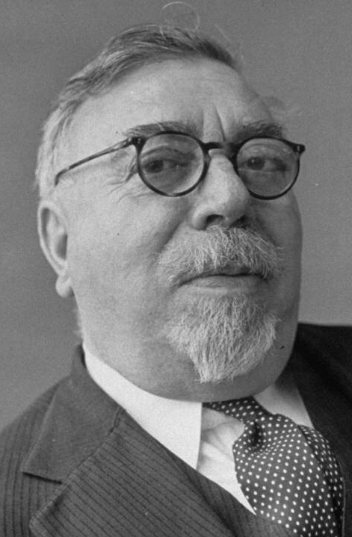
Recap 1/5
Norbert Wiener (1894-1964)

Slide 4
Recap 2/5
1
Will use
u[k]
PS: Shorthand notation u_{k}=u[k], y_{k}=y[k], d_{k}=d[k], e_{k}=e[k],
Filter coefficients (‘weights’) are w_{l} (replacing b_{l} of
previous chapters)
For adaptive filters w_{l} also have a time index w_{l}[k]
e[k]
y[k]
d[k]

Slide 5
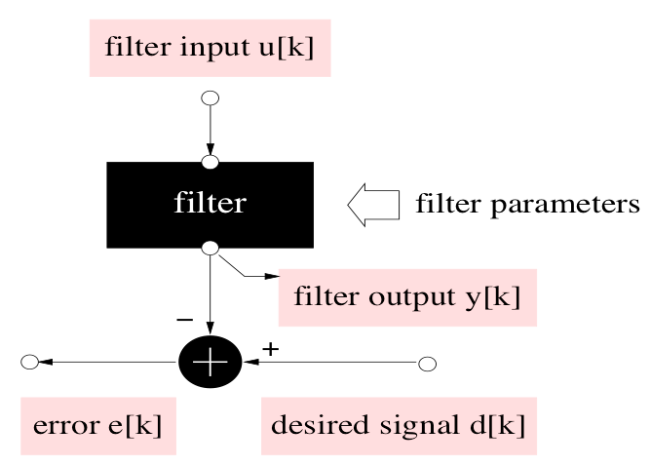
Recap 3/5
2
Will use
= minimize

Slide 6
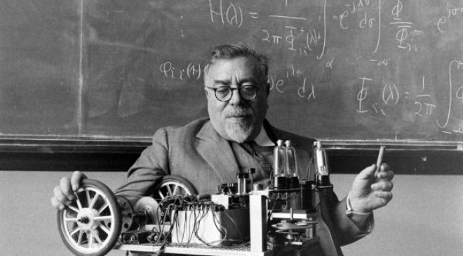
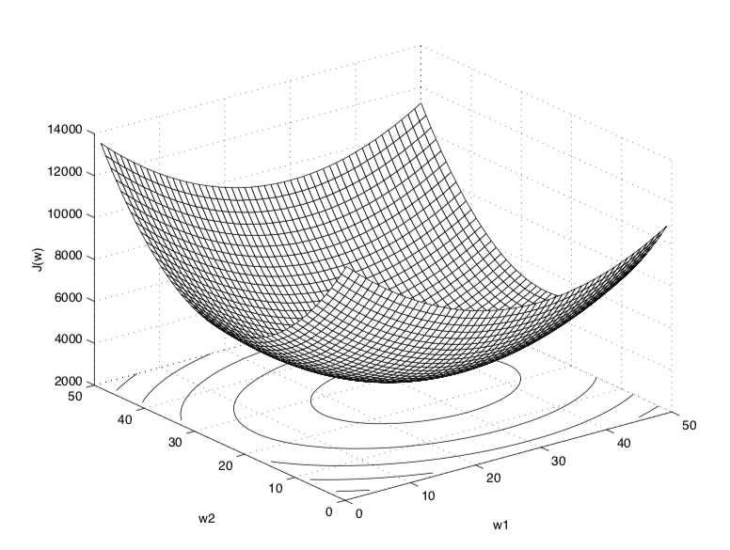
Recap 4/5
MMSE cost function can
be expanded as…(continued)
This is the ‘Wiener Filter’ solution

Slide 7
Recap 5/5

Slide 8
Part-III : Optimal & Adaptive Filters
Chapter-7
Optimal Filters - Wiener Filters
        Introduction : General Set-Up & Applications
        Wiener Filters
        Adaptive Filters - LMS & RLS
        Least Means Squares (LMS) Algorithm
        Recursive Least Squares (RLS) Algorithm
        Square Root & Fast RLS Algorithms
        Square Root Algorithms
        Fast Algorithms
      Kalman Filters
        Introduction – Least Squares Parameter Estimation
        Standard Kalman Filter
        Square-Root Kalman Filter
Chapter-8
Chapter-9
Chapter-10

Slide 9
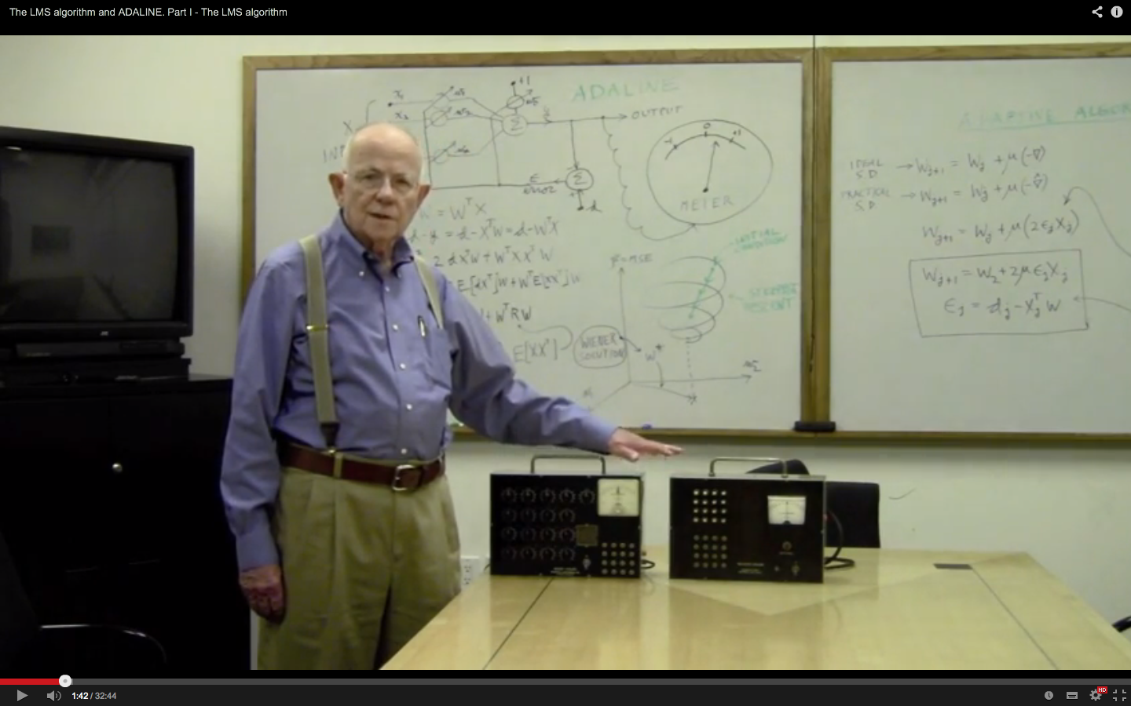
Adaptive Filters: LMS
How do we solve the Wiener–Hopf equations?
Alternatively, an iterative steepest
descent algorithm can be used
This will be the basis for the derivation of the
Least Mean Squares (LMS)
adaptive filtering algorithm…
Bernard Widrow 1965 (https://www.youtube.com/watch?v=hc2Zj55j1zU)

Slide 10

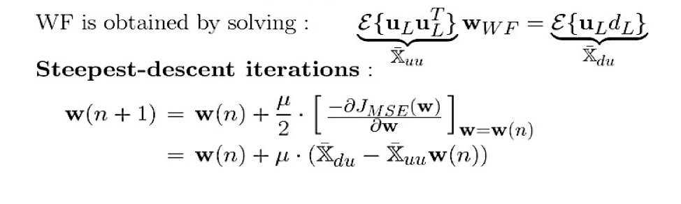
Adaptive Filters: LMS
How do we compute the Wiener filter?
1) Cfr supra: By solving Wiener-Hopf equations (L+1 equations in L+1 unknowns)
2) Can also apply iterative procedure to minimize MMSE criterion, e.g.
here n is iteration index
μ is ‘stepsize’ (to be tuned..)

Slide 11
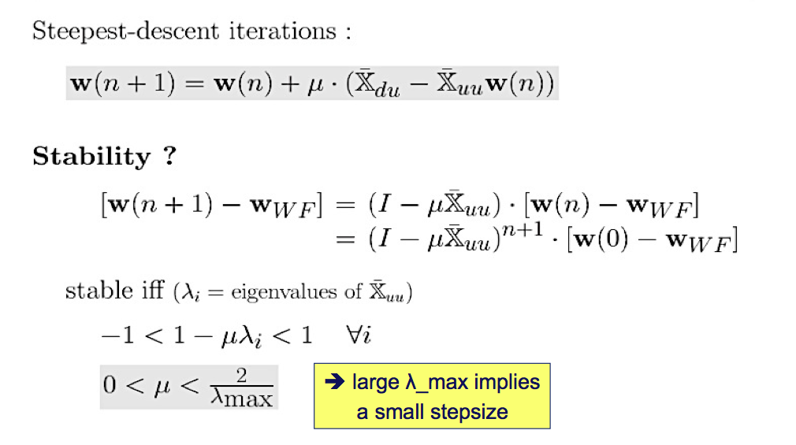
Adaptive Filters: LMS
Bound on stepsize ?

Slide 12
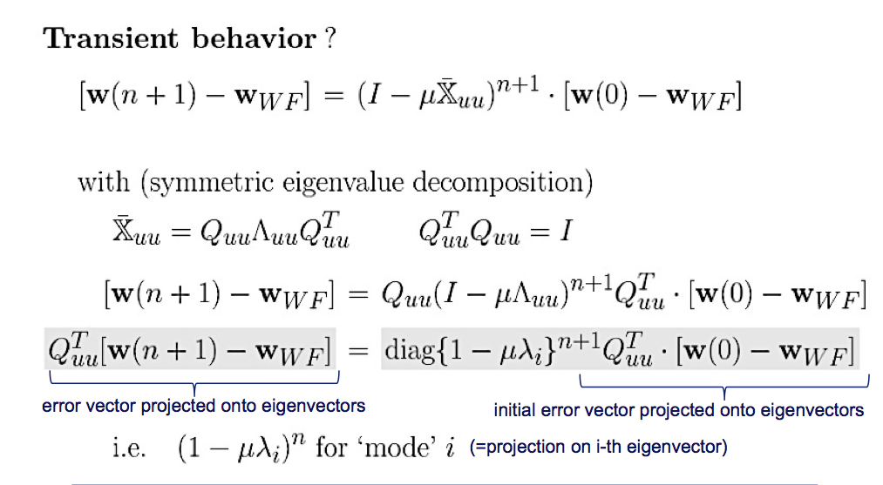
Adaptive Filters: LMS
Convergence speed?
➔ small λ_{i} implies slow convergence (1-μλ_{i} close to 1) for mode i

Slide 13
Adaptive Filters: LMS
Convergence speed?
Hence slowest convergence for λ_{i}=λ_{min}
With upper bound for μ (see p11) :
1-2(λ_{min}/λ_{max)} ≤ 1-μλ_{i} ≤ 1
Hence λ_{min}<<λ_{max} (i.e. large ‘eigenvalue spread’)
implies very slow convergence
λ_{min}<<λ_{max} whenever input signal u[k] is very ‘colored’
(λ_{min}=λ_{max} for ‘white’ input signal (i.e. autocorrelation matrix = I))

Slide 14
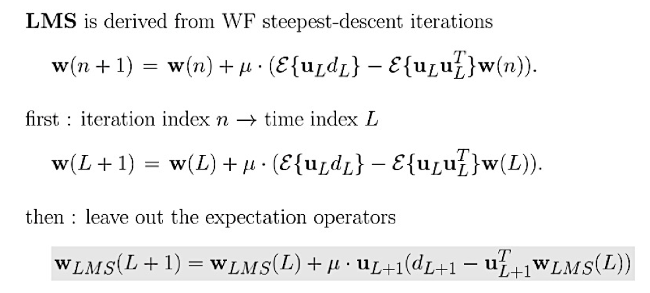
Adaptive Filters: LMS
as follows
Replace n+1 by n for convenience…
Then replace iteration index n by time index k
(i.e. perform 1 iteration per sampling interval)
k
Then leave out expectation operators
(i.e. replace expected values by instantaneous estimates)
‘a priori error’

Slide 15
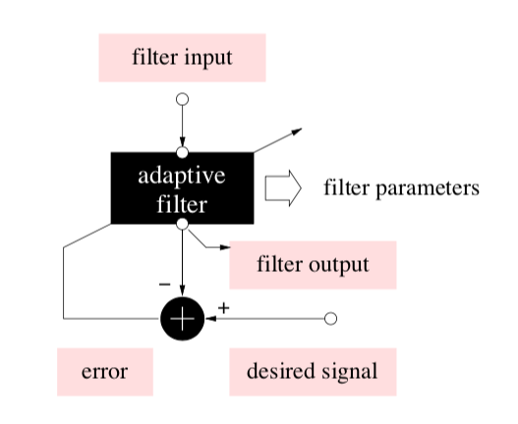
Adaptive Filters: LMS
‘a priori error’
Note that this matches
with the prototype
adaptive filter set-up (p7)

Slide 16
Adaptive Filters: LMS
Simple & cheap algorithm:
complexity is ≈2L multiplications per time update
(i.e. per sampling period)

Slide 17
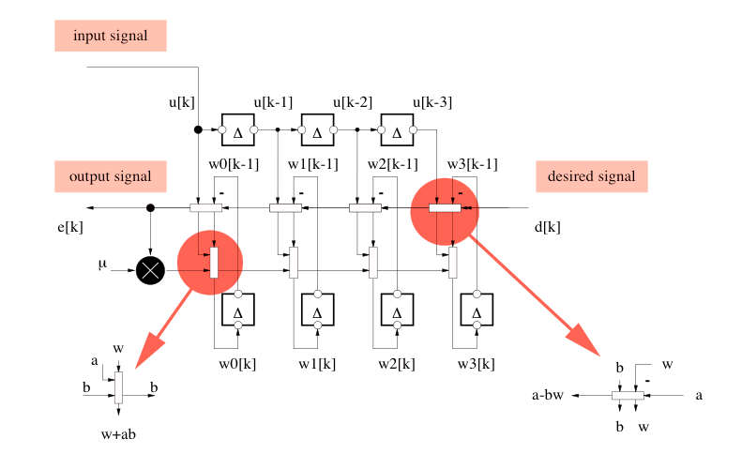
Adaptive Filters: LMS
Simple algorithm, can even draw
signal flow graph (=realization)…

Slide 18
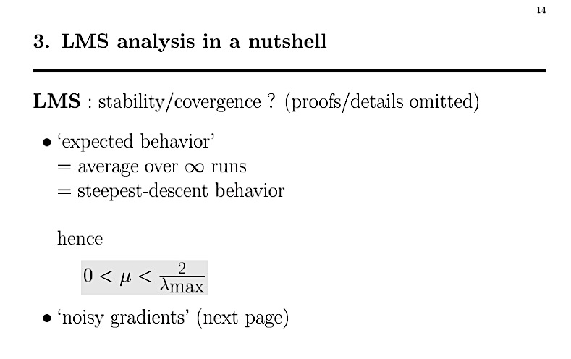
Adaptive Filters: LMS

Slide 19
Adaptive Filters: LMS
‘Noisy gradients’
Whenever LMS has reached the WF solution
the expected value of
(=estimated gradient in update formula)
is zero
but the instantaneous value
is generally non-zero (=noisy),
and hence LMS will again move away from the WF solution!

Slide 20
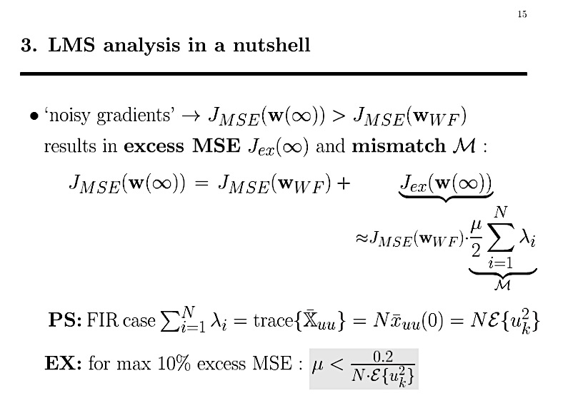
Adaptive Filters: LMS
L
L
L
L
means step size has to be much smaller…!

Slide 21
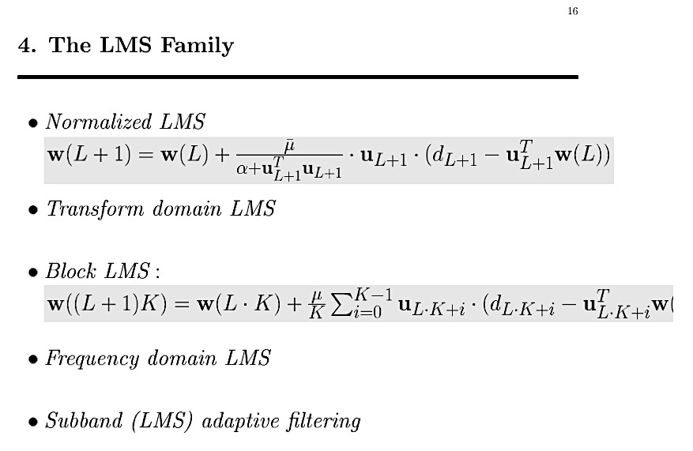
Adaptive Filters: LMS
LMS is an extremely popular algorithm
many LMS-variants have been developed (cheaper/faster/…)…
(see p19-20)
K is block index, L_{B} is block size
(see Chapter-13

Slide 22
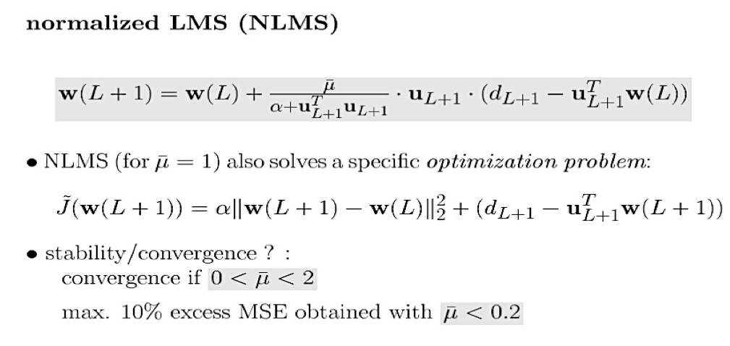
Adaptive Filters: LMS
= LMS with normalized step size
(mostly used in practice)
Computational complexity is larger
≈3L instead of ≈2L multiplications per time update
(except when u_{k}^{T.}u_{k} is computed recursively)

Slide 23
Adaptive Filters: LMS
= LMS with normalized step size
(mostly used in practice)
Step size tuning for NLMS is much easier…

Slide 24
Adaptive Filters: LMS
= LMS with normalized step size
(mostly used in practice)
‘a posteriori error’
For instance with (normalized step size=1 and) α➔0, the NLMS solution at time k sets the a posteriori error to zero, with minimal change with respect to previous NLMS solution at time k-1

Slide 25
Part-III : Optimal & Adaptive Filters
Chapter-7
Optimal Filters - Wiener Filters
        Introduction : General Set-Up & Applications
        Wiener Filters
        Adaptive Filters - LMS & RLS
        Least Means Squares (LMS) Algorithm
        Recursive Least Squares (RLS) Algorithm
        Square Root & Fast RLS Algorithms
        Square Root Algorithms
        Fast Algorithms
      Kalman Filters
        Introduction – Least Squares Parameter Estimation
        Standard Kalman Filter
        Square-Root Kalman Filter
Chapter-8
Chapter-9
Chapter-10

Slide 26
Least Squares & RLS Estimation

Slide 27
Least Squares & RLS Estimation

Slide 28
Least Squares & RLS Estimation
u_{k}
d_{k}
e_{k}
d_{k}
u_{k}^{T}

Slide 29
Least Squares & RLS Estimation
This is the
‘Least Squares Solution’
‘Normal equations’
(L+1 equations in L+1 unknowns)

Slide 30
Least Squares & RLS Estimation

Slide 31
Least Squares & RLS Estimation

Slide 32
Least Squares (LS) Estimation
In words:
Whenever statistical info (autocorrelation and crosscorrelation) is missing, this can be estimated from observed data (assuming ergodicity)
The Wiener filter solution, with true statistical quantities replaced by estimated quantities, then turns out to be the same as the LS solution
LS approach in itself optimizes a different (LS) criterion, without any need for statistical assumptions (e.g. ergodicity..)

Slide 33

Least Squares & RLS Estimation
k
Matrices and vectors now
with time index added
Can LS solution @ time k be computed from solution @ time k-1 ?

Slide 34


Least Squares & RLS Estimation
Rank-1
updates
(check ‘matrix inversion lemma’ in Wikipedia)
With this it is proved that:

Slide 35
Least Squares & RLS Estimation
Next to a mechanism for adding new observations, also need a mechanism
for removing old observations. First approach is as follows…
Skip this slide

Slide 36
Least Squares & RLS Estimation
Skip this slide

Slide 37
Least Squares & RLS Estimation
Next to a mechanism for adding new observations, also need a mechanism
for removing old observations. Simpler approach is as follows…
: Goal is to give a smaller weight to ‘older’ data, i.e.
Which leads to…

Slide 38
Least Squares & RLS Estimation
i.e. exponential weighting hardly changes RLS formulas.. (easy!)

Slide 39
Recursive Least Squares (RLS) Algorithm
Computational Complexity:
Standard RLS algorithm (with exponential weighting)
has O(L²) computational complexity per time update
Compare to O(L) for LMS (=cheaper, but slow convergence)
In Chapter-9, will present ‘Fast RLS’ algorithms
with O(L) computational complexity (and without compromising convergence properties)

Slide 40
Recursive Least Squares (RLS) Algorithm
Numerical Analysis/Stability:
Standard RLS algorithm (even with exponential weighting)
has been shown to have unstable quantization error
propagation (in low-precision implementation)
In Chapter-9, will present ‘Square Root RLS’ algorithms
which are shown to be perfectly stable numerically
(without compromising complexity & convergence properties)

