Slide 1
DSP-CIS
Part-III : Optimal & Adaptive Filters
Chapter-7 : Optimal Filters - Wiener Filters
Marc Moonen
Dept. E.E./ESAT-STADIUS, KU Leuven
marc.moonen@kuleuven.be
www.esat.kuleuven.be/stadius/

Slide 2
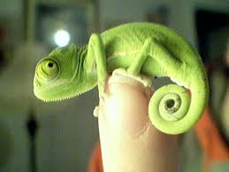
Part-III : Optimal & Adaptive Filters
Chapter-7
Optimal Filters - Wiener Filters
        Introduction : General Set-Up & Applications
        Wiener Filters
        Adaptive Filters - LMS & RLS
        Least Means Squares (LMS) Algorithm
        Recursive Least Squares (RLS) Algorithm
        Square Root & Fast RLS Algorithms
        Square Root Algorithms
        Fast Algorithms
      Kalman Filters
        Introduction – Least Squares Parameter Estimation
        Standard Kalman Filter
        Square Root Kalman Filter
Chapter-8
Chapter-9
Chapter-10

Slide 3
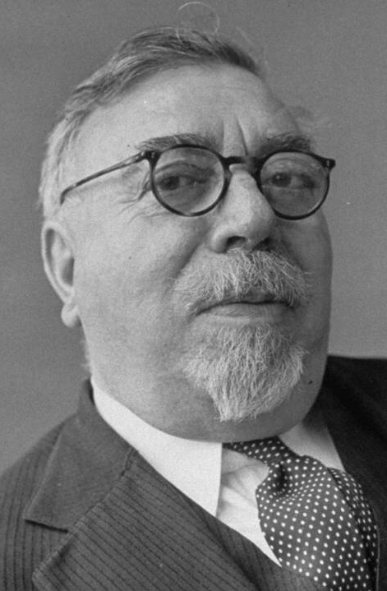
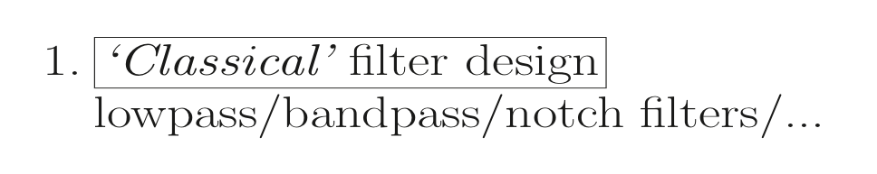
Introduction : General Set-Up
1. ‘Classical’ Filter Design
See Part-II
Norbert Wiener (1894-1964)
2. ‘Optimal’ Filter Design
realizations of

Slide 4
Introduction : General Set-Up
Norbert Wiener (1894-1964)

Slide 5
Introduction : General Set-Up
3. ‘Adaptive’ Filters

Slide 6
Introduction : General Set-Up

Slide 7
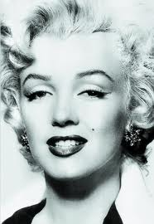
Introduction : Applications
‘plant’ can be any system
Optimal/adaptive filter to provide mathematical model
for input/output-behavior of the ‘plant’

Slide 8
Introduction : Applications
Optimal/adaptive filter to provide mathematical model
for signal propagation in a radio channel, from transmitter to receiver

Slide 9

Introduction : Applications
echo path
near-end signal
near-end signal
+ echo
Optimal/adaptive filter to provide mathematical model
for signal propagation in acoustic channel, from loudspeaker to microphone

Slide 10
Introduction : Applications
to/from network
‘Hybrid’ is never ideally matched to line impedance, hence generates echo of transmitted signal into received signal
Optimal/adaptive filter to model echo path, from transmitter into receiver

Slide 11
Introduction : Applications
noise
signal
+ noise

Slide 12
Introduction : Applications
Example: Linear Prediction
u[k]
z
u[k+1]
Optimal/adaptive filter to provide prediction model, predicting next sample u[k+1] from previous samples u[k], u[k-1], …,u[k-L]
Used in speech codecs, etc…

Slide 13
Introduction : Applications

Slide 14
Introduction : Applications

Slide 15
Introduction : Applications

Slide 16
Optimal Filtering : Wiener Filters
Have to decide on 2 things..
1
2

Slide 17
Optimal Filtering : Wiener Filters
1
Will use
u[k]
PS: Shorthand notation u_{k}=u[k], y_{k}=y[k], d_{k}=d[k], e_{k}=e[k],
Filter coefficients (‘weights’) are w_{l} (replacing b_{l} of
previous chapters)
For adaptive filters w_{l} also have a time index w_{l}[k]
e[k]
y[k]
d[k]

Slide 18
Optimal Filtering : Wiener Filters

Slide 19
Optimal Filtering : Wiener Filters
PS: Can generalize FIR filter to ‘multi-channel FIR filter’
example: see page 11

Slide 20
Optimal Filtering : Wiener Filters
PS: Special case of ‘multi-channel FIR filter’ is ‘linear combiner’
FIR filter may then also be viewed as special case of ‘linear combiner’
where input signals are delayed versions of each other

Slide 21
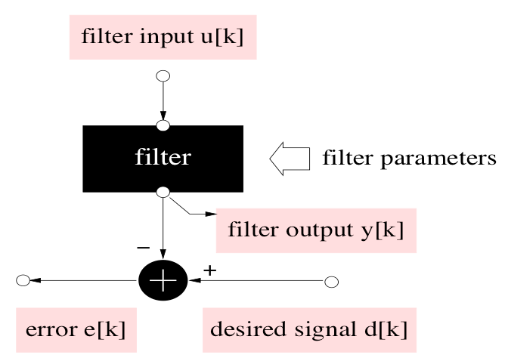
Optimal Filtering : Wiener Filters
2
Will use
= minimize

Slide 22
Optimal Filtering : Wiener Filters
MMSE cost function can
be expanded as…

Slide 23
Optimal Filtering : Wiener Filters
Correlation matrix has a special structure…

Slide 24
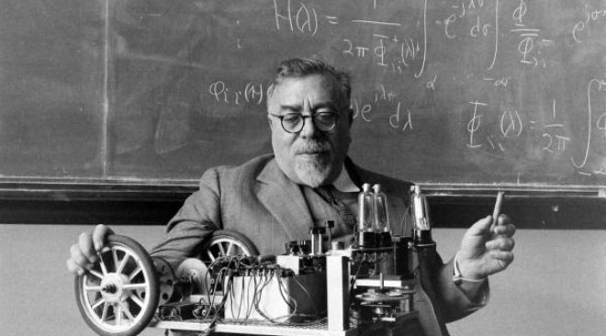
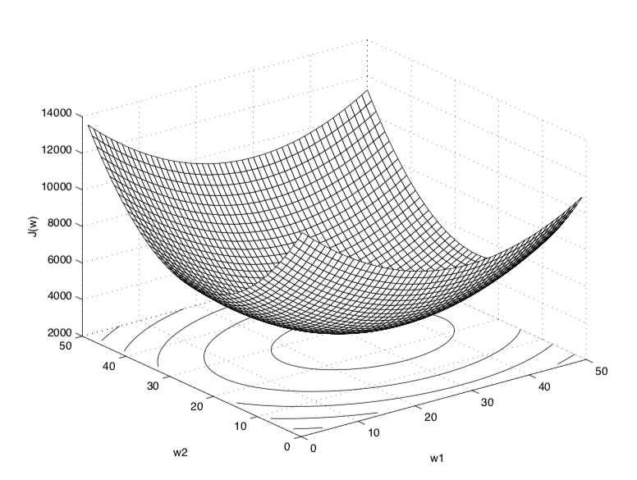
Optimal Filtering : Wiener Filters
MMSE cost function can
be expanded as…(continued)
This is the ‘Wiener Filter’ solution

Slide 25
Optimal Filtering : Wiener Filters
PS: Can easily verify that
Bowl-shaped error performance surface
where X_{uu} defines shape of the bowl
Example L=1

Slide 26

Optimal Filtering : Wiener Filters
PS: Can easily verify that
This is referred to as the ‘orthogonality principle’
i.e. the error signal for the optimal filter is orthogonal
to the input signals used for the estimation
As a corollary, the error signal signal is also
orthogonal to the optimal filter output

Slide 27
Optimal Filtering : Wiener Filters
How do we solve the Wiener–Hopf equations?
( L+1 linear equations in L+1 unknowns)
O(L³)
O(L²)
= used intensively in applications, e.g. in speech codecs, etc.
details omitted (see next slides)

Slide 28
Appendix
Skip this slide

Slide 29
Appendix
Skip this slide

Slide 30
Appendix
Skip this slide

Slide 31
Appendix
Skip this slide

Slide 32
Appendix
Skip this slide

Slide 33
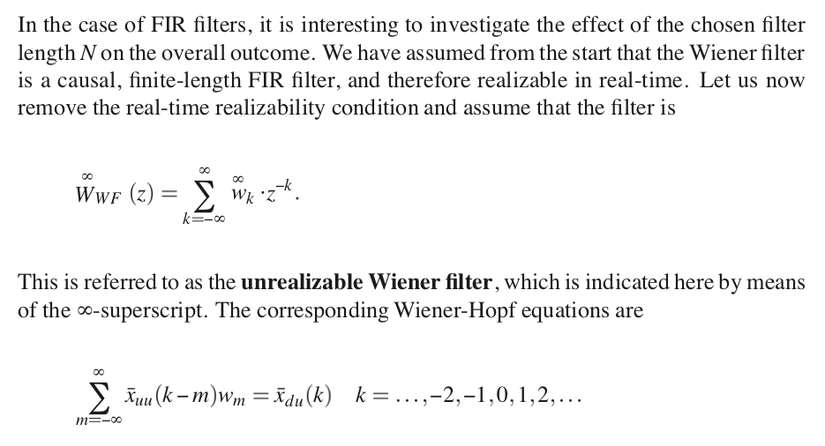
Optimal Filtering : Wiener Filters
PS: ‘Unrealizable Wiener Filter’
L

Slide 34
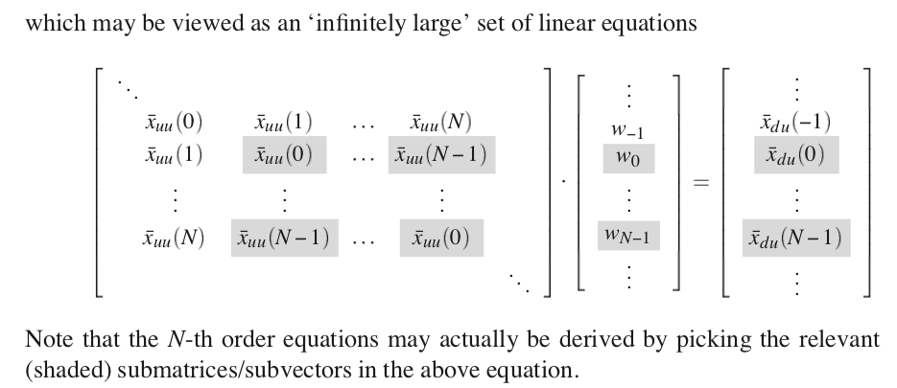
Optimal Filtering : Wiener Filters
PS: ‘Unrealizable Wiener Filter’ (continued)
…

Slide 35
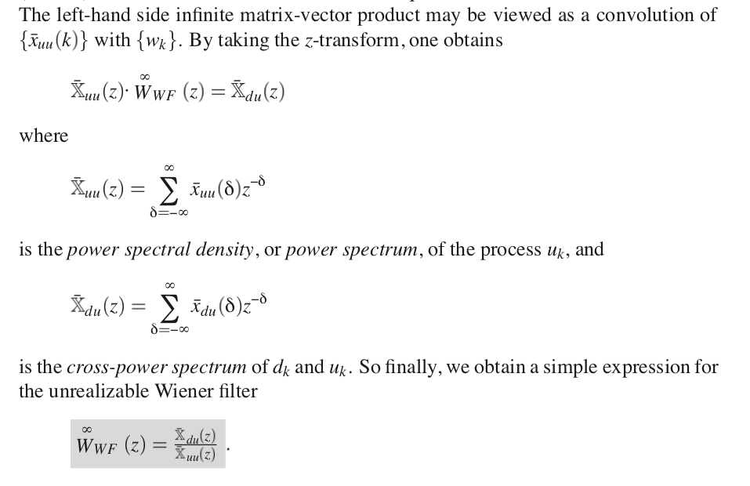
Optimal Filtering : Wiener Filters
PS: ‘Unrealizable Wiener Filter’ (continued)
Compare to WF solution on p24

Slide 36
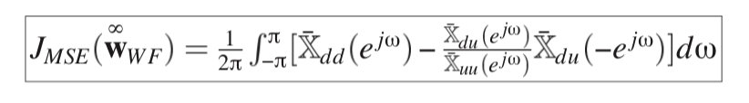

Optimal Filtering : Wiener Filters
PS: ‘Unrealizable Wiener Filter’ (continued)
Unrealizable WF provides lower bound on attainable MSE =‘irreducible error’ = the part of d_{k} that no WF can ever remove
For L-th order filter, then MSE is
= irreducible error + least squares error when unrealizable WF is approximated by causal L-th order filter, with input power spectrum included as a weighting function (proofs omitted)

Slide 37
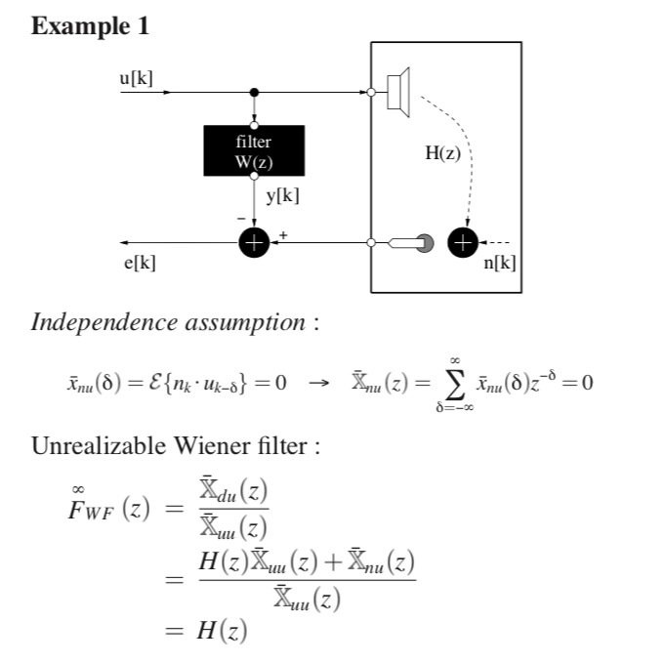

Optimal Filtering : Wiener Filters
d[k]
PS: Realizable when H(z) is FIR (and causal)

Slide 38
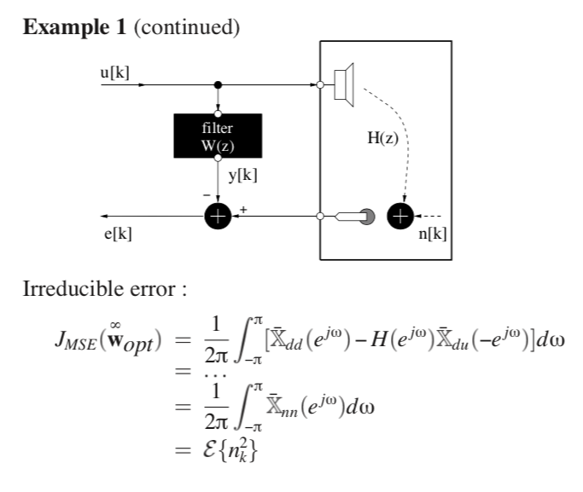
Optimal Filtering : Wiener Filters
d[k]

Slide 39
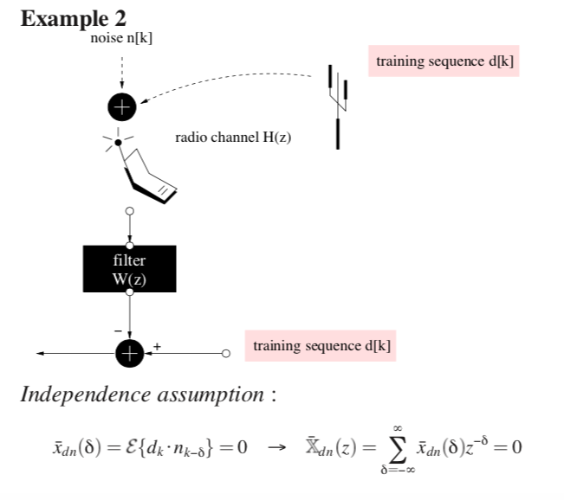
Optimal Filtering : Wiener Filters
U(z)=H(z).D(z)+N(z)

Slide 40
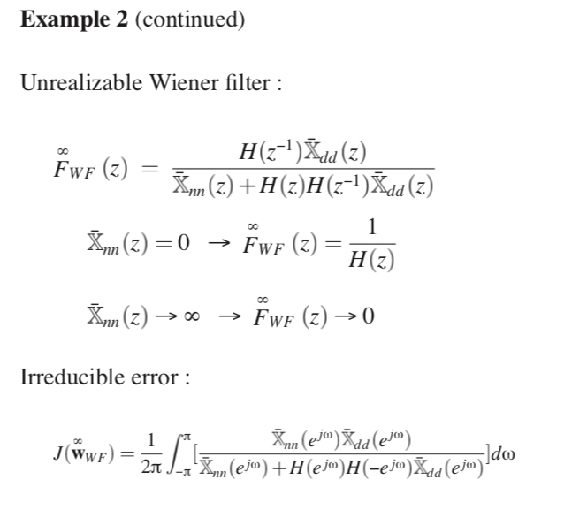
Optimal Filtering : Wiener Filters

