Slide 1
DSP-CIS
Part-II : Filter Design & Implementation
Chapter-6 : Filter Implementation
Marc Moonen
Dept. E.E./ESAT-STADIUS, KU Leuven
marc.moonen@kuleuven.be
www.esat.kuleuven.be/stadius/

Slide 2


Filter Design Process
Step-1 : Define filter specs
Pass-band, stop-band, optimization criterion,…
Step-2 : Derive optimal transfer function
FIR or IIR design
Step-3 : Filter realization (block scheme/flow graph)
Direct form realizations, lattice realizations,…
Step-4 : Filter implementation (software/hardware)
Finite word-length issues, …
Question: implemented filter = designed filter ?
‘You can’t always get what you want’ -Jagger/Richards (?)
Chapter-4
Chapter-5
Chapter-6

Slide 3

Chapter-6 : Filter Implementation
Introduction
  Filter implementation & finite wordlength problem
Coefficient Quantization
Arithmetic Operations
  Quantization noise
  Statistical Analysis
  Limit Cycles
  Scaling
PS: Short version, does not include…
  Fixed & floating point representations, overflow, etc. (see literature)

Slide 4

Introduction
Q:Why bother
about many different realizations
for one and the same filter?
Back to Chapter-5…

Slide 5
Introduction
Filter implementation & finite word-length problem
So far have assumed that signals/coefficients/arithmetic operations are represented/performed with infinite precision
In practice, numbers are represented only to a finite precision, hence signals/coefficients/arithmetic operations are subject to quantization (truncation/rounding/...) errors
Quantization effects relevant in fixed-point implementations with a `short’ word-length (versus less of an issue when `sufficiently long’ word-length is used (e.g. 24 bits), or with floating-point representations and arithmetic)
Investigate impact of…
- Quantization of filter coefficients
- Quantization in arithmetic operations

Slide 6
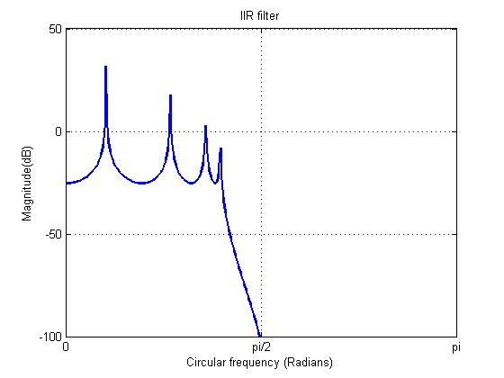
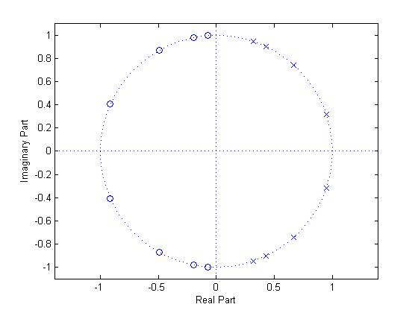
Introduction: Example
% IIR Elliptic Lowpass filter designed using
% ELLIP function.
% All frequency values are in Hz.
Fs = 48000; % Sampling Frequency
L = 8; % Order
Fpass = 9600; % Passband Frequency
Apass = 60; % Passband Ripple (dB)
Astop = 160; % Stopband Attenuation (dB)
Transfer function
Poles & zeros

Slide 7
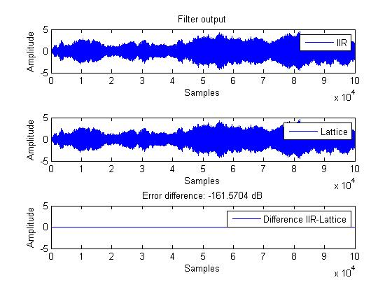
Introduction: Example
Filter outputs…
Direct form realization
@ infinite precision…
Lattice-ladder realization
@ infinite precision…
Difference…

Slide 8
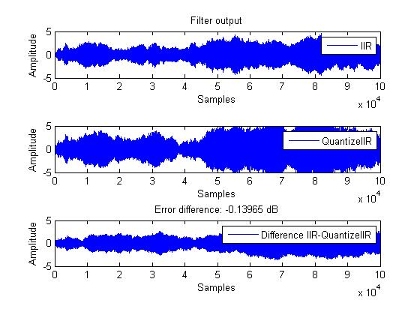
Introduction: Example
Filter outputs…
Direct form realization
@ infinite precision…
Direct form realization
@ 8-bit precision…
Difference…

Slide 9
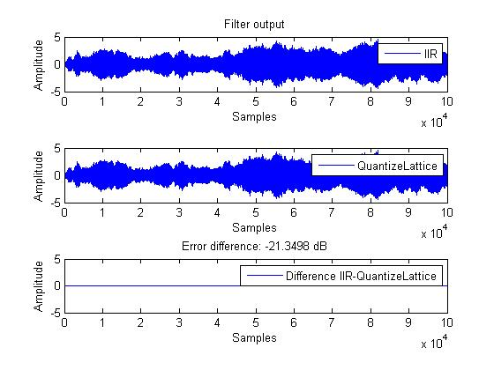
Introduction: Example
Filter outputs…
Direct form realization
@ infinite precision…
Lattice-ladder realization
@ 8-bit precision…
Difference…
Better select a good realization !

Slide 10
Coefficient Quantization
Coefficient quantization problem
Filter design in Matlab (e.g.) provides filter coefficients to 15 decimal digits (such that filter meets specifications)
For implementation, have to quantize coefficients to the word-length used for the implementation
As a result, implemented filter may fail to meet specifications…

Slide 11

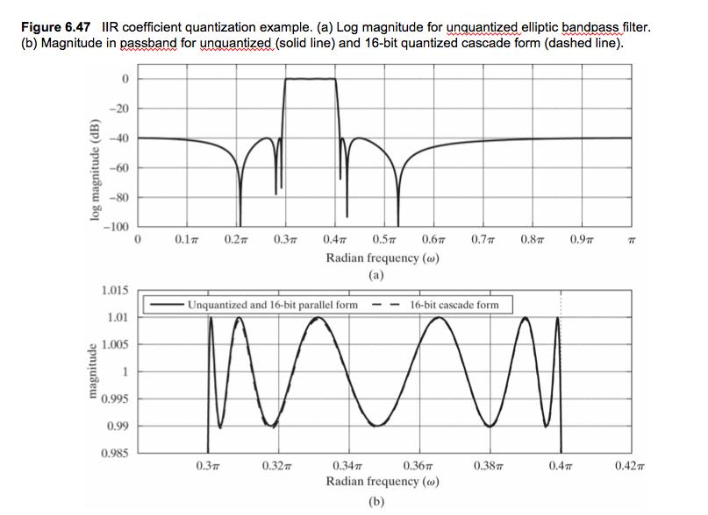
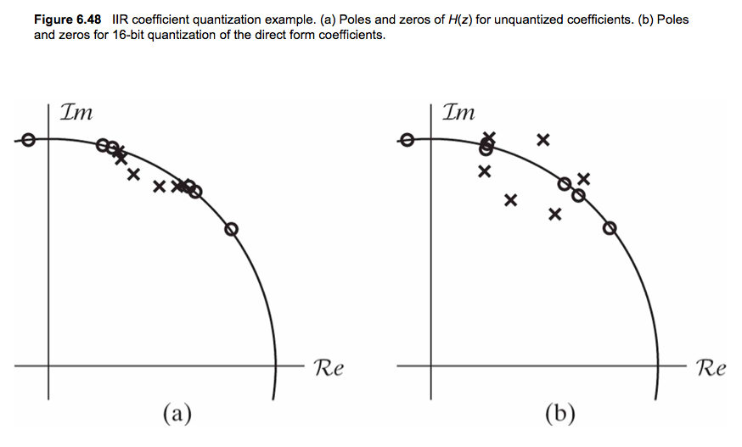
Example from
Better select a good realization !

Slide 12
Coefficient Quantization
Coefficient quantization effect on pole locations
Example : 2nd-order system (e.g. for cascade/direct form realization)
`Triangle of stability’ : denominator polynomial is stable (i.e.
roots inside unit circle) iff coefficients lie inside triangle…
Proof: Apply Schur-Cohn stability test (see Chapter-5).
1
-2
2
-1

Slide 13
Coefficient Quantization
Example (continued)
With 5 bits per coefficient, all possible `quantized’ pole positions are...
Low density of `quantized’ pole locations at z=1, z=-1, hence problem for narrow-band LP and HP filters in (transposed) direct form (see Chapter-4).

Slide 14
Coefficient Quantization
Example (continued)
Possible remedy: `coupled realization’
Poles are where are realized/quantized
hence ‘quantized’ pole locations are (5 bits)
u[k]
+
-
+
+
y[k]
coefficient precision = pole precision

Slide 15
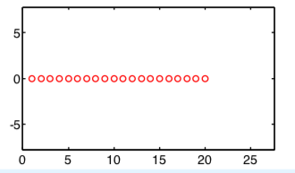
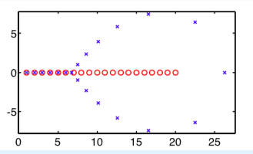
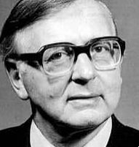
Coefficient Quantization
Coefficient quantization effect on pole locations
Fact: For high-order polynomials, roots can be very sensitive to small changes in coefficient values
Famous example:
Wilkinson’s polynomial
  Roots Roots after multiplying coefficient of z¹⁹ by 1.000001
  “Speaking for myself I regard it as the most traumatic experience in
  my career as a numerical analyst” James H. Wilkinson, 1984

Slide 16
Coefficient Quantization
Coefficient quantization effect on pole locations
Higher-order systems (first-order analysis)
➔ Tightly spaced poles (e.g. for narrow band filters) imply
high sensitivity of pole locations to coefficient quantization
➔ Hence preference for low-order systems (e.g. in parallel/cascade)

Slide 17
Coefficient Quantization
Coefficient quantization effect on zero locations
Analog filter design + bilinear transformation often lead to numerator polynomial of the form (e.g. 2nd-order cascade realization)
hence with zeros always on the unit circle
Quantization of the coefficient
shifts zeros on the unit circle,
which mostly has only minor effect
on the filter characteristic.
Hence mostly ignored…

Slide 18
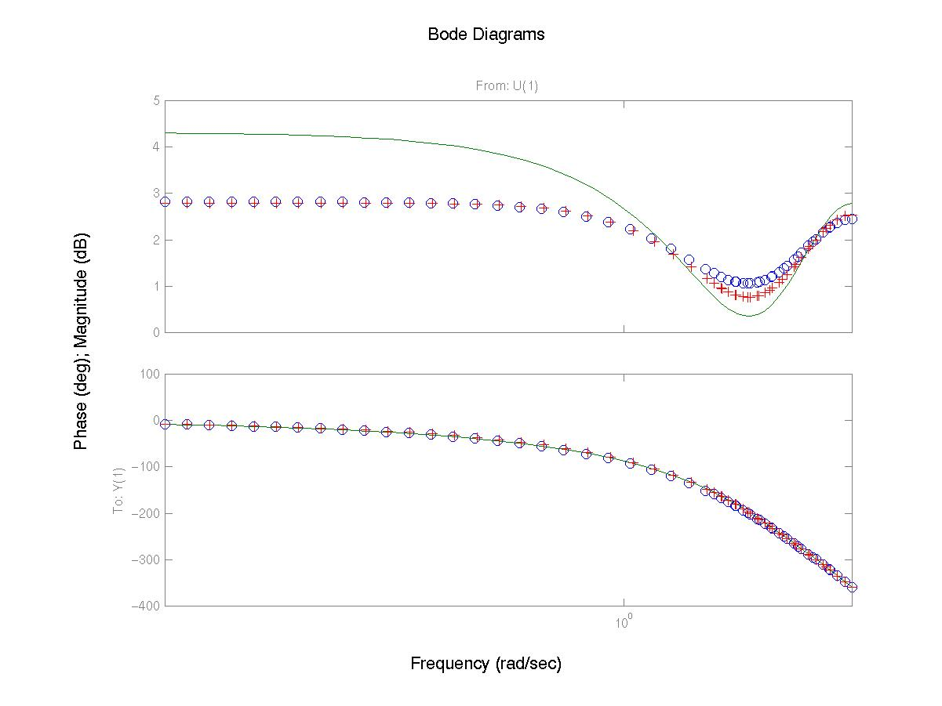
Coefficient Quantization
Coefficient quantization in lossless lattice realizations
In lossless lattice, all coefficients are sines and cosines, hence all
values between –1 and +1…, i.e. `dynamic range’ and coefficient
quantization error well under control.
o = original transfer function
+ = transfer function after 8-bit
truncation of lossless lattice
filter coefficients
- = transfer function after 8-bit
truncation of direct-form
coefficients (bi’s)

Slide 19
Arithmetic Operations
Quantization noise problem
If two B-bit numbers are added, the result is a B+1 bit number.
If two B-bit numbers are multiplied, the result is a 2B-1 bit number.
Typically (especially so in an IIR (feedback) filter), the result of an addition/multiplication has to be represented again as a B’-bit number (e.g. B’=B). Hence have to remove least significant bits (*).
Rounding/truncation/… to B’ bits introduces quantization noise.
The effect of quantization noise is usually analyzed in a statistical manner (see p.20-25)
Quantization, however, is a deterministic non-linear effect, which may give rise to limit cycle oscillations (see p.26-30)
(*) ..and/or most significant bits - not considered here

Slide 20
Quantization Noise / Statistical Analysis
Quantization mechanisms
Rounding Truncation Magnitude Truncation
mean=0 mean=(-0.5)LSB (biased!) mean=0
variance=(1/12)LSB^2 variance=(1/12)LSB^2 variance=(1/6)LSB^2
PS: …assuming input to quantization is uniformly distributed (is it?)
output
input
probability
error

Slide 21
Quantization Noise / Statistical Analysis
Statistical analysis is based on the following assumptions :
- Each quantization error is random, i.e. uncorrelated/independent of the number that is quantized, and with uniform probability distribution function (see previous slide) (ps: model more suited for multipliers than for adders)
- Successive quantization errors at the output of a given multiplier/adder are uncorrelated/independent (=white noise assumption)
- Quantization errors at the outputs of different multipliers/adders are uncorrelated/independent (=independent sources assumption)
➔A noise source (representing quantization) is inserted
after each (ideal, then) multiplier/adder
➔Since the filter is a linear filter the
output noise generated by each noise source
is added to the output signal
u[k]
+
+
e1[k]
-.99
e2[k]
+
x
y[k]

Slide 22
Quantization Noise / Statistical Analysis
Effect on the output signal of a noise generated at a particular
point in the filter is computed as follows:
- Noise is e[k], assumed white (=flat PSD) with mean & variance
- Transfer function from from e[k] to filter output is G(z),g[k]
(=‘noise transfer function’)
- Noise mean at the output is
- Noise variance at the output is
Repeat procedure for each noise source…

Slide 23
Quantization Noise / Statistical Analysis
PS: In a transposed direct form realization all noise transfer
functions are equal (up to delay), hence all noise sources
can be lumped into one equivalent noise source
…which simplifies analysis considerably
u[k]
bo
b1
b2
b3
b4
x
x
x
x
x
x1[k]
x2[k]
x3[k]
x4[k]
e[k]
+
+
+
+
-a1
-a2
-a3
-a4
x
x
x
x
y[k]

Slide 24
Quantization Noise / Statistical Analysis
PS: In a direct form realization all noise sources can be
lumped into two equivalent noise sources
…which simplifies analysis considerably
e1[k]
u[k]
+
+
+
+
-a1
-a2
-a3
-a4
x
x
x
x
x1[k]
x2[k]
x3[k]
x4[k]
bo
b1
b2
b3
b4
x
x
x
x
x
y[k]
+
+
+
+
e2[k]

Slide 25
Quantization Noise / Statistical Analysis
PS: Quantization noise of A/D-converters can be modeled/analyzed in a similar fashion.
Noise transfer function is filter transfer function H(z)
PS: Quantization noise of D/A-converters can be modeled/analyzed in a similar fashion.
Non-zero quantization noise if D/A converter wordlength is shorter than filter wordlength.
Noise transfer function = 1

Slide 26
Quantization Noise / Limit Cycles
Statistical analysis is simple/convenient, but quantization is truly a non-linear effect, and should be analyzed as a deterministic process
Though very difficult, such analysis may reveal odd behavior :
Example: y[k] = -0.625.y[k-1]+u[k]
4-bit rounding arithmetic
input u[k]=0, y[0]=3/8
output y[k] = 3/8, -1/4, 1/8, -1/8, 1/8, -1/8, 1/8, -1/8, 1/8,..
Oscillations in the absence of input (u[k]=0) are called
`zero-input limit cycle oscillations’

Slide 27
Quantization Noise / Limit Cycles
Example: y[k] = -0.625.y[k-1]+u[k]
4-bit truncation (instead of rounding)
input u[k]=0, y[0]=3/8
output y[k] = 3/8, -1/4, 1/8, 0, 0, 0,.. (no limit cycle!)
Example: y[k] = 0.625.y[k-1]+u[k]
4-bit rounding
input u[k]=0, y[0]=3/8
output y[k] = 3/8, 1/4, 1/8, 1/8, 1/8, 1/8,..
Example: y[k] = 0.625.y[k-1]+u[k]
4-bit truncation
input u[k]=0, y[0]=-3/8
output y[k] = -3/8, -1/4, -1/8, -1/8, -1/8, -1/8,..
Conclusion: weird, weird, weird,… !

Slide 28
Quantization Noise / Limit Cycles
Limit cycle oscillations are clearly unwanted (e.g. may be audible in speech/audio applications)
Limit cycle oscillations can only appear if the filter has feedback. Hence FIR filters cannot have limit cycle oscillations
Mathematical analysis is very difficult ☹

Slide 29
Quantization Noise / Limit Cycles
Truncation often helps to avoid limit cycles (e.g. magnitude truncation, where absolute value of quantizer output is never larger than absolute value of quantizer input (=`passive quantizer’))
Some filter realizations can be made limit cycle free, e.g. coupled realization, orthogonal filters (details omitted)

Slide 30
Quantization Noise / Limit Cycles
Here’s the good news:
  For a..
  lossless lattice realization of a general IIR filter
  lattice-ladder realization of a general IIR filter
  and when
  magnitude truncation (=`passive quantization’) is used
  the filter is guaranteed to be free of limit cycles !
(details omitted)
Intuition: magnitude truncation consumes energy/power, orthogonal filter operations do not generate power to feed limit cycle

Slide 31
Scaling
The scaling problem
Finite word-length implementation implies maximum representable number. Whenever a signal (output or internal) exceeds this value, overflow occurs.
Digital overflow may lead (e.g. in 2’s-complement arithmetic) to polarity reversal (instead of saturation such as in analog circuits), hence may be very harmful.
Avoid overflow through proper signal scaling, implemented by bit shift-operations applied to signals, or by scaling of filter coefficients, or..
Scaled transfer function may be c.H(z) instead of H(z) (hence need proper tracing of scaling factors)
Skip this slide

Slide 32
Scaling
Time domain (‘deterministic’) scaling:
Assume input signal is bounded in magnitude
i.e. u-max is the largest number that can be represented in the `words’ reserved for the input signal
Then output signal is bounded by
ps : stability of the filter h implies that its 1-norm is finite
Skip this slide

Slide 33
Scaling
Time domain (‘deterministic’) scaling: (continued)
Assume input signal is bounded in magnitude
Then output signal is bounded by
To satisfy
i.e. y-max is the largest number that can be represented in the
`words’ reserved for the output signal
we have to scale H(z) to c.H(z), with
Skip this slide

Slide 34
Scaling
Example:
assume u[k] produced by 12-bit A/D-converter
assume we use 16-bit arithmetic for y[k] & multiplier
hence inputs u[k] have to be shifted by
3 bits to the right before entering the filter
(=remove 3 LSB’s)
u[k]
+
0.99
x
Skip this slide
y[k]
shift
+
u[k]
0.99
x
y[k]

Slide 35
Scaling
Time domain (‘deterministic’) scaling:
Frequency domain (‘deterministic’) scaling:
Frequency-domain analysis leads to alternative scaling factors, e.g...
...or...
…which may (or may not) be less conservative
-> proper choice of scaling factor in general is a difficult problem
Skip this slide

Slide 36
Scaling
L2-scaling: (`scaling in L2 sense’, `probabilistic scaling’)
Time-domain scaling is simple & guarantees that overflow will never occur, but often over-conservative (=too small c)
Define L2-norm :
If input signal u[k] is (`wide sense’) stationary signal with power spectral density (`PSD’, i.e. Fourier transform of its covariance sequence)
then variance of output signal y[k] is bounded:
Leads to scaling factor
where alpha defines overflow probability
Skip this slide

Slide 37
Scaling
So far considered scaling of H(z), i.e. transfer function from u[k] to y[k].
In practice, have to consider overflow and scaling of each internal signal, i.e. scaling
of transfer function from u[k]
to each and every internal signal !
May require quite some thinking…
(but doable)
Skip this slide
+
+
+
+
-a1
-a2
-a3
-a4
x
x
x
x
x1[k]
x2[k]
x3[k]
x4[k]
bo
b1
b2
b3
b4
x
x
x
x
x
y[k]
+
+
+
+

Slide 38
Scaling
Something that may help: If 2’s-complement arithmetic is used, and if the sum of K numbers (K>2) is guaranteed not to overflow, then overflows in partial sums cancel out and do not affect the final result (similar to `modulo arithmetic’)
Example:
if x1+x2+x3+x4 is guaranteed not to
overflow, then if in (((x1+x2)+x3)+x4)
the sum (x1+x2) overflows, this overflow
can be ignored, without affecting the
final result.
As a result (1), in a direct form realization,
only 2 signals have to be
considered in view of scaling :
Skip this slide
+
+
+
+
-a1
-a2
-a3
-a4
x
x
x
x
x1[k]
x2[k]
x3[k]
x4[k]
bo
b1
b2
b3
b4
x
x
x
x
x
+
+
+
+

Slide 39
Scaling
As a result (2), in a transposed direct form realization,
only 1 signal has to be considered in view of scaling:
u[k]
Skip this slide
bo
b1
b2
b3
b4
x
x
x
x
x
x1[k]
x2[k]
x3[k]
x4[k]
+
+
+
+
-a1
-a2
-a3
-a4
x
x
x
x
y[k]

Slide 40
Scaling
As a result (3), in a state space realization
only output signal + internal states have to
be considered in view of scaling:
-Matrix
defines transfer from input to internal states
( i-th row has impulse response from input u[k] to i-th internal state)
-Internal states can be re-scaled by means of diagonal transformation T, such that
-If T is such that all rows of this tilde-matrix have equal L2-norm, then
overflow probability is the same in all states.
This is referred to as ‘L2 scaled realization’
u[k]
+
Skip this slide
y[k]
+

