Slide 1
DSP-CIS Part-II : Filter Design & Implementation Chapter-5 : Filter Realization
Marc Moonen
Dept. E.E./ESAT-STADIUS, KU Leuven
marc.moonen@kuleuven.be
www.esat.kuleuven.be/stadius/

Slide 2
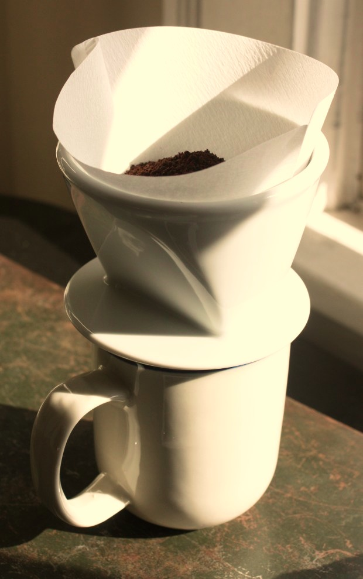
Filter Design Process
Step-1 : Define filter specs
Pass-band, stop-band, optimization criterion,…
Step-2 : Derive optimal transfer function
FIR or IIR design
Step-3 : Filter realization (block scheme/flow graph)
Direct form realizations, lattice realizations,…
Step-4 : Filter implementation (software/hardware)
Finite word-length issues, …
Question: implemented filter = designed filter ?
‘You can’t always get what you want’ -Jagger/Richards (?)
Chapter-4
Chapter-5
Chapter-6

Slide 3
Chapter-5 : Filter Realization
FIR Filter Realization
IIR Filter Realization
PS: Will always assume real-valued filter coefficients
PS:
Q:Why bother
about many different realizations for one and the same filter?
A: See Chapter-6 !

Slide 4
FIR Filter Realization
FIR Filter Realization
=Construct (realize) LTI system (with delay elements, adders and multipliers), such that I/O behavior is given by..
Several possibilities exist…
1. Direct form
2. Transposed direct form
3. Lattice realization (LPC lattice)
4. Lossless lattice realization
5. Frequency-domain realization: see Part-IV

Slide 5
FIR / 1. Direct Form
u[k]
u[k-1]
u[k-2]
u[k-3]
u[k-4]
bo
b1
b2
b3
b4
x
x
x
x
x
y[k]
+
+
+
+

Slide 6
FIR / 2. Transposed Direct Form
Starting point is direct form :
`Retiming’ =
select subgraph (shaded)
remove one delay element on all
inbound arrows
add one delay element on all
outbound arrows
u[k]
u[k-1]
u[k-3]
u[k-4]
bo
b1
b2
b3
b4
x
x
x
x
x
y[k]
+
+
+
+
u[k]
u[k-1]
u[k-3]
u[k-4]
bo
b1
b2
b3
b4
x
x
x
x
x
y[k]
+
+
+
+

Slide 7
FIR / 2. Transposed Direct Form
`Retiming’ : repeated application results in...
i.e. `transposed direct form‘(named after ‘transposed’ state space model)
u[k]
bo
b1
b2
b3
b4
x
x
x
x
x
y[k]
+
+
+
+
(=different software/hardware (`pipeline delays’), same i/o-behavior)

Slide 8
FIR / 3. Lattice Realization
Derived from combined realization of…
…with `flipped’ version of H(z)
Reversed (real-valued) coefficient vector results in...
i.e. - same magnitude response
- different phase response

Slide 9
FIR / 3. Lattice Realization
Starting point is direct form realization…
u[k]
u[k-1]
u[k-2]
u[k-3]
u[k-4]
b4
b3
b2
b1
bo
x
x
x
x
x
bo
b1
b2
b3
b4
x
x
x
x
x
~
y[k]
+
+
+
+
y[k]
+
+
+
+
Now 1 page of maths…

Slide 10
FIR / 3. Lattice Realization
With this can be rewritten as
order
reduction
PS: find fix for case bo=0
PS: if |ko|=1, then transformation matrix is rank-deficient

Slide 11
FIR / 3. Lattice Realization
This is equivalent to...
…Now repeat procedure for shaded graph
(=same structure as the one we started from)
u[k]
u[k-2]
u[k-2]
u[k-3]
b’3
b’2
b’1
b’o
~
x
x
x
x
y[k]
b’o
b’1
b’2
b’3
x
x
x
x
+
x
+
+
+
ko
+
+
+
y[k]
x
+

Slide 12
FIR / 3. Lattice Realization
Repeated application results in `lattice form’
explain
u[k]
bo
x
~
y[k]
+
+
+
+
x
x
x
x
ko
k1
k2
k3
y[k]
x
x
x
x
+
+
+
+
(= different software/hardware, same i/o-behavior)

Slide 13
FIR / 3. Lattice Realization
Also known as `linear predictive coding (LPC) lattice‘
Ki’s are so-called `reflection coefficients’
Every set of bi’s corresponds to a set of Ki’s, and vice versa
Procedure for computing Ki’s from bi’s corresponds to the well-known `Schur-Cohn’stability test (from control theory):
Problem = for a given polynomial B(z), how do we find out if all the zeros
of B(z) are ‘stable’ (i.e. lie inside unit circle) ?
Solution = from bi’s, compute reflection coefficients Ki’s (=procedure on
previous slides). Zeros are (proved to be) stable iff all Ki’s statisfy |Ki|<1 !
Procedure (page 10) breaks down if |Ki|=1 is encountered. Then have to select other realization (direct form, lossless lattice, …) for B(z)
Lattice form not overly relevant at this point, but sets stage for similar derivations that lead to more relevant realizations (read on…)

Slide 14
FIR / 4. Lossless Lattice Realization
Derived from combined realization of H(z)…
…with
…which is such that
(*)
PS : Interpretation ?… (see next slide)
PS : May have to scale H(z) to achieve this (why?) (scaling omitted here)

Slide 15
FIR / 4. Lossless Lattice Realization
PS : Interpretation ?
When evaluated on the unit circle, formula (*) is
equivalent to (for filters with real-valued coefficients)
i.e. and are `power complementary’
(= form a 1-input/2-output `lossless’ system, see also below)
1

Slide 16
FIR / 4. Lossless Lattice Realization
PS : How is computed ?
Note that if zi (and zi*) is a root of R(z), then 1/zi (and 1/zi*) is also
a root of R(z). Hence can factorize R(z) as…
Note that zi’s can be selected such that all roots of lie inside the
unit circle, i.e. is a minimum-phase FIR filter.
This is referred to as spectral factorization, =spectral factor.

Slide 17
FIR / 4. Lossless Lattice Realization
Starting point is direct form realization…
u[k]
u[k-1]
u[k-2]
u[k-3]
u[k-4]
x
x
x
x
x
x
bo
x
b1
x
b2
x
b3
x
b4
~
~
y[k]
+
+
+
+
y[k]
+
+
+
+
Now 1 page of maths…

Slide 18
FIR / 4. Lossless Lattice Realization
From (*) (page 14), it follows that (**)
Hence there exists a rotation angle θo such that
= orthogonal
vectors
order
reduction

Slide 19
FIR / 4. Lossless Lattice Realization
This is equivalent to...
Now shaded graph can again be proved (***) to be
power complementary system (Intuition? Hint: p.21).
Hence can repeat procedure…
u[k]
u[k-2]
u[k-2]
u[k-3]
~
x
x
x
x
~
y[k]
+
x
x
x
x
x
b’o
b’1
b’2
b’3
x
+
+
+
x
+
+
+
y[k]
+
x

Slide 20
FIR / 4. Lossless Lattice Realization
Repeated application results in `lossless lattice’
explain
u[k]
~
~
y[k]
+
x
+
x
+
x
+
x
x
x
x
x
x
x
x
x
x
y[k]
+
x
+
x
+
x
+
x
x

Slide 21
FIR / 4. Lossless Lattice Realization
Lossless lattice :
Also known as `paraunitary lattice‘
Each 2-input/2-output section is based on an orthogonal transformation, which preserves norm/energy/power
i.e. forms a 2-input/2-output `lossless’ system (=time-domain view)
Overall system is realized as cascade of lossless sections (+delays), hence is itself also `lossless’ (see p.15, =freq-domain view)

Slide 22
FIR / 4. Lossless Lattice Realization
PS : Can be generalized to 1-input N-output lossless systems
(will be used in Part-IV) (compare to p.20 !)
~
u[k]
~
y[k]
+
x
x
N=3
x
~
x
y[k]
+
x
+
x
x
x
y[k]
x
+
x
x
explain/derive!

Slide 23
IIR Filter Realization
IIR Filter Realization
=Construct (realize) LTI system (with delay elements, adders and multipliers), such that I/O behavior is given by..
Several possibilities exist…
1. Direct form
2. Transposed direct form
PS: Parallel and cascade realization
4. Lattice-ladder realization
5. Lossless lattice realization

Slide 24
IIR / 1. Direct Form
PS : If all ai=0 (i.e. H(z) is FIR), then this reduces to a direct form FIR
u[k]
+
+
+
+
-a1
-a2
-a3
-a4
x
x
x
x
bo
b1
b2
b3
b4
x
x
x
x
x
y[k]
+
+
+
+

Slide 25
IIR / 2. Transposed Direct Form
Transposed direct form is similarly easily obtained (after retiming ...)
PS : If all ai=0 (i.e. H(z) is FIR), then this reduces to a transposed direct form FIR
u[k]
bo
b1
b2
b3
b4
x
x
x
x
x
+
+
+
+
-a1
-a2
-a3
-a4
x
x
x
x
y[k]

Slide 26
IIR / PS: Parallel & Cascade Realization
Parallel realization based on partial fraction decomposition
Each term realized in, e.g., direct form
Transmission zeros are realized iff signals from
different sections exactly cancel out
(=difficult in finite word-length implementation)
Cascade realization based on pole-zero factorization
Each section(‘biquad’) realized in, e.g., direct form
Cascade realization is not unique (details omitted)
(=multiple ways of pairing poles and zeros (need for ‘pairing procedures’)
and multiple ways of ordering sections in cascade)
u[k]
For simple poles
+
+
y[k]
u[k]
For L even
y[k]

Slide 27
IIR / 3. Lattice-Ladder Realization
Derived from combined realization of
with…
- Numerator polynomial is denominator polynomial with
reversed coefficient vector (see also p.8)
- Hence is an `all-pass’ (=`SISO lossless’) filter :

Slide 28
IIR / 3. Lattice-Ladder Realization
Starting point is direct form realization…
u[k]
-
+
+
+
+
a1
a2
a3
a4
x
x
x
x
will use
‘state vector’
x[k]
a4
a3
a2
a1
1
x
x
x
x
x
b0
x
b1
x
b2
b3
b4
x
x
x
~
y[k]
+
+
+
+
y[k]
+
+
+
+
Now 1 page (full) of maths…

Slide 29
IIR / 3. Lattice-Ladder Realization
If A(z) = stable polynomial (should be!),
Then |Ko|<1 (cfr.Shur-Cohn). Hence define
Skip this slide
order
reduction

Slide 30
IIR / 3. Lattice-Ladder Realization
Then this is equivalent to…
u[k]
-
x
+
+
+
+
x
x
x
x
x
~
y[k]
x
x
x
x
+
x
x
x
x
x
x
b4
+
+
+
y[k]
+
+
+
+

Slide 31
IIR / 3. Lattice-Ladder Realization
Procedure can be repeated (explain), leads to `lattice-ladder form’
u[k]
x
+
x
+
x
+
x
+
‘lattice part’
x
x
x
x
x
x
x
x
~
y[k]
+
x
+
x
+
x
+
x
x
x
x
x
x
‘ladder part’
b4
b3’
b2’’
b1’’’
y[k]
+
+
+
+

Slide 32
IIR / 3. Lattice-Ladder Realization
PS: Similar derivation leads to 2nd ‘lattice-ladder’ form
u[k]
x
+
x
+
x
+
x
+
‘lattice part’
x
x
x
x
x
x
x
x
~
y[k]
+
x
+
x
+
x
+
x
x
x
x
x
x
‘ladder part’
b0
b1’
b2’’
b3’’’
y[k]
+
+
+
+

Slide 33
IIR / 3. Lattice-Ladder Realization
Ki’s (=sin(thetai) !) are `reflection coefficients’
Procedure for computing Ki’s from ai’s again corresponds to `Schur-Cohn’ stability test
Orthogonal transformations correspond to 2-input/2-output `lossless’ sections (=time-domain view).
Cascade of lossless sections (+delays) is also `lossless’,
i.e. `all-pass’ (see p.27, =freq-domain view)

Slide 34
IIR / 3. Lattice-Ladder Realization
PS : Note that the all-pass part corresponds to A(z) (i.e. L angles θi correspond to L coeffs ai) while the ladder part corresponds to B(z). If all ai=0 (i.e. H(z) is FIR), then all θi=0, hence the all-pass part reduces to a delay line, and the lattice-ladder form reduces to a direct-form FIR.
PS : `All-pass’ part (SISO u[k]->y[k]) is known as `Gray-Markel’ structure
~
u[k]
x
+
x
+
x
+
x
+
x
x
x
x
x
x
x
x
~
y[k]
+
x
+
x
+
x
+
x

Slide 35
IIR / 4. Lossless Lattice Realization
Derived from combined realization of (possibly rescaled, as on p.14)
with...
such that…
(**)
i.e. and are `power complementary’ (p.15)

Slide 36
IIR / 4. Lossless Lattice Realization
Starting point is direct form realization…
u[k]
-
+
+
+
+
a1
a2
a3
a4
x
x
x
x
will use
‘state vector’
x[k]
x
x
x
x
x
b0
x
b1
x
b2
b3
b4
x
x
x
~
y[k]
+
+
+
+
y[k]
+
+
+
+
Now 1 page (full) of maths…

Slide 37
IIR / 4. Lossless Lattice Realization
PS: right-hand side of (o) has
modulus <1 (hence |sinθo|≠1, cosθo≠0)
which follows from ‘modulus property’
for (**) p.35:
Now it is proved that
From (**) p.35 it follows that
= ‘orthogonal’ vectors
Skip this slide
This leads to
order
reduction

Slide 38
IIR / 4. Lossless Lattice Realization
Rearranging rows, etc.., and repeating the order-reduction process, leads to…
u[k]
x
+
x
x
+
x
x
x
x
~
x
y[k]
+
x
y[k]
+
x

Slide 39
IIR / 4. Lossless Lattice Realization
Orthogonal transformations correspond to (3-input 3-output) `lossless sections‘
Overall system is realized as cascade of lossless sections (+delays), hence is itself also `lossless‘
PS : If all ai=0 (i.e. H(z) is FIR), then all θi=0 and then this reduces to FIR lossless lattice
PS : If all φi=0, then this reduces to Gray-Markel structure
!
!

Slide 40
IIR / 4. Lossless Lattice Realization
PS : Can be generalized to 1-input N-output lossless systems
(=combine p.22 & p.38 !)
u[k]
x
+
~
~
y[k]
+
x
x
x
x
x
~
x
+
y[k]
x
+
x
+
x
x
x
y[k]
x
+
x
x

