Slide 1
DSP-CIS
Part-II: Filter Design and Implementation
Chapter-4 : Filter Design
Marc Moonen
Dept. E.E./ESAT-STADIUS, KU Leuven
marc.moonen@kuleuven.be
www.esat.kuleuven.be/stadius/

Slide 2
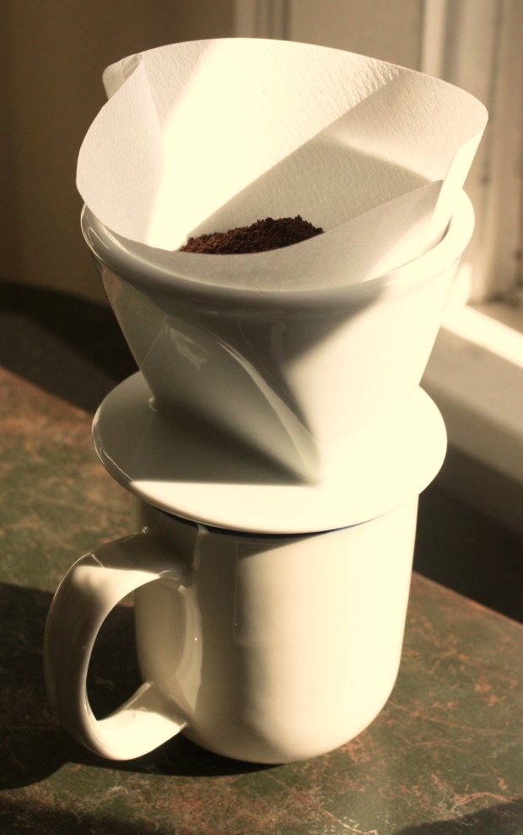

Filter Design Process
Step-1 : Define filter specs
Pass-band, stop-band, optimization criterion,…
Step-2 : Derive optimal transfer function
FIR or IIR filter design
Step-3 : Filter realization (block scheme/flow graph)
Direct form realizations, lattice realizations,…
Step-4 : Filter implementation (software/hardware)
Finite word-length issues, …
Question: implemented filter = designed filter ?
‘You can’t always get what you want’ -Jagger/Richards (?)
Chapter-4
Chapter-5
Chapter-6

Slide 3
Filter Design Process
Step-1: Filter Specification
Example: Low-pass filter

Slide 4

Chapter-4 : Filter Design
FIR filters
  Linear-phase FIR filters
  FIR design by optimization
  Weighted least-squares design, Minimax design
  FIR design in practice
  `Windows’, Equiripple design, …
  Software (Matlab,…)
IIR filters
  Poles and zeros
  IIR design by optimization
  Weighted least-squares design, Minimax design
  IIR design in practice
  Software (Matlab,…)

Slide 5
FIR Filters
FIR filter = finite impulse response filter
L poles at the origin z=0 (hence guaranteed stability)
L zeros (zeros of B(z)), `all zero’ filters
Corresponds to difference equation
Hence also known as `moving average filters’ (MA)
Impulse response

Slide 6
Linear Phase FIR Filters
Non-causal zero-phase filters :
Example: symmetric impulse response (length 2.Lo+1)
h[-Lo],….h[-1], h[0] ,h[1],...,h[Lo]
h[k]=h[-k], k=1..Lo
Frequency response is
i.e. real-valued (=zero-phase) transfer function
k
Lo
2Lo+1 terms
Lo+1 terms

Slide 7
Linear Phase FIR Filters
Causal linear-phase filters = non-causal zero-phase + delay
Example: symmetric impulse response & L even
h[0],h[1],….,h[L]
L=2.Lo
h[k]=h[L-k], k=0..L
Frequency response is
= i.e. causal implementation of zero-phase filter, by
introducing delay
k
0
L
⬅ phase is linear function
of frequency

Slide 8
Linear Phase FIR Filters
Type-1 Type-2 Type-3 Type-4
L=2Lo=even L=2Lo+1=odd L=2Lo=even L=2Lo+1=odd
symmetric symmetric anti-symmetric anti-symmetric
h[k]=h[L-k] h[k]=h[L-k] h[k]=-h[L-k] h[k]=-h[L-k]
zero at zero at zero at
LP/HP/BP LP/BP BP HP/BP
PS: `Modulating’ Type-2 with 1,-1,1,-1,.. gives Type-4 (LP->HP)
PS: `Modulating’ Type-4 with 1,-1,1,-1,.. gives Type-2 (HP->LP)
PS: `Modulating’ Type-1 with 1,-1,1,-1,.. gives Type-1 (LP<->HP)
PS: `Modulating’ Type-3 with 1,-1,1,-1,.. gives Type-3 (BP<->BP)
PS: IIR filters can NEVER have linear-phase property ! (proof see literature)

Slide 9
FIR Filter Design by Optimization
Weighted Least Squares Design :
Select one of the basic forms that yield linear phase
e.g. Type-1
Specify desired frequency response (LP,HP,BP,…)
Optimization criterion is
where is a weighting function

Slide 10
FIR Filter Design by Optimization
This is `Quadratic Optimization’ problem
… with solution

Slide 11
FIR Filter Design by Optimization
Example: Low-pass design
Optimization function is
i.e.

Slide 12
FIR Filter Design by Optimization
A simpler problem is obtained by replacing the F(..) by…
where the wi’s are a set of sample frequencies
This leads to an equivalent (`discretized’) quadratic optimization function:
+++ Simple
- - - Unpredictable behavior in between sample freqs.
Compare to p.10

Slide 13
FIR Filter Design by Optimization
This is often supplemented with additional constraints, e.g. for pass-band and stop-band ripple control :
The resulting optimization problem is :
minimize : (=quadratic function)
subject to (=pass-band constraints)
(=stop-band constraints)
= `Quadratic Programming’ problem

Slide 14
FIR Filter Design by Optimization
`Minimax’ Design :
Select one of the basic forms that yield linear phase
e.g. Type-1
Specify desired frequency response (LP,HP,BP,…)
Optimization criterion is
where is a weighting function
Leads to `Semi-Definite Programming’ (SDP) problem, for which efficient interior-point algorithms & software are available.

Slide 15
FIR Filter Design by Optimization
Conclusion:
(I) Weighted least squares design
(II) Minimax design
provide general `framework’, procedures to translate filter design problems into standard optimization problems
In practice (and in textbooks):
Emphasis on specific (ad-hoc) procedures :
- Filter design based on `windows’
- Equiripple design

Slide 16
FIR Filter Design using `Windows’
Example : Low-pass filter design
Ideal low-pass filter is
Hence ideal time-domain impulse response is (non-causal zero-phase)
Truncate hd[k] to L+1 samples (L even):
Add delay to turn into causal filter

Slide 17
FIR Filter Design using `Windows’
Example : Low-pass filter design (continued)
PS : It can be shown (use Parceval’s theorem) that the filter obtained by such time-domain truncation is also obtained by using a weighted least-squares design procedure with the given Hd (+linear phase) and weighting function
Truncation corresponds to applying a `rectangular window’ :
+++ Simple procedure (also for HP,BP,…)
- - - Truncation in time-domain results in `Gibbs effect’ in frequency domain, i.e. large ripple in pass-band and stop-band (at band edge discontinuity), which cannot be reduced by increasing the filter order L.

Slide 18
FIR Filter Design using `Windows’
Remedy: Apply other window functions…
Time-domain multiplication with a window function w[k] corresponds to frequency domain convolution with W(z) :
Candidate windows : Han, Hamming, Blackman, Kaiser,…. (see textbooks, see DSP-I)
Window choice/design = trade-off between side-lobe levels (define peak pass-/stop-band ripple) and width main-lobe (defines transition bandwidth), see examples p.25-28

Slide 19
FIR Equiripple Design
Starting point is minimax criterion, e.g.
Based on theory of Chebyshev approximation and the `alternation theorem’, which (roughly) states that the optimal d’s are such that the `max’ (maximum weighted approximation error) is obtained at Lo+2 extremal frequencies…
…that hence will exhibit the same maximum ripple (`equiripple’)
Iterative procedure for computing extremal frequencies, etc. (Remez exchange algorithm, Parks-McClellan algorithm)
Very flexible, etc., available in many software packages
Details omitted here (see textbooks)

Slide 20
FIR Filter Design Software
FIR Filter design abundantly available in commercial software
Matlab:
b=fir1(L,Wn,type,window), windowed linear-phase FIR design, L is filter order, Wn defines band-edges, type is `high’,`stop’,…
b=fir2(L,f,m,window), windowed FIR design based on inverse Fourier transform with frequency points f and corresponding magnitude response m
b=remez(L,f,m), equiripple linear-phase FIR design with Parks-McClellan (Remez exchange) algorithm

Slide 21
FIR Filter Design – Matlab Examples
for filter_order=10:30:100
% Impulse response
b = fir1(filter_order,[W1 W2],'bandpass');
% Frequency response
% Plotting
end
1/8
filter_order-10

Slide 22
FIR Filter Design – Matlab Examples
for filter_order=10:30:100
% Impulse response
b = fir1(filter_order,[W1 W2],'bandpass');
% Frequency response
% Plotting
end
2/8
filter_order-40

Slide 23
FIR Filter Design – Matlab Examples
for filter_order=10:30:100
% Impulse response
b = fir1(filter_order,[W1 W2],'bandpass');
% Frequency response
% Plotting
end
3/8
filter_order-70

Slide 24
FIR Filter Design – Matlab Examples
for filter_order=10:30:100
% Impulse response
b = fir1(filter_order,[W1 W2],'bandpass');
% Frequency response
% Plotting
end
4/8
% See help fir1
% Bandpass filter
% B = FIR1(N,Wn,'bandpass')
% Wn = [W1 W2] upper and lower cut-off freq
W1 = 0.25; % 1/4*pi
W2 = 0.75; % 3/4*pi
for filter_order=10:30:100
% Impulse response
b = fir1(filter_order,[W1 W2],'bandpass');
% Frequency response
[H W]=freqz(b);
% Plotting
subplot(211)
plot(W,db(abs(H)));hold on
set(gca,'XTick',0:pi/2:pi)
set(gca,'XTickLabel',{'0','pi/2','pi'})
title('FIR filter design');
xlabel('Circular frequency (Radians)');
ylabel('Magnitude response (dB)');
axis([0 pi -100 20])
subplot(212)
plot(b)
xlabel('Samples');
ylabel('Impulse response');
axis([0 100 -0.5 0.5])
pause
end
hold off
filter_order-100

Slide 25
FIR Filter Design – Matlab Examples
5/8

Slide 26
FIR Filter Design – Matlab Examples
6/8

Slide 27
FIR Filter Design – Matlab Examples
7/8

Slide 28
FIR Filter Design – Matlab Examples
% See help fir1
% Bandpass filter
% B = FIR1(N,Wn,'bandpass',win)
% Wn = [W1 W2] upper and lower cut-off frequencies
% win windown type
W1 = 0.25; % 1/4*pi
W2 = 0.75; % 3/4*pi
filter_order = 50;
win1 = triang(filter_order+1);
win2 = rectwin(filter_order+1);
win3 = hamming(filter_order+1);
win4 = blackman(filter_order+1);
b1 = fir1(filter_order,[W1 W2],'bandpass',win1);
b2 = fir1(filter_order,[W1 W2],'bandpass',win2);
b3 = fir1(filter_order,[W1 W2],'bandpass',win3);
b4 = fir1(filter_order,[W1 W2],'bandpass',win4);
[H1 W] = freqz(b1);
[H2 W] = freqz(b2);
[H3 W] = freqz(b3);
[H4 W] = freqz(b4);
subplot(211)
plot(W,db(abs(H1)));hold on;plot(W,db(abs(H2)));plot(W,db(abs(H3)));plot(W,db(abs(H4)));hold off
set(gca,'XTick',0:pi/2:pi)
set(gca,'XTickLabel',{'0','pi/2','pi'})
title('Blackman window');
xlabel('Circular frequency (Radians)');
ylabel('Magnitude response (dB)');
axis([0 pi -100 20])
subplot(212)
plot(b4);hold on;plot(win4,'r');;hold off
xlabel('Samples');
ylabel('Impulse response');
axis([0 filter_order+1 -0.5 1.5])
8/8

Slide 29
IIR filters
Rational transfer function :
L poles (zeros of A(z)) , L zeros (zeros of B(z))
Infinitely long impulse response
Stable iff poles lie inside the unit circle
Corresponds to difference equation
= also known as `ARMA’ (autoregressive-moving average)

Slide 30
IIR Filter Design
+
Low-order filters can produce sharp frequency response
Low computational cost (cfr. difference equation p.29)
-
Design more difficult
Stability should be checked/guaranteed
Phase response not easily controlled
(e.g. no linear-phase IIR filters)
Coefficient sensitivity, quantization noise, etc. can be a problem (see Chapter-6)

Slide 31
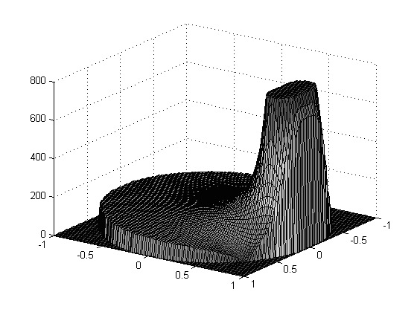
IIR filters
Frequency response versus pole-zero location :
( ~ Frequency response is z-transform
evaluated on the unit circle)
Example
Low-pass filter with
poles at
zeros at
pole
pole
Nyquist freq (z=-1)
zero
DC (z=1)
Pole near unit-circle introduces `peak’ in frequency response
hence pass-band can be set by pole placement
Zero near (or on) unit-circle introduces `dip’ (or transmision zero) in freq. response
hence stop-band can be emphasized by zero placement

Slide 32
IIR Filter Design by Optimization
(I) Weighted Least Squares Design :
IIR filter transfer function is
Specify desired frequency response (LP,HP,BP,…)
Optimization criterion is
where is a weighting function
Stability constraint :

Slide 33
IIR Filter Design by Optimization
(II) `Minimax’ Design :
IIR filter transfer function is
Specify desired frequency response (LP,HP,BP,…)
Optimization criterion is
where is a weighting function
Stability constraint :

Slide 34
IIR Filter Design by Optimization
These optimization problems are significantly more
difficult than those for the FIR design case… :
Problem-1: Presence of denominator polynomial leads to non-linear/non-quadratic optimization
Problem-2: Stability constraint
(zeros of a high-order polynomial are related to the its
coefficients in a highly non-linear manner)
  Solutions based on alternative stability constraints, that e.g. are affine functions of the filter coefficients, etc…
  Topic of ongoing research, details omitted here

Slide 35
IIR Filter Design by Optimization
Conclusion:
(I) Weighted least squares design
(II) Minimax design
provide general `framework’, procedures to translate filter design problems into ``standard’’ optimization problems
In practice (and in textbooks):
Emphasis on specific (ad-hoc) procedures :
- IIR filter design based analog filter design (Butterworth,
Chebyshev, elliptic,…) and analog->digital conversion
- IIR filter design by modeling = direct z-domain design
(Pade approximation, Prony, etc., not addressed here)

Slide 36
IIR Filter Design Software
IIR filter design considerably more complicated than FIR design (stability, phase response, etc..)
(Fortunately) IIR Filter design abundantly available in commercial software
Matlab:
[b,a]=butter/cheby1/cheby2/ellip(L,…,Wn),
IIR LP/HP/BP/BS design based on analog prototypes, pre-warping,
bilinear transform, …
immediately gives H(z) ☺
analog prototypes, transforms, … can also be called individually
filter order estimation tool
etc...

Slide 37
IIR Filter Design – Matlab Examples
1/4
Butterworth 2nd order

Slide 38
IIR Filter Design – Matlab Examples
2/4
Butterworth 2nd , 10th order

Slide 39
IIR Filter Design – Matlab Examples
3/4
Butterworth 2nd, 10th, 18th order

Slide 40
IIR Filter Design – Matlab Examples
% See help butter
% Bandpass filter
% [B,A] = butter(filter_order,[W1 W2],'bandpass');
% Wn = [W1 W2] upper and lower cut-off frequencies
W1 = 0.25; % 1/4*pi
W2 = 0.75; % 3/4*pi
for filter_order=2:8:28
% Coefficients response
[B,A] = butter(filter_order,[W1 W2],'bandpass');
% Frequency response
[H W] = freqz(B,A);
% Impulse response
h = filter(B,A,[zeros(2,1);1;zeros(100,1)]);
% Plotting
subplot(211)
plot(W,db(abs(H)));hold on
set(gca,'XTick',0:pi/2:pi)
set(gca,'XTickLabel',{'0','pi/2','pi'})
title('IIR filter design');
xlabel('Circular frequency (Radians)');
ylabel('Magnitude response (dB)');
axis([0 pi -100 20])
subplot(212)
plot(h)
xlabel('Samples');
ylabel('Impulse response');
axis([0 100 -0.5 0.5])
pause
end
hold off
4/4
Butterworth 2nd, 10th, 18th, 26th order

