Slide 1
DSP-CIS
Part-I : Introduction
Chapter-3: Acoustic Modem Project
Marc Moonen
Dept. E.E./ESAT-STADIUS, KU Leuven
marc.moonen@kuleuven.be
www.esat.kuleuven.be/stadius/

Slide 2

Chapter-3: Acoustic Modem Project
Introduction
  Overview & Target
Work Plan
  Week-1
  Week-2: Channel modeling & evaluation
  Week 3-4: OFDM modulation
  Week 5-6
  Week 7-8

Slide 3

Introduction/Overview
  Digital communication over an acoustic channel
  (from loudspeaker to microphone)
  FFT/IFFT-based modulation format : OFDM
  (as in ADSL/VDSL, WiFi, DAB, DVB…)
  Channel estimation, equalization, etc…
Digital Picture (IN)
Receiver
Tx
D-to-A
A-to-D
Rx
Transmitter
+filtering
+amplif.
+filtering
+…
Digital Picture (OUT)

Slide 4
Introduction
Digital communications over an acoustic channel:
Discrete-time
transmit signal
(sampling rate Fs, e.g. 10kHz)
Discrete-time
receiver signal
(sampling rate Fs, e.g. 10kHz)
Tx
D-to-A
A-to-D
Rx
+filtering
+amplif.
+filtering
+…

Slide 5
Introduction
Digital communications over an acoustic channel:
Discrete-time
transmit signal
(sampling rate Fs, e.g. 10kHz)
Discrete-time
receiver signal
(sampling rate Fs, e.g. 10kHz)
Tx
D-to-A
A-to-D
Rx
+filtering
+amplif.
+filtering
+…
This will be the easy part…

Slide 6
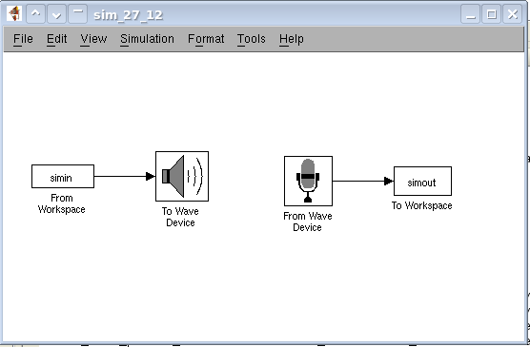
Introduction
Digital communications over an acoustic channel:
…straightforwardly realized
(in Matlab/Simulink with `Real-Time Workshop’, see below)
Discrete-time
transmit signal
(sampling rate Fs, e.g. 10kHz)
Discrete-time
receiver signal
(sampling rate Fs, e.g. 10kHz)
Tx
D-to-A
A-to-D
Rx
+filtering
+amplif.
+filtering
+…
Means we do not have to deal with
hardware issues, components, etc.

Slide 7
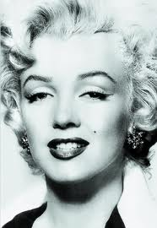
Introduction
Digital communications over an acoustic channel:
…and will be modeled by a linear discrete-time transfer function
(see below)
Discrete-time
transmit signal
(sampling rate Fs, e.g. 10kHz)
Discrete-time
receiver signal
(sampling rate Fs, e.g. 10kHz)
H(z)
Tx
D-to-A
A-to-D
Rx
+filtering
+amplif.
+filtering
+…

Slide 8
Introduction
Digital communications over an acoustic channel:
Discrete-time
transmit signal
(sampling rate Fs, e.g. 10kHz)
Discrete-time
receiver signal
(sampling rate Fs, e.g. 10kHz)
Tx
D-to-A
A-to-D
Rx
+filtering
+amplif.
+filtering
+…
This is the interesting part…
(where we will spend most of the time)

Slide 9

Introduction
Will use OFDM as a modulation format
  OFDM/DMT is used in ADSL/VDSL, WiFi, DAB, DVB …
  OFDM heavily relies on DSP functionalities (FFT/IFFT, …)
Orthogonal frequency-division multiplexing
From Wikipedia, the free encyclopedia
Orthogonal frequency-division multiplexing (OFDM), essentially identical to (…) discrete multi-tone modulation (DMT), is a frequency-division multiplexing (FDM) scheme used as a digital multi-carrier modulation method. A large number of closely-spaced orthogonal sub-carriers are used to carry data. The data is divided into several parallel data streams or channels, one for each sub-carrier. Each sub-carrier is modulated with a conventional modulation scheme (such as quadrature amplitude modulation or phase-shift keying) at a low symbol rate, maintaining total data rates similar to conventional single-carrier modulation schemes in the same bandwidth. OFDM has developed into a popular scheme for wideband digital communication, whether wireless or over copper wires, used in applications such as digital television and audio broadcasting, wireless networking and broadband internet access.

Slide 10
Introduction
Target:
Design efficient OFDM based modem (Tx/Rx)
for transmission over acoustic channel
Tx
D-to-A
A-to-D
Rx
Specifications:
Data rate (e.g. 1kbits/sec), bit error rate (e.g. 0.5%),
channel tracking speed, synchronisation, …

Slide 11
Work Plan
8 Weeks:
  Week 0: Introduction Matlab/Simulink
  Week 1: Audio playback, recording and analysis
  Week 2: Acoustic channel measurement & modeling
  *deliverable*
  Week 3-4: OFDM transmitter/receiver design
  *deliverable*
  Week 5-6: OFDM over acoustic channel
  *deliverable*
  Week 7-8: OFDM with adaptive equalization
  *deliverable*

Slide 12
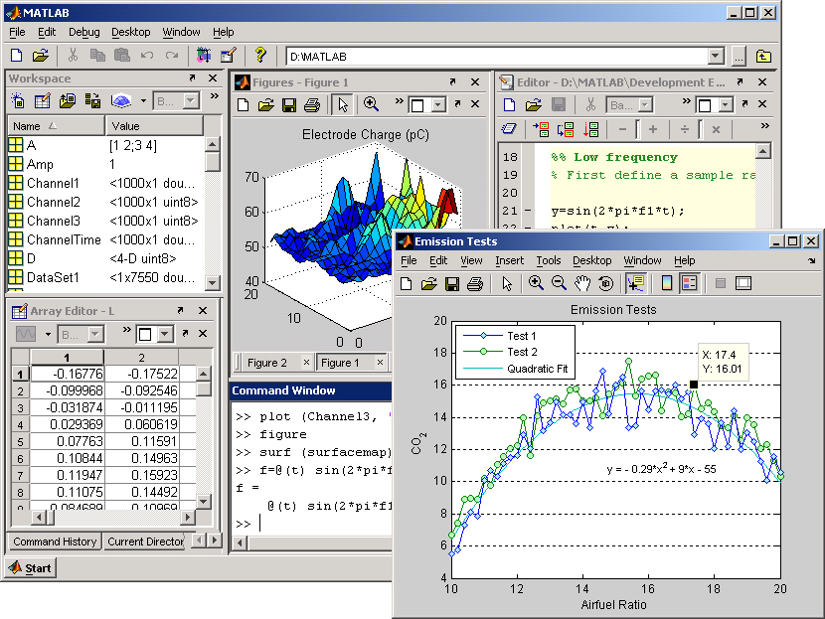

Week 0 / Introduction to Matlab & Simulink
Matlab tutorial provided..
Self-test = exercise 6 (IF ‘failure’,THEN ‘brush up your Matlab skills!’)
=CRUCIAL
PREREQUISITE

Slide 13
Week 1 / Audio playback, recording and analysis
Will provide basic Simulink scheme… (`Real-Time Workshop’)
✪Time-frequency analysis of recorded signals

Slide 14
Week 2 / Channel Modeling & Evaluation
Transmission channel consist of
  Tx `front end’: Digital-to-Analog conv./filtering/amplification
  Loudspeaker (ps: cheap loudspeakers mostly have a non-linear characteristic ☹)
  Acoustic channel
  Microphone
  Rx `front end’: filtering/Analog-to-Digital conv.
Discrete-time
transmit signal
(sampling rate Fs, e.g. 10kHz)
Discrete-time
receiver signal
(sampling rate Fs, e.g. 10kHz)
Tx
D-to-A
A-to-D
Rx
+filtering
+amplif.
+filtering
+…

Slide 15
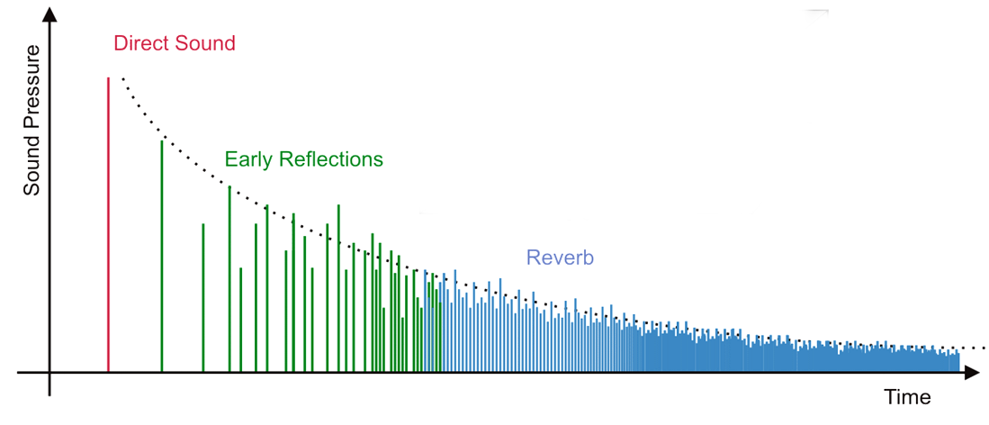
Week 2 / Channel Modeling & Evaluation
Acoustic channel (`room acoustics’):
Acoustic path between loudspeaker and microphone is represented by the acoustic impulse response (which can be recorded/measured)
  First there is a dead time
  Then come the direct path impulse
  and some early reflections, which
  depend on the geometry of the room
  Finally there is an exponentially decaying tail called reverberation,
  corresponding to multiple reflections on walls, objects,...

Slide 16
Week 2 / Channel Modeling & Evaluation
Complete transmission channel will be modeled by a
discrete-time (FIR `finite impulse response’) transfer function
  Pragmatic & good-enough approximation
  Model order L depends on sampling rate (e.g. L=100…1000…)
PS: will use shorthand notation here, i.e.
hk, xk, yk , instead of h[k], x[k], y[k]
H(z)
Tx
D-to-A
A-to-D
Rx
+filtering
+amplif.
+filtering
+…

Slide 17
Week 2 / Channel Modeling & Evaluation
When a discrete-time (Tx) signal xk is sent over a channel…
..then channel output signal (=Rx input signal) yk is
=`convolution’

Slide 18
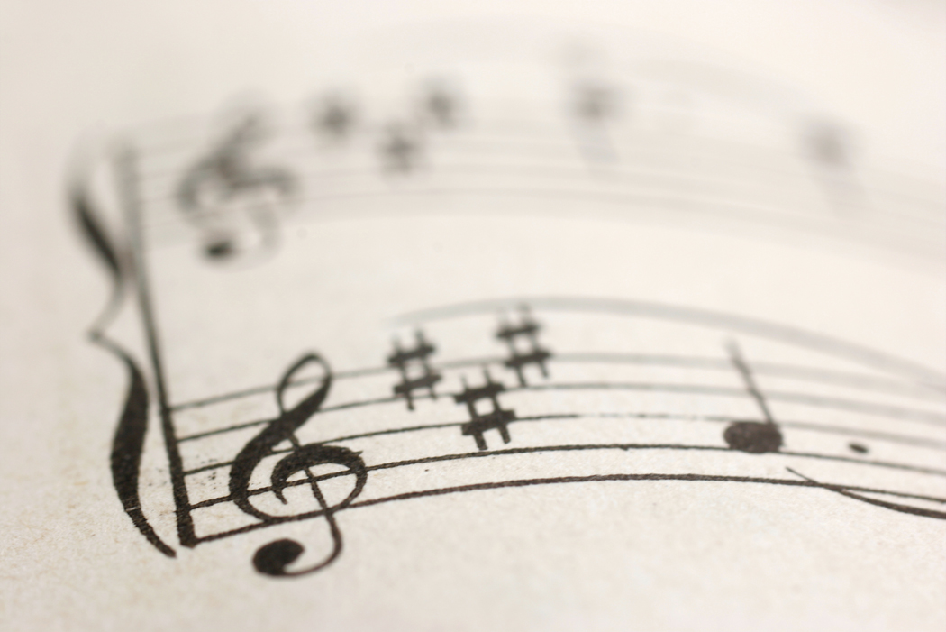

Week 2 / Channel Modeling & Evaluation
Can now run parameter estimation experiment:
  Transmit your favorite signal xk
  Record corresponding signal yk
xk
H(z)
yk
Tx
D-to-A
A-to-D
Rx
+filtering
+amplif.
+filtering
+…

Slide 19
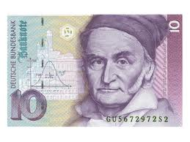
Week 2 / Channel Modeling & Evaluation
  3. Least squares estimation
(i.e. one line of Matlab code ☺)
Carl Friedrich Gauss (1777 – 1855)

Slide 20
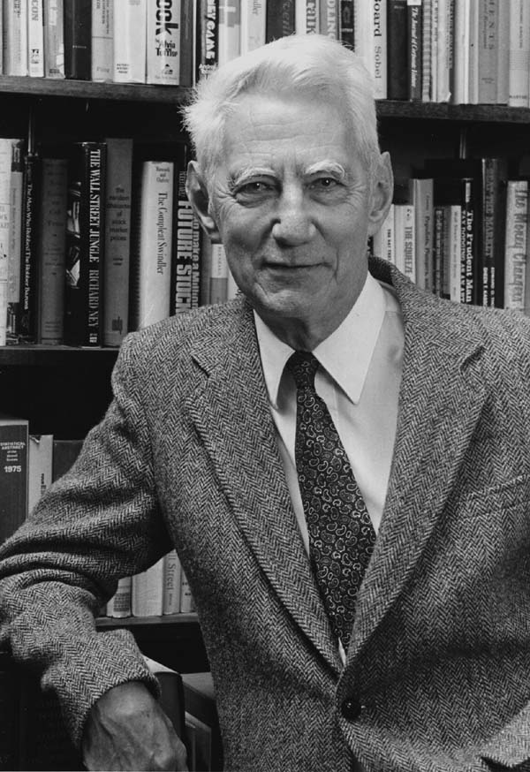
Week 2 / Channel Modeling & Evaluation
Estimated transmission channel can then be analysed…
Frequency response
Information theoretic capacity
ps: noise spectrum?
Claude Shannon 1916-2001

Slide 21
Week 3-4 / OFDM modulation
OFDM – Orthogonal Frequency Division Multiplexing
a.k.a.
DMT – Discrete Multitone Modulation
Basic idea is to (QAM-)modulate (many) different carriers with low-rate bit
streams. The modulated carriers are summed and then transmitted.
A high-rate bit stream is thus carried by dividing it into hundreds
of low-rate streams.
Modulation/demodulation is performed by FFT/IFFT (see below)
Now 14 pages of (simple) maths/theory…

Slide 22
OFDM Modulation
1/14
Consider the modulation of
a complex exponential carrier (with period N)
by a `symbol sequence’ (see p.27)
defined as
(i.e. “1 symbol per N samples of the carrier”)
PS: remember that modulation of sines and cosines is similar/related
to modulation of complex exponentials (see also p.26, 2nd ‘PS’)
carrier
x
symbol
sequence

Slide 23
OFDM Modulation
2/14
This corresponds to (for k=0,N,2N,..):
carrier
x
symbol
sequence

Slide 24
OFDM Modulation
3/14
Now consider the modulation of
N such complex exponential carriers
by `symbol sequences’
defined as
x
…
x
x
…
+
x

Slide 25
OFDM Modulation
4/14
This corresponds to (for k=0,N,2N,..):
..and so can be realized by means of an N-point
`Inverse Discrete Fourier Transform’ (IDFT) !!!

Slide 26
OFDM Modulation
5/14
PS: Note that modulates a DC signal (hence often set to zero)
PS: To ensure time-domain signal is real-valued, have to choose
PS: The IDFT matrix is a cool matrix:
  For any chosen dimension N, an IDFT matrix can be constructed as given on the previous slide.
  Its inverse is the DFT matrix (symbol `F’). DFT and IDFT matrices are unitary (up to a scalar), i.e.
  The structure of the IDFT matrix allows for a cheap (complexity N.logN instead of N.N) algorithm to compute the matrix-vector product on the previous slide (=IFFT =inverse fast Fourier transform)

Slide 27
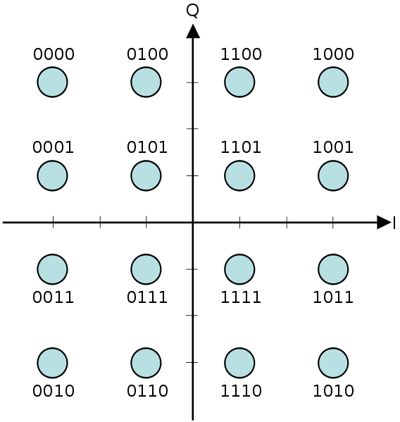
OFDM Modulation
6/14
So this will be the basic modulation operation at the Tx :
  The X’s are (QAM-symbols) defined by the input bit stream
  The time-domain signal segments are obtained by IDFT/IFFT and then transmitted over the channel, one after the other. At the Rx, demodulation is done with an inverse operation (i.e. DFT/FFT=fast Fourier transform, see also p.33).
Imag(X)
  Example: ‘16-QAM’
Real(X)

Slide 28
OFDM Modulation
7/14
Sounds simple, but forgot one thing: channel H(z) !!
  OFDM has an ingenious way of dealing with the channel effect, namely through the insertion of a so-called `cyclic prefix’ at the Tx :
  If the channel is FIR with order L (see p.16), then per segment, instead of transmitting N samples, N+L sampes are transmitted (assuming L<<N), where the last L samples are copied and put up front…
L
N

Slide 29
OFDM Modulation
8/14
At the Rx, throw away L samples corresponding to cyclic prefix, keep the other N samples, which correspond to
This is equivalent to …
prefix
N+L
N

Slide 30
OFDM Modulation
9/14
The resulting matrix (call it `H’) is an NxN `circulant matrix’
=every row is the previous row up to a ‘cyclic shift’
N
N
(*)

Slide 31
OFDM Modulation
10/14
PS: Cyclic prefix converts a (linear) convolution (see p.29) into a so-called ‘circular convolution’ (see p.30)
Circulant matrices are cool matrices…
  A weird property (proof by Matlab!) is that when a circulant matrix H is pre-/post-multiplied by the DFT/IDFT matrix, a diagonal matrix is always obtained:
  Hence, a circulant matrix can always be written as (=eigenvalue decomposition!)

Slide 32
OFDM Modulation
11/14
Combine previous formulas, to obtain…

Slide 33
OFDM Modulation
12/14
In other words…
This means that after removing the prefix part and performing a DFT in the Rx, the obtained Y’s are equal to the transmitted X’s, up to (scalar) channel attenuations Hn (!!)

Slide 34
OFDM Modulation
13/14
PS: It can be shown (check first column of ) that Hn is the channel frequency response evaluated at the n-th carrier !
(p.33 then represents ‘frequency domain version’ of circular convolution,
i.e. ‘component-wise multiplication in the frequency domain’)

Slide 35
OFDM Modulation
13/14
PS: It can be shown (check first column of ) that Hn is the channel frequency response evaluated at the n-th carrier !
`Channel equalization’ may then be performed after the DFT
(=in the frequency domain), by component-wise division (divide by Hn for
carrier-n). This is referred to as `1-tap FEQ’ (Freq.-domain EQualization)

Slide 36
OFDM Modulation
14/14
Conclusion: DMT-modulation with cyclic prefix leads to a simple (trivial) channel equalization problem (!!)
CP insertion
CP removal
0
P/S
S/P
IFFT
Discrete
equivalent
channel
FFT
FEQ

Slide 37
Week 3-4
Target Week 3-4:
  Study/understand OFDM scheme
  Surf around, use IEEE Xplore, Wikipedia, etc.
  Simulate basic OFDM Transceiver in Matlab
  First without channel dispersion & without noise, then with noise,
  then with channel (model from Week-2)
  Optional : Extend OFDM Tx/Rx with `bit-loading‘
  =Carriers with a high SNR transmit more bits/sec

Slide 38
Week 5-6
Target Week 5-6:
  OFDM over acoustic channel, with basic Simulink (Real-time Workshop) scheme (Week-1)
  Extend OFDM Tx/Rx with mechanism for channel estimation and/or equalizer (FEQ) initialization/updating based on transmitted training symbols
Tx
D-to-A
A-to-D
Rx

Slide 39
Week 7-8
Target Week 7-8:
    OFDM over acoustic channel, with decision-directed adaptive equalization (see Part III)
Tx
D-to-A
A-to-D
Rx

Slide 40
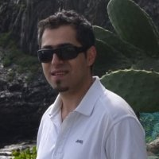
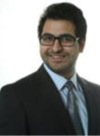

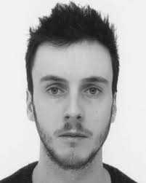
Important !
PS: groups of 2
Runs over 8 weeks
Each week
  1 PC/Matlab session (supervised, 2.5hrs)
  2 ‘Homework’ sesions (unsupervised, 2*2.5hrs)
PS: Time budget = 8*(2.5hrs+5hrs) = 60 hrs
‘Deliverables’ after week 2, 4, 6, 8
Grading: based on deliverables, evaluated during sessions
main part=80%, optional part=20%
TAs: amin.hassani@kuleuven.be (English+Persian)
mohit.sharma@kuleuven.be (English+Hindi)
robbe.vanrompaey@kuleuven.be (Dutch+English+French)
jeroen.verdyck@kuleuven.be (Dutch+English+French)
BE THERE !!

