Slide 1
DSP-CIS
Part-I: Introduction
Chapter-2 : Signals & Systems Review
Marc Moonen & Toon van Waterschoot
Dept. E.E./ESAT-STADIUS, KU Leuven
marc.moonen@kuleuven.be
www.esat.kuleuven.be/stadius/

Slide 2

Chapter-2 : Signals & Systems Review
Discrete-Time/Digital Signals (10 slides)
  Sampling, quantization, reconstruction
Discrete-Time Systems (13 slides)
  LTI, impulse response, convolution, z-transform, frequency
  response, frequency spectrum, IIR/FIR
Discrete Fourier Transform (4 slides)
  DFT-IDFT, FFT
Multi-Rate Systems (11 slides)
Notes:
2

Slide 3
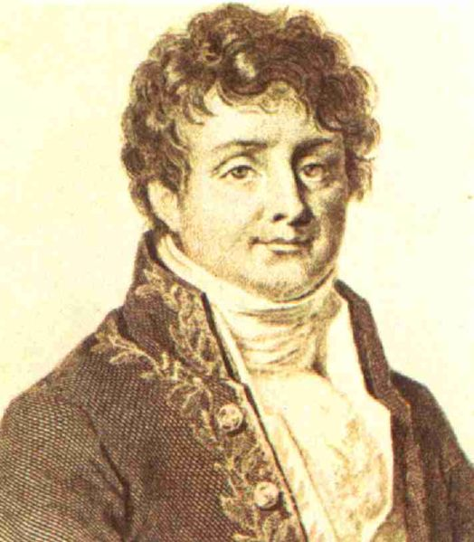
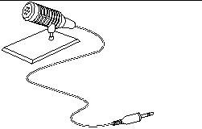
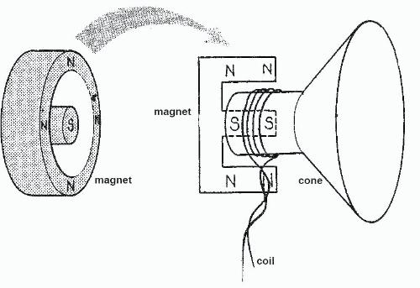
Discrete-Time/Digital Signals 1/10
Analog signal processing
Analog domain
(continuous-time domain)
Jean-Baptiste Joseph Fourier (1768-1830)
Analog Signal Processing Circuit
Analog IN
Analog OUT
(Fourier Transform / spectrum, where f = frequency)
Notes:
3

Slide 4
Discrete-Time/Digital Signals 2/10
Digital signal processing
Analog domain
Digital
domain
Analog domain
Analog-to-
Digital
Conversion
0110100101
1001100010
Digital-to-
Analog
Conversion
DSP
Analog IN
Digital IN
Digital OUT
Analog OUT
sampling
reconstruction
& quantization
Notes:
4

Slide 5
Discrete-Time/Digital Signals 3/10
Sampling
amplitude
amplitude
continuous-time
signal
discrete-time
signal
impulse train
continuous-time (t)
0 1 2 3 4
discrete-time [k]
It will turn out (p.24-25) that a spectrum can be computed from x[k] (=discrete-time), which (remarkably) will be equal to the spectrum (=Fourier transform) of the (continuous-time) sequence of impulses…...
Notes:
5

Slide 6
Discrete-Time/Digital Signals 4/10
So what does this spectrum of x_{D}(t) look like…
Spectrum replication
  Time domain:
  Frequency domain:
magnitude
magnitude
frequency (f)
frequency (f)
Notes:
6

Slide 7

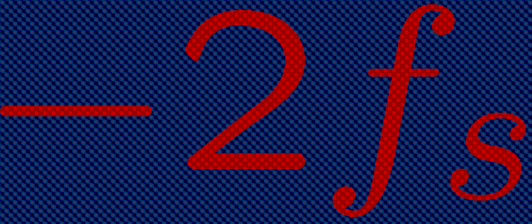


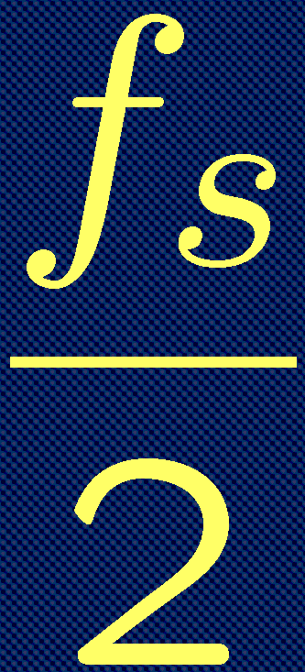
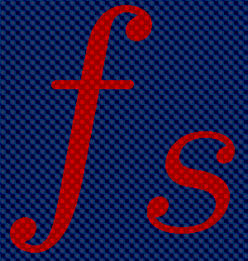
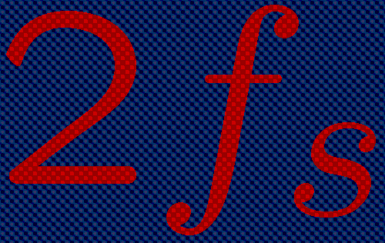
Discrete-Time/Digital Signals 5/10
Sampling theorem
  Analog signal spectrum X(f) runs up to f_{max} Hz
  Spectrum replicas are separated by f_{s} =1/T_{s} Hz
  No spectral overlap if and only if
magnitude
frequency
f_{s} > 2.f_{max}
Notes:
7

Slide 8
Discrete-Time/Digital Signals 6/10
Sampling theorem
  Analog signal spectrum X(f) runs up to f_{max} Hz
  Spectrum replicas are separated by f_{s} =1/T_{s} Hz
  Spectral overlap (=‘folding’, ‘aliasing’) if
magnitude
frequency
f_{s} < 2.f_{max}
Notes:
8

Slide 9
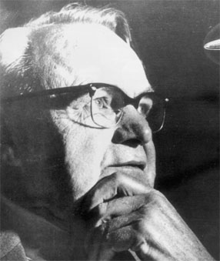


Discrete-Time/Digital Signals 7/10
Sampling theorem
  Terminology:
    sampling frequency/rate f_{s}
    Nyquist frequency f_{s}/2
    sampling interval/period T_{s}
  E.g. CD audio: f_{s} = 44,1 kHz
(*)
Harry Nyquist (1889 –1976)
Anti-aliasing prefilters
  If then frequencies above the Nyquist frequency are ‘folded’ into lower frequencies (=aliasing)
  To avoid aliasing, sampling is usually preceded by (analog-domain) low-pass (=anti-aliasing) filtering
(*) An equivalent formulation is fs > fmax-(-fmax) = fmax-fmin = ‘bandwidth’…will use this in p.36
Notes:
9

Slide 10
Discrete-Time/Digital Signals 8/10
2. B-bit quantization
quantized discrete-time signal
=discrete-amplitude&time signal
=digital signal
discrete-time signal
amplitude
amplitude
3Q
2Q
Q
0
R
-Q
-2Q
-3Q
6dB per bit rule:
discrete time [k]
discrete time [k]
  Ex: CD audio = 16bits ~ 96dB SNR
  (LP’s: 60dB SNR)
Notes:
10

Slide 11
Discrete-Time/Digital Signals 9/10
3. Reconstruction
  Reconstruction = ‘fill the gaps’ between adjacent samples
  Example: staircase reconstructor
  In a practical realization x_{D}(t) is generated first as an intermediate signal by means of a D-to-A & sampler, which is then followed by (analog domain) filtering (details omitted)
amplitude
amplitude
discrete-time/digital signal
reconstructed
analog signal
discrete time [k]
continuous time (t)
Notes:
11

Slide 12
Discrete-Time/Digital Signals 10/10
Complete scheme is…
Analog IN
Analog OUT
anti-aliasing prefilter
anti-image postfilter
No longer interested in this part…
No longer interested in this part…
sampler
quantizer
DSP
reconstructor
Digital IN
Digital OUT
Notes:
12

Slide 13
Discrete-Time Systems 1/13
Discrete-time system is `sampled data’ system
Input signal u[k] is a sequence of samples (=numbers)
..,u[-2],u[-1] ,u[0], u[1],u[2],…
System then produces a sequence of output samples y[k]
..,y[-2],y[-1] ,y[0], y[1],y[2],…
Example: `DSP’ block in previous slide
u[k]
y[k]

Slide 14
Discrete-Time Systems 2/13
Will consider linear time-invariant (LTI) systems
Linear :
input u1[k] -> output y1[k]
input u2[k] -> output y2[k]
hence a.u1[k]+b.u2[k]-> a.y1[k]+b.y2[k]
Time-invariant (shift-invariant)
input u[k] -> output y[k]
hence input u[k-T] -> output y[k-T]
u[k]
y[k]

Slide 15
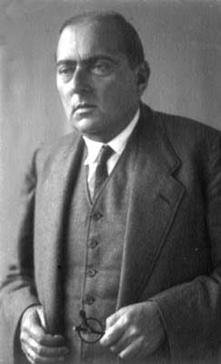
Discrete-Time Systems 3/13
Will consider causal systems
iff for all input signals with u[k]=0,k<0 -> output y[k]=0,k<0
Impulse response
input …,0,0, 1 ,0,0,0,...-> output …,0,0, h[0] ,h[1],h[2],h[3],...
General input u[0],u[1],u[2],u[3] (cfr. linearity & shift-invariance!)
K=0
K=0
Otto Toeplitz (1881–1940)
this is called a
`Toeplitz’ matrix

Slide 16
Discrete-Time Systems 4/13
Convolution
u[0],u[1],u[2],u[3]
y[0],y[1],...
h[0],h[1],h[2],0,0,...
= `convolution sum‘
(=more convenient than Toeplitz matrix notation when considering (infinitely) long input and impulse response sequences

Slide 17
Discrete-Time Systems 5/13
Z-Transform of system h[k] and signals u[k],y[k]
Definition:
Input/output relation:
H(z) is `transfer function’

Slide 18
Discrete-Time Systems 6/13
Z-Transform
Easy input-output relation:
May be viewed as `shorthand’ notation
(for convolution operation/Toeplitz-vector product)
Stability
=bounded input u[k] leads to bounded output y[k]
--iff
--iff all the poles of H(z) lie inside the unit circle
(now z=complex variable)
(for causal, rational systems, see below)

Slide 19
Discrete-Time Systems 7/13
Example-1 : `Delay operator’
Impulse response is …,0,0, 0 ,1,0,0,0,…
Transfer function is
Pole at z=0
Example-2 : Delay + feedback
Impulse response is …,0,0, 0 ,1,a,a^2,a^3…
Transfer function is
Pole at z=a
u[k]
y[k]=u[k-1]
K=0
u[k]
y[k]
K=0
+
a
x
=simple rational function
realized with a delay element,
a multiplier and an adder

Slide 20
Discrete-Time Systems 8/13
Will consider only rational transfer functions:
L poles (zeros of A(z)) , L zeros (zeros of B(z))
Corresponds to difference equation
Hence rational H(z) can be realized with finite number of delay elements, multipliers and adders
In general, this is a `infinitely long impulse response’ (`IIR’) system (as in example-2)

Slide 21
Discrete-Time Systems 9/13
Special case is
L poles at the origin z=0 (hence guaranteed stability)
L zeros (zeros of B(z)) = `all zero’ filter
Corresponds to difference equation
=`moving average’ (MA) filter
Impulse response h[k] is
= `finite impulse response’ (`FIR’) filter

Slide 22
Discrete-Time Systems 10/13
H(z) & frequency response:
Given a system H(z)
Given an input signal = complex exponential
Output signal :
= `frequency response’
= complex function of radial frequency ω
= H(z) evaluated on the unit circle
Im
u[2]
u[1]
Re
u[0]=1
(where ω=radial frequency)

Slide 23
Discrete-Time Systems 11/13
H(z) & frequency response:
Periodic with period =
For a real-valued impulse response h[k]
- magnitude response is even function
- phase response is odd function
Example-1: Low-pass filter
Example-2: All-pass filter
Nyquist frequency
(=2 samples/period)
DC

Slide 24
Discrete-Time Systems 12/13
Z-Transform & Discrete-Time Fourier Transform
  is frequency response of the LTI system
  is frequency spectrum (‘Discrete-Time Fourier Transform’)
  of input signal
  (compare to Fourier Transform, see p.3)
  is frequency spectrum of the output signal

Slide 25
Discrete-Time Systems 13/13
Z-Transform & Fourier Transform It is proved that…
  The frequency response of an LTI system is equal to the Fourier transform of the continuous-time impulse sequence (see p.5) constructed with h[k]
  The frequency spectrum of a discrete-time signal is equal to the Fourier transform of the continuous-time impulse sequence constructed with u[k] or y[k]
  corresponds to continuous-time
  iff are bandlimited (➔no aliasing)
⬇

Slide 26
Discrete/Fast Fourier Transform 1/4
DFT definition:
  The `Discrete-time Fourier Transform’ of a discrete-time system/signal x[k] is a (periodic) continuous function of the radial frequency ω (see p.28)
  The `Discrete Fourier Transform’ (DFT) is a discretized version of this, obtained by sampling ω at N uniformly spaced frequencies (n=0,1,..,N-1) and by truncating x[k] to N samples (k=0,1,..,N-1)

Slide 27
Discrete/Fast Fourier Transform 2/4
DFT & Inverse DFT (IDFT):
  An N-point DFT sequence can be calculated from an
  N-point time sequence:
  Conversely, an N-point time sequence can be calculated from an N-point DFT sequence:
= DFT
= IDFT

Slide 28
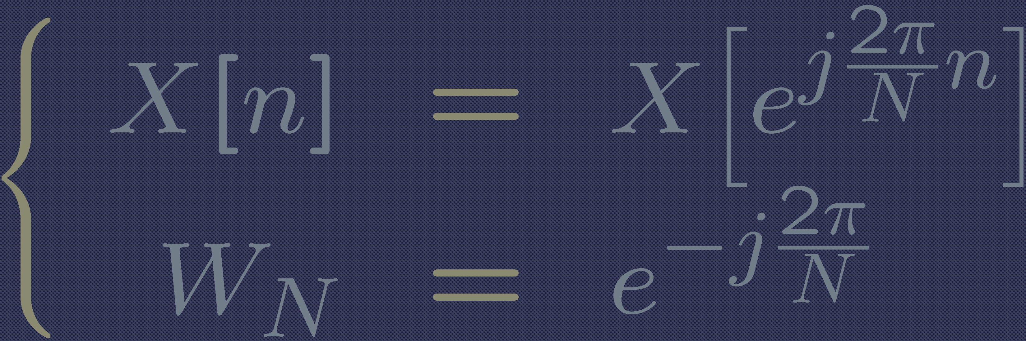
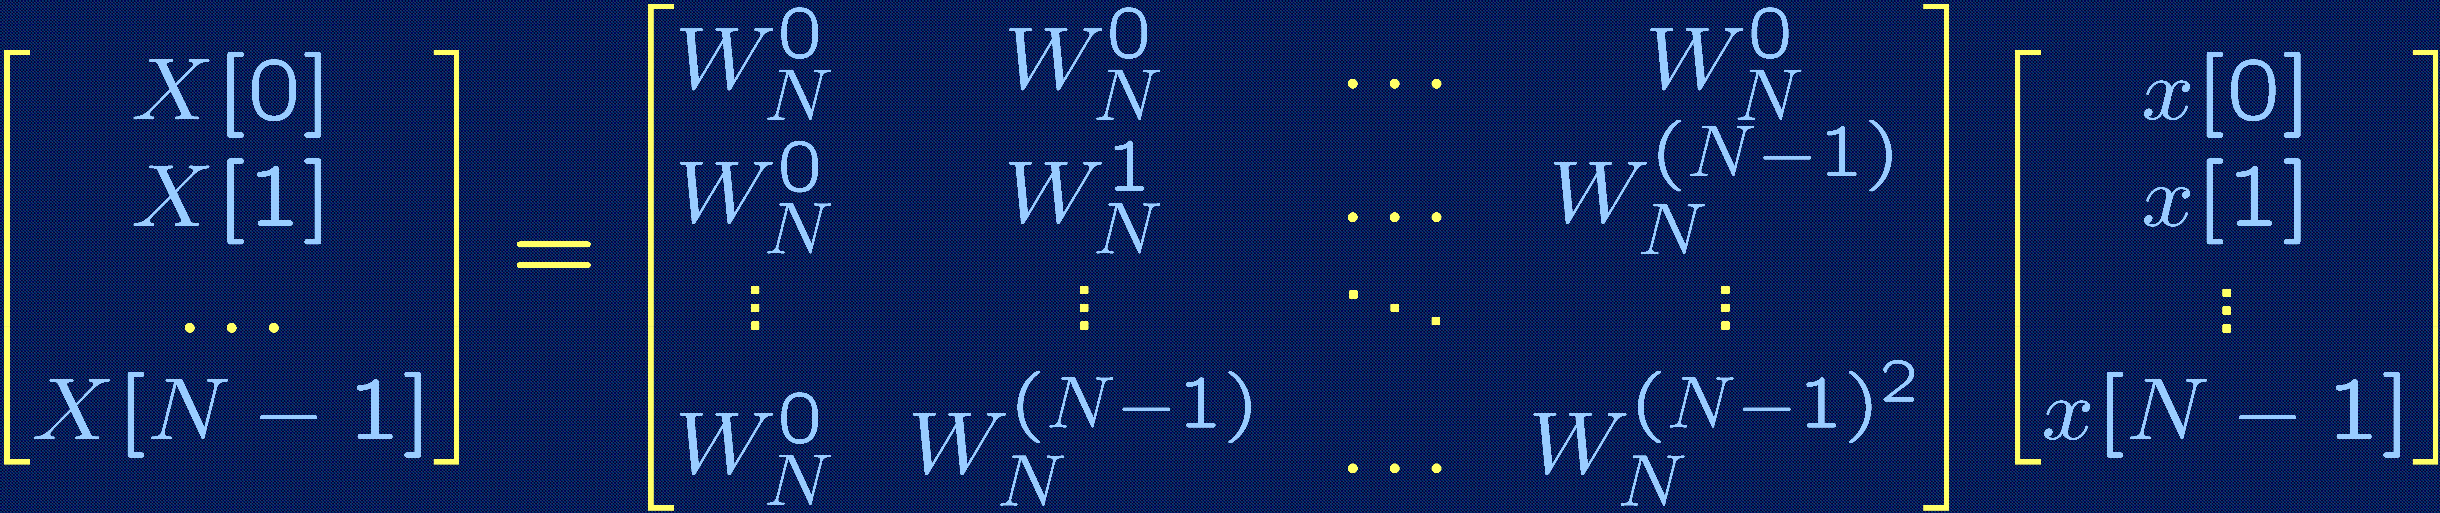
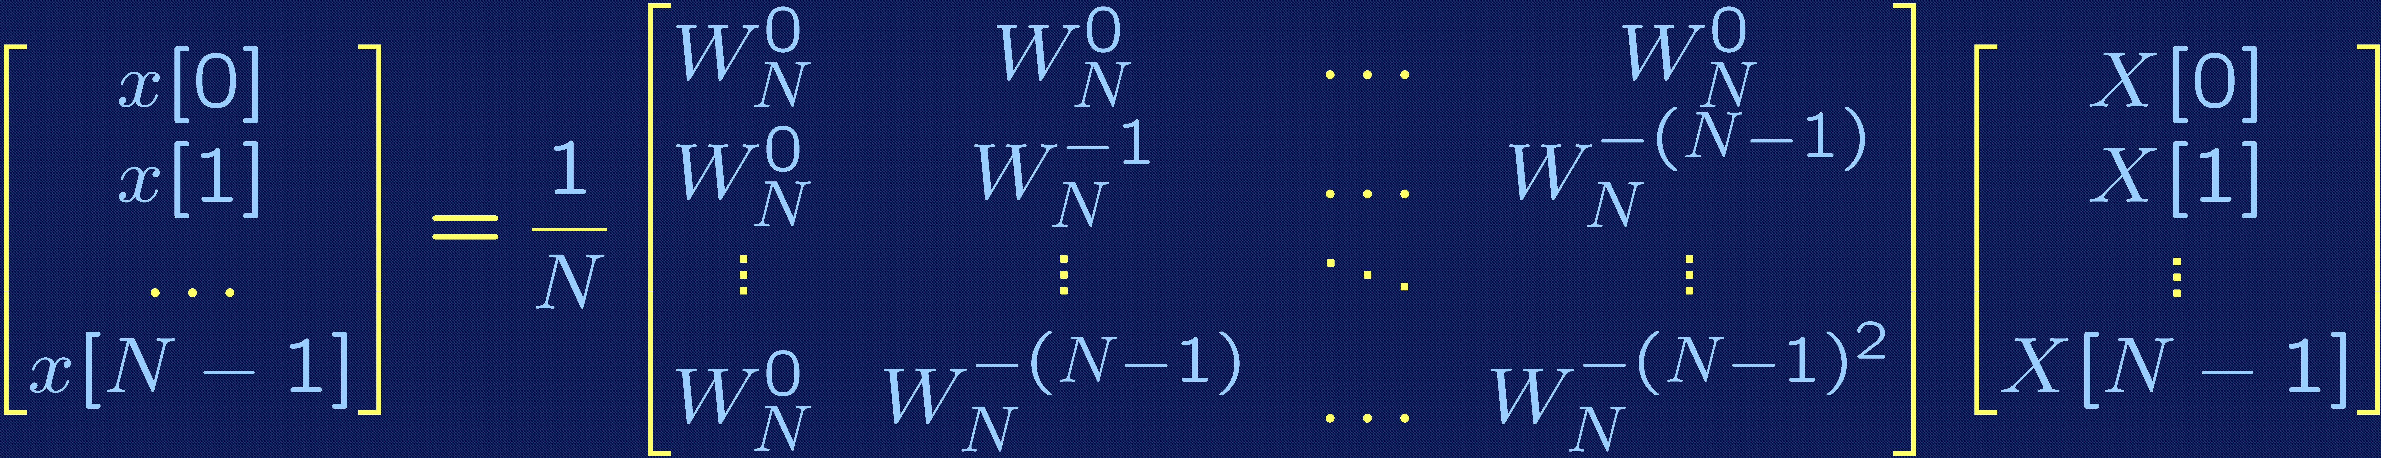
Discrete/Fast Fourier Transform 3/4
DFT/IDFT in matrix form
  Using shorthand notation..
  ..the DFT can be rewritten as
  ..the IDFT can be rewritten as

Slide 29
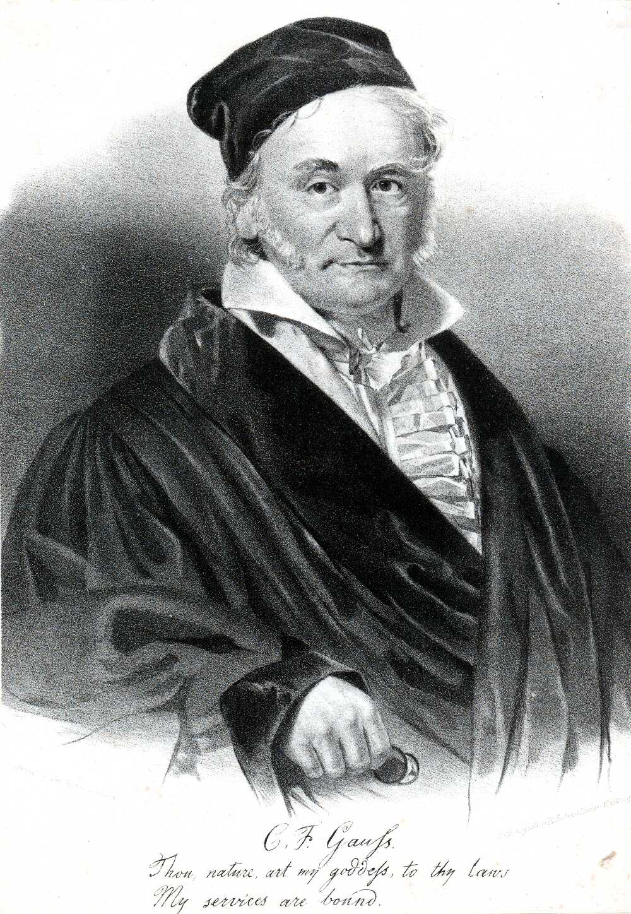

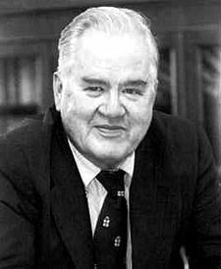
Discrete/Fast Fourier Transform 4/4
Fast Fourier Transform (FFT) (1805/1965)
  Divide-and-conquer approach:
    Split up N-point DFT in two N/2-point DFT’s
    Split up two N/2-point DFT’s in four N/4-point DFT’s
    …
    Split up N/2 2-point DFT’s in N 1-point DFT’s
    Calculate N 1-point DFT’s
    Rebuild N/2 2-point DFT’s from N 1-point DFT’s
    …
    Rebuild two N/2-point DFT’s from four N/4-point DFT’s
    Rebuild N-point DFT from two N/2-point DFT’s
  DFT complexity of N² multiplications is reduced to FFT complexity of O(N.log₂(N)) multiplications
  Similar IFFT
James W. Cooley
Carl Friedrich Gauss (1777-1855)
John W.Tukey

Slide 30
Multi-Rate Systems 1/11
Decimation : decimator (=downsampler)
Example : u[k]: 1,2,3,4,5,6,7,8,9,…
2-fold downsampling: 1,3,5,7,9,...
Interpolation : expander (=upsampler)
Example : u[k]: 1,2,3,4,5,6,7,8,9,…
2-fold upsampling: 1,0,2,0,3,0,4,0,5,0...
u[0],u[1],u[2]...
D
u[0], u[D], u[2D]...
u[0], u[1], u[2],...
D
u[0],0,..0,u[1],0,…,0,u[2]...

Slide 31
Multi-Rate Systems 2/11
Z-transform & frequency domain analysis of expander
`Expansion in time domain ~ compression in frequency domain’
u[0], u[1], u[2],...
D
u[0],0,..0,u[1],0,…,0,u[2]...
D
`images’
3

Slide 32
Multi-Rate Systems 3/11
Z-transform & frequency domain analysis of expander
Expander mostly followed by `interpolation filter’ to remove images
(and `interpolate the zeros’)
Interpolation filter can be low-/band-/high-pass (see p.35-36 and Chapter-10)
u[0], u[1], u[2],...
D
u[0],0,..0,u[1],0,…,0,u[2]...
`images’
3
LP

Slide 33
Multi-Rate Systems 4/11
Z-transform & frequency domain analysis of decimator
`Compression in time domain ~ expansion in frequency domain’
PS: Note that is periodic with period while is periodic with period
The summation with d=0…D-1 restores the periodicity with period !
u[0],u[1],u[2]...
D
u[0], u[D], u[2D]...
D
d=2
d=0
d=1
3

Slide 34
Multi-Rate Systems 5/11
Z-transform & frequency domain analysis of decimator
Decimation introduces ALIASING if input signal occupies frequency band
larger than , hence mostly preceded by anti-aliasing (decimation)
filter
Anti-aliasing filter can be low-/band-/high-pass (see p.35-36 and Chapter-10)
u[0],u[1],u[2]...
D
u[0], u[D], u[2D]...
d=2
d=0
d=1
LP
3

Slide 35
Multi-Rate Systems 6/11
Example: LP anti-aliasing / down / up / LP interpolation
fmax
LP
(*)
3
3
LP
Will be used in Part IV on ‘Filterbanks’
(*) Corresponds to Nyquist theorem: 3-fold reduction fmax ➔ 3-fold reduction fs

Slide 36
Multi-Rate Systems 7/11
Example: HP anti-aliasing / down / up / HP interpolation
fmin
fmax
HP
(*)
3
3
HP
Will be used in Part IV on ‘Filterbanks’
(*) Corresponds to Nyquist theorem for ‘passband’ signals: fs > fmax-fmin (as in footnote p.9, now fmin ≠ -fmax )

Slide 37
Multi-Rate Systems 8/10
Interconnection of multi-rate building blocks
i.e. all filter operations can be performed at the lowest rate!
Identities also hold if decimators are replaced by expanders
x
D
=
D
x
a
a
u1[k]
u1[k]
D
+
+
D
=
u2[k]
u2[k]
D
u1[k]
x
D
=
u1[k]
D
x
u2[k]
u2[k]
D

Slide 38
Multi-Rate Systems 9/11
`Noble identities‘(only for rational functions)
u[k]
y[k]
u[k]
y[k]
D
=
D
u[k]
y[k]
u[k]
y[k]
D
=
D

Slide 39
Multi-Rate Systems 10/10
Application of `noble identities : efficient multi-rate realizations of FIR filters through…
Polyphase decomposition:
Example : (2-fold decomposition)
Example : (3-fold decomposition)
General: (D-fold decomposition)

Slide 40
Multi-Rate Systems 11/11
Polyphase decomposition:
Example : efficient realization of FIR decimation/interpolation filter
i.e. all filter operations can be performed at the lowest rate!
u[k]
H(z)
u[k]
=
2
+
2
2
+
u[k]
2
H(z)
=
u[k]
2
+
2
+

