Slide 1
DSP-CIS Part-IV : Filter Banks & Time-Frequency Transforms Chapter-14 : Time-Frequency Analysis & Scaling
Marc Moonen
Dept. E.E./ESAT-STADIUS, KU Leuven
marc.moonen@kuleuven.be
www.esat.kuleuven.be/stadius/

Slide 2
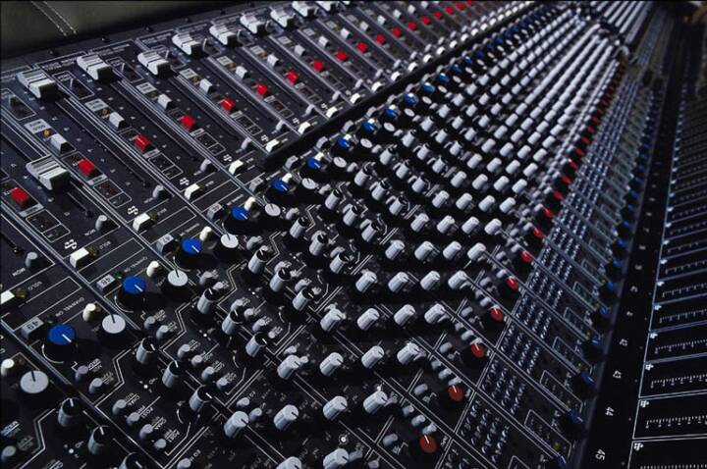
Part-IV : Filter Banks & Time-Frequency Transforms
Filter Bank Preliminaries
Filter Bank Design
Frequency Domain Filtering
Time-Frequency Analysis & Scaling
Chapter-11
Chapter-12
Chapter-13
Chapter-14

Slide 3
Overview
Time-Frequency Analysis
Short-time Fourier Transform (STFT)
Weighted OverLap-Add (WOLA)
Wavelet Analysis & Wavelet Filter Banks
Time/Frequency Scaling of Speech/Audio Signals
Problem Statement & Approaches
STFT-Based Time Scaling

Slide 4
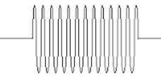
Short-Time Fourier Transform
Starting point is Discrete-Time Fourier Transform
= infinitely long sequence u[k] is evaluated at infinitely many frequencies
Inversion/reconstruction/synthesis (=filter bank jargon) is..
= u[k] represented as weighted sum of (orthogonal) basis functions
Notion of `spectrum that varies with time’ not accommodated
(e.g. `short lived sine’ will correspond to non-localized spectrum)

Slide 5
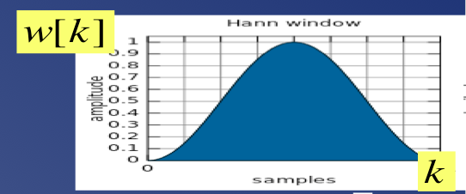
Short-Time Fourier Transform
Tool to fill this need = Short-Time Fourier Transform
Starting point is now…
where w[k] is your favorite window function
typically with `compact support’ (=FIR), e.g. …
Reversed (check formula) window slides past the data
For each window position k, compute Discrete-Time Fourier Transform
PS: If w[k]=1 (all k) then this is just Discrete-Time Fourier Transform, for all window positions

Slide 6
Short-Time Fourier Transform
Tool to fill this need = Short-Time Fourier Transform
Starting point is now…
Question: What would an inversion formula look like, here?
In the following slides, will provide a
filter bank derivation of STFT,
also leading to a simple
inversion formula (based on perfect reconstruction theory)

Slide 7
Short-Time Fourier Transform
First, rewrite formula as…
where the phase factor can effectively be removed
Interpretation-1: ‘windowed’ signal segment with window positioned at time k is shifted to
time zero (*) before computing discrete-time Fourier transform (DTFT) , so that the DTFT
indeed gets multiplied by
Interpretation-2: modulate window instead of input signal
So from now on will use

Slide 8
Short-Time Fourier Transform
This correspond to performing a convolution of u[k] with (infinitely many) filters
In practice, will compute this for a discrete set of (N) frequencies…
n=0,…,N-1
leading to a finite set of filters…
This is a DFT-modulated analysis bank (Chapter-12, p.14)
N channels, prototype defined by window function, with subband signals

Slide 9
Short-Time Fourier Transform
Hence, can use efficient implementation based on
polyphase decomposition of prototype Ho(z) (Chapter-12, p.17)
u[k]
freq.resolution N
window length/N

Slide 10
Short-Time Fourier Transform
In practice, mostly window length=freq.resolution=N
(=DFT-modulated FB with 1-tap polyphase components of prototype)
PS: also remember F⁻¹ (inverse DFT-matrix) is not very different from F (DFT-matrix) …
Will use this from now on...
u[k]
window length N
freq.resolution N

Slide 11
Short-Time Fourier Transform
In practice analysis is done only for k=0,D,2D,...
(i.e. decimation D = ‘window shift’ > 1)
If maximally decimated (D=N) then analysis FB operation
corresponds to Short-Time Fourier Transform (STFT)
xn[k] = decimated subband signals
= `STFT-coefficients’
= infinitely long sequence u[k] is
evaluated at N frequencies,
infinitely many times (i.e. for
infinitely many window positions)
...to be compared to p.4
u[k]
4
4
4
4

Slide 12
Short-Time Fourier Transform
Corresponding (PR) DFT-modulated synthesis FB is
i.e. synthesis prototype filter f_{o}[k]
= ‘synthesis window’
=
Synthesis FB operation then corresponds to Inverse STFT
...to be compared to p.4
4
4
+
4
+
4
+

Slide 13
Overview
Time-Frequency Analysis
Short-time Fourier Transform (STFT)
Weighted OverLap-Add (WOLA)
Wavelet Analysis & Wavelet Filter Banks
Time/Frequency Scaling of speech/audio signals
Problem Statement & Approaches
STFT-Based Time Scaling

Slide 14
Weighted OverLap-Add
Continued from p.12…
If oversampled (D=N/d), then analysis FB operation is
d=2,3,4,.. corresponds to decimation D (=window shift) of N/2, N/3, N/4,..
i.e. 50%, 66%, 75%,.. ‘window overlap’
Example: N=4, d=2, D=2
u[k]
u[k]
2
2
=
2
2
2
2

Slide 15
Weighted OverLap-Add
Example: N=4, d=2, D=2 (continued)
Corresponding (PR) synthesis filter bank (also DFT-modulated) is..
PR condition then defines synthesis window v_{k}
..which has many solutions. A usefull solution (see below) will be (**)

Slide 16
Weighted OverLap-Add
PR condition
can be generalized for other oversampling factors D=N/d
Synthesis FB operation corresponds to Inverse Transform
This analysis/synthesis is referred to as
Weighted OverLap-Add (WOLA)

Slide 17
Weighted OverLap-Add
A WOLA filter bank is often used for ‘subband processing’…
(a.k.a. ‘frequency domain processing’)
Example:
…where the scalar multipliers (A,BC,D) for instance result from a per-
subband noise reduction strategy (see Speech&Audio course)
Input-output characteristic then approximates
a linear time-invariant filtering
(better approximation with better (more frequency selective) analysis/synthesis filters)
…
u[k]
A
2
x
2
B
x
C
2
x
D
2
x
+

Slide 18
Weighted OverLap-Add
A WOLA filter bank is often used for ‘subband processing’…
(a.k.a. ‘frequency domain processing’)
A special case for d=2 (50% overlap) is the ‘overlap-save’...
…and ‘overlap-add’ filter bank
as used for frequency domain filter realizations (see Chapter 13)

Slide 19
Weighted OverLap-Add
Hence note that with an (unweighted) overlap-add (or –save) FB...
(despite the poor analysis/synthesis filter bank characteristics!)
…the subband processing with (e.g.) scalar multipliers (A,B,C,D) can be
made to correspond exactly to a linear time-invariant filtering,
iff the scalars jointly satisfy a specific condition (see Chapter 13)
u[k]
A
2
x
2
B
x
C
2
x
D
2
x
+

Slide 20
Overview
Time-Frequency Analysis
Short-time Fourier Transform (STFT)
Weighted OverLap-Add (WOLA)
Wavelet Analysis & Wavelet Filter Banks
Time/Frequency Scaling of speech/audio signals
Problem Statement & Approaches
STFT-Based Time Scaling

Slide 21
Wavelet Filter Banks & Wavelets
For some time-frequency analysis applications (e.g. in audio),
would like to have a non-uniform filter bank
(instead of the uniform DFT-modulated filter bank of STFT)
hence also with non-uniform (maximum) decimation, e.g…
Non-uniform filters = low frequency resolution at high frequencies, high frequency resolution at low frequencies (as human hearing)
Non-uniform decimation = high time resolution at high frequencies, low time resolution at low frequencies
H0(z)
8
u[k]
8
H0
H1
H2
H3
H1(z)
H2(z)
4
H3(z)
2

Slide 22
Wavelet Filter Banks & Wavelets
This can be built as a tree-structure, based on a
2-channel filter bank with
2
2
2
2
2
u[k]
2
(by applying Noble identities)
H0
H1
H2
H3

Slide 23
Wavelet Filter Banks & Wavelets
Similar synthesis bank can be constructed with
If and form a PR FB (delay δ=0), then the complete analysis/synthesis structure is PR (why?)
Example : `Haar’ wavelet (after Alfred Haar) (compare to 2-channel DFT)
2
2
+
2
2
+
2
2
+

Slide 24
Wavelet Filter Banks & Wavelets
Analysis bank corresponds to
Discrete-Time Wavelet Transform (DTWT)
With a corresponding (PR) synthesis filter bank, the reconstruction/synthesis formula (inverse DTWT) is
…to be compared to p.4 & p.11-12
x_{k}[n] = `DTWT-coefficients’

Slide 25
Wavelet Filter Banks & Wavelets
Reconstruction formula may be viewed as an expansion of u[k], using a set of basis functions (infinitely many)
If the 2-channel filter bank is paraunitary, then this basis is orthonormal (which is a desirable property) :
=`Orthonormal wavelet basis’

Slide 26
Wavelet Filter Banks & Wavelets
Not treated here…
`Continuous wavelet transform’ (CWT) of a continuous-time function u(t)
h(t)=prototype
p,q are real-valued continuous variables
p introduces `dilation’ of prototype, q introduces `shift’ of prototype
`Discrete wavelet transform’ (DWT) is CWT with discretized p,q
T is sampling interval
p-bar, q-bar are real-valued integer variables mostly a=2
Skip this slide

Slide 27
Overview
Time-Frequency Analysis
Short-time Fourier Transform (STFT)
Weighted OverLap-Add (WOLA)
Wavelet Analysis & Wavelet Filter Banks
Time/Frequency Scaling of speech/audio signals
Problem Statement & Approaches
STFT-Based Time Scaling

Slide 28
Time Scaling & Frequency Scaling
Time Scaling
Modify time domain attributes (tempo/duration) of a speech/audio signal, without modifying perceived frequency domain attributes (pitch), i.e. without introducing frequency distortion
Compression/expansion
Applications : movie post-synchronization (synchronization with
video signal), dictation (synchronization with typing speed),
fast rendering (e.g. in answering machines) ,…
Frequency Scaling (=‘dual’ problem)
Modify frequency domain attributes (pitch) of a speech/audio signal, without modifying perceived time domain attributes (tempo/duration)
A.k.a. `Pitch shifting’
Applications : games, karaoke, Doppler-effects in 3D audio…

Slide 29
Time Scaling & Frequency Scaling
Remember:
scaling with alpha in the time domain ~ scaling with 1/alpha in frequency domain
Hence straightforward scaling in the time or frequency domain does not provide a solution for the intended time or frequency scaling
PS: Continuous-time signal u’(t)=u(α.t) is obtained by α times faster (α>1) or slower (α<1) playback of u(t).
PS: Discrete-time signal (when sampling rate is to be kept constant and α can be non-integer) u’[k]=u[α.k] is obtained by re-sampling/digital interpolation of u[k] (ps: watch out for aliasing when α>1 !)
Will consider only Time Scaling. Frequency Scaling can then be done as follows: If u^(t) is a time-scaled version of u(t) (e.g. duration increased by factor α, frequency attributes unchanged), then u^(α.t) is a frequency-scaled version of u(t) (i.e. duration unchanged, frequency attributes scaled by α).

Slide 30
Time Scaling
Different approaches
Signal modeling based (`parametric’)
Example : speech production model (LPC), …
Not treated here
Time/Frequency-analysis based (`non-parametric’)
STFT-based
Wavelet transform based
…
Will consider STFT-based approach only…

Slide 31
Overview
Time-Frequency Analysis
Short-time Fourier Transform (STFT)
Weighted OverLap-Add (WOLA)
Wavelet Analysis & Wavelet Filter Banks
Time/Frequency Scaling of speech/audio signals
Problem Statement & Approaches
STFT-Based Time Scaling

Slide 32
STFT-Based Time Scaling
General procedure is…
1. Apply STFT to input signal u[k] (p.7, with (n,k) instead of (k,k) for clarity)
=estimates frequency content in neighborhood of n (for n € grid)
2. Apply time axis transformation
Will use simple transformation here…
3. Apply inverse STFT (to be defined)
PS: requires interpolation
⬅ if α.n is non-integer

Slide 33
STFT-Based Time Scaling
How to compute inverse STFT here?
Usually, parameters are chosen such that corresponds to an oversampled STFT (=WOLA)
In an oversampled STFT (p.14), the number of `subband samples’ is larger than number of full-band samples (=time-domain samples), hence STFT is `redundant’ and so not straightforwardly invertible…
In general, there does not exist any for which
is the STFT (for all n)
( ≈ overdetermined set of linear equations)
➔Compute `maximally close’ time-domain signal, in a
least squares sense !

Slide 34
STFT-Based Time Scaling
Least Squares Problem is…
Given
compute time-domain sequence with
such that
In words:
Compute a time-domain sequence such that its STFT
is optimally close to for all (i.e. summed over all) window
positions n € grid

Slide 35
STFT-Based Time Scaling
For each n € grid define as inverse DTFT(p.4) of
followed by a shift to time n
(to compensate for (*) p.7)
so that…
Then with…
the least-squares
criterion…
can be replaced by…
(=Parceval’s theorem)

Slide 36
STFT-Based Time Scaling
Now
which corresponds to a separate least-squares problem for each , i.e.
Least-squares solution is (see Chapter-8, p.7)

Slide 37
STFT-Based Time Scaling
In words: For each considered window position n € grid, compute inverse
Fourier transform of and shift to position n, resulting in
signals . Then u^[k] is a weighted sum of these sequences.
PS: Compare weights in this formula to (**) p.15 & try to establish link…!
PS: Procedure corresponds to STFT inversion if is a valid
STFT (then ) and (**) p.15 provides PR.

Slide 38
STFT-Based Time Scaling
Method-1: OLA synthesis (`overlap-add’)
Observe that Fourier- and inverse Fourier cancel each other…
This leads to simple time-domain (OLA) procedure:
w[k]
k
0
100
200
PS: requires interpolation if α.n is non-integer
0
50
100
k

Slide 39
STFT-Based Time Scaling
Method-1: Does not seem to work well, because repositioning of signal segments destroys time structure (phase relation) across segments (example : applying procedure to a pure sine, results in harmonic distortion)
Hence in practice variants are used…
Method-2: Only use magnitude information from STFT, add phase information based on an iterative procedure
Method-3: Synchronized OLA, `SOLA’
Reposition segments as in OLA, but then apply small additional re-alignment such that each re-aligned segment has maximum correlation with already formed portion of output signal (to restore phase relation across segments)
Method-4: Pitch-Synchronous OLA, `PSOLA’, …
Method-5: Waveform Similarity OLA, `WSOLA’, …
etc… (details omitted)

Slide 40
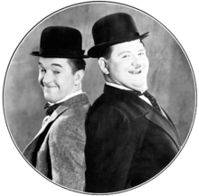
Last Slide

