Slide 1
DSP-CIS Part-IV : Filter Banks & Time-Frequency Transforms Chapter-13 : Frequency Domain Filtering
Marc Moonen
Dept. E.E./ESAT-STADIUS, KU Leuven
marc.moonen@kuleuven.be
www.esat.kuleuven.be/stadius/

Slide 2
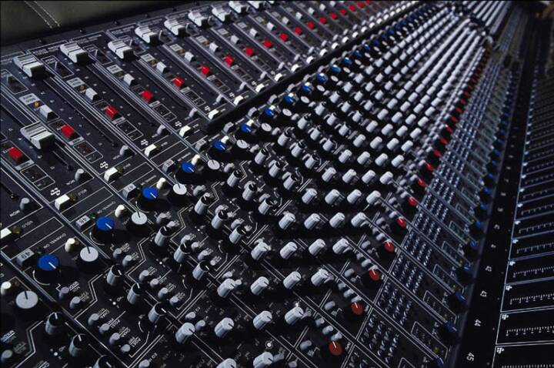
Part-IV : Filter Banks & Time-Frequency Transforms
Filter Bank Preliminaries
Filter Bank Design
Frequency Domain Filtering
Frequency Domain FIR Filter Realization
Frequency Domain Adaptive Filtering
Time-Frequency Analysis & Scaling
Chapter-11
Chapter-12
Chapter-13
Chapter-14

Slide 3
FIR Filter Realization
FIR Filter Realization
=Construct (realize) LTI system (with delay elements, adders and multipliers), such that I/O behavior is given by..
Several possibilities exist…
1. Direct form
2. Transposed direct form
3. Lattice realization (LPC lattice)
4. Lossless lattice realization
5. Frequency domain realization: see Part IV
Return to Chapter-5
For convenience, number of filter coefficients is now L instead of L+1
(…easier formulas)
⬅

Slide 4
Frequency Domain FIR Filter Realization
Have to know a theorem from linear algebra here:
A `circulant’ matrix is a matrix where each row is obtained from the
previous row using a right-shift (by 1 position),
the rightmost element which spills over is
circulated back to become the leftmost element
The eigenvalue decomposition of a circulant matrix is always given as...
(4x4 example)
with F the DFT-matrix. This means that the eigenvectors are equal to
the column-vectors of the IDFT-matrix, and that then eigenvalues are
obtained as the DFT of the first column of the circulant matrix (proof by Matlab)

Slide 5
Frequency Domain FIR Filter Realization
FIR Filter Realization (example L=4, similar for other L)
Consider a 'block processing’ where a block of L_{B} output
samples are computed at once, with ‘block length’ L_{B}=L:

Slide 6
Frequency Domain FIR Filter Realization
Now some matrix manipulation…

Slide 7
Frequency Domain FIR Filter Realization
This means that a block of L_{B}=L output samples can be computed as follows (read previous formula from right to left) :
Compute DFT of 2L input samples, i.e. last L samples combined (‘overlapped’) with previous L samples
Perform component-wise multiplication with…
(=freq.domain representation of the FIR filter)
Compute IDFT
Throw away 1st half of result, select (‘save’) 2nd half
This is referred to as an ‘overlap-save’ procedure
(and ‘frequency domain filter realization’ because of the DFT/IDFT)

Slide 8
Frequency Domain FIR Filter Realization
This corresponds to a filter bank-type realization as follows...
Analysis bank:
Subband processing:
Synthesis bank:
This is a 2L-channel filter bank, with L-fold downsampling
The analysis FB is a 2L-channel uniform DFT filter bank (see Chapter 11)
The synthesis FB is matched to the analysis bank, for PR:
4
4
u[k]
4
4
y[k]
+
4
4
4
4

Slide 9
Frequency Domain FIR Filter Realization
☺ Overlap-save procedure is very efficient for large L :
Computational complexity (with FFT/IFFT i.o. DFT/IDFT) is 2.[α.2L.log(2L)] + 2L multiplications for L output samples, i.e. O(log(L)) per sample for large L
Compare to computational complexity for direct form realization: L multiplications per output sample, i.e. O(L) per sample
☹ Overlap-save procedure introduces O(L) processing
delay/latency (e.g. y[k-L+1] only available sometime after time k)
Conclusion: For large L, complexity reduction is large, but latency is also large
Will derive ‘intermediate’ realizations, with a smaller latency at the expense of a smaller complexity reduction. This will be based on an N^{th} order polyphase decomposition of B(z)…

Slide 10
Frequency Domain FIR Filter Realization
A compact derivation will rely on a result from filter bank theory
(return to Chapter-11…)
(…and now let B(z) take the place of ‘distortion function’ T(z))
This means that a filter (specified with N-fold polyphase decomposition)
can be realized in a multirate structure, based on a
pseudo-circulant matrix
4
4
4
T(z)*u[k-3]
u[k]
4
+
4
4
4
4
PS: formulas given for N=4, for conciseness (but without loss of generality)

Slide 11
Frequency Domain FIR Filter Realization
Now some matrix manipulation… (compare to p.6)

Slide 12
Frequency Domain FIR Filter Realization
An (8-channel) filter bank representation of this is...
Analysis bank:
Subband processing:
Synthesis bank:
This is a 2N-channel filter bank, with N-fold downsampling (see Chapter 13)
The analysis FB is a 2N-channel DFT filter bank (see Chapter 11)
The synthesis FB is matched to the analysis bank, for PR:
4
4
u[k]
4
4
y[k]
+
4
4
4
4

Slide 13
Frequency Domain FIR Filter Realization
This is again known as an `overlap-save’ realization :
Analysis bank: performs 2N-point DFT (FFT) of a block of (N=4) samples, together with the previous block of (N) samples
(hence `overlap’)
Synthesis bank: performs 2N-point IDFT (IFFT), throws away the 1st half of the result, saves the 2nd half
(hence `save’)
Subband processing corresponds to `frequency domain’ operation
Complexity/latency? See p.16…
`block’
`previous block’
`throw away’
`save’

Slide 14
Frequency Domain FIR Filter Realization
Derivation on p.10 can also be modified as follows…

Slide 15
Frequency Domain FIR Filter Realization
This is known as an `overlap-add’ realization :
Analysis bank: performs 2N-point DFT (FFT) of a block of (N=4) samples, padded with N zero samples
Synthesis bank: performs 2N-point IDFT (IFFT), adds 2nd half
of the result to 1st half of previous IDFT
(hence `add’)
Subband processing corresponds to `frequency domain’ operation
`block’
`zero padding’
`overlap’
`add’

Slide 16
Frequency Domain FIR Filter Realization
Computational complexity is (with FFT/IFFT i.o. DFT/IDFT, plus subband processing) 2.[α.2N.log(2N)] + 2L multiplications for N output samples, i.e. O(log(N))+O(L/N) per sample
☺ For large N≈L this is O(log(L)) i.e. dominated by FFT/IFFT (cheap!)
☹ For N<<L this is O(L), i.e. dominated by subband processing
Processing delay/latency is O(N)
Standard `overlap-add’ and `overlap-save’(=p.7) realizations are derived when 0th order poly-phase components are used in the above derivation (N=L, i.e. each poly-phase component has only 1 filter coefficient). For large L, this leads to a large complexity reduction, but also a large latency (=O(L))
In the more general case, with higher-order polyphase components (N<L, i.e. each poly-phase component has >1 filter coefficients) a smaller complexity reduction is achieved, but the latency is also smaller (=O(N)).

Slide 17
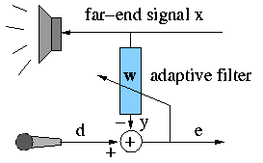
Frequency Domain Adaptive Filtering
A similar derivation can be made for LMS-based adaptive filtering with block processing ('Block-LMS'). The adaptive filter then consist in a filtering operation plus an adaptation operation, which corresponds to a correlation operation. Both operations can be performed cheaply in the frequency domain..
Starting point is the LMS update equation

Slide 18
Frequency Domain Adaptive Filtering
Consider block processing with so-called 'Block-LMS'
Remember that LMS is a ‘stochastic gradient’ algorithm, where instantaneous estimates of the autocorrelation matrix and cross-correlation vector are used to compute a gradient (=steepest descent vector)
Block-LMS uses averaged estimates, with averaging over a block of L_{B} (=‘block length’) samples, and hence an averaged gradient.
The update formula is then..
where n is the block index
Compared to LMS, Block-LMS does fewer updates (one per L_{B} samples), but with (presumably) better gradient estimates. Overall, convergence could be faster or slower (=unpredictable).
The important thing is that Block-LMS can be realized cheaply…

Slide 19
Frequency Domain Adaptive Filtering
Will consider case where block length L_{B} = filter length L
The update formulas are then given as follows
1) Compute a priori residuals (example L_{B}=L=4 , similar for other L)
=frequency domain filtering
with W_{i}=…

Slide 20
Frequency Domain Adaptive Filtering
Will consider case where block length L_{B} = filter length L
The update formulas are then given as follows
2) Filter update (example L_{B}=L=4 , similar for other L)
=frequency domain correlation
with E_{i}=…

Slide 21
Frequency Domain Adaptive Filtering
This is referred to as FDAF (’Frequency Domain Adaptive Filtering’)
FDAF is functionally equivalent to Block-LMS (but cheaper, see below)
Convergence: Instead of using one and the same stepsize μ for all ‘frequency bins’, frequency dependent stepsizes can be applied..
In the update formula, μ is removed and E_{i} is replaced by μ_{i}.E_{i}
Stepsize μ_{i} dependent on the energy in the i^{th} frequency bin
Leads to increased convergence speed at only a small extra cost

Slide 22
Frequency Domain Adaptive Filtering
This is referred to as FDAF (’Frequency Domain Adaptive Filtering’)
Complexity ≈ 5 (I)FFT’s (size 2L)
per block of L output samples (check!)
Hence for large L, FDAF is very efficient/cheap, only O(log(L)) multiplications per output sample (compared to O(L) for (Block-)LMS)
Example: L_{B}=L=1024, then !
Processing delay/latency is again O(L).
Example: L_{B}=L=1024 and f_{s}=8000Hz, then delay is 256 ms !
In cases where this is objectionable (e.g. acoustic echo cancellation), need ‘intermediate’ algorithms with smaller latency and smaller complexity reduction, based on a polyphase decomposition…(read on)

Slide 23
Frequency Domain Adaptive Filtering
For large L, a block length of L_{B}=L may lead to a too large latency
If an N^{th}order polyphase decomposition of the adaptive filter is considered (hence with L_{P}=L/N coefficients per polyphase component), then a frequency domain adaptive filtering algorithm with block length L_{B}=N can derived as follows... (where “N takes the place of L”)
Example L_{B}=N=4, i.e. (as on p.9)
with

Slide 24
Frequency Domain Adaptive Filtering
(compare to p.19-20)
The update formulas are given as follows
1) Compute a priori residuals (example L_{B}=N=4 , similar for other N)
with P^{i}_{j}=…

Slide 25
Frequency Domain Adaptive Filtering
(compare to p.18-19)
The update formulas are given as follows
2) Filter update (example L_{B}=N=4 , similar for other N)

Slide 26
Frequency Domain Adaptive Filtering
This is referred to as PB-FDAF
(’Partitioned Block Frequency Domain Adaptive Filtering’)
PB-FDAF is functionally equivalent to Block-LMS
Complexity ≈ 3+2.L_{P} (I)FFT’s (size 2N))
per block of N output samples (check!)
Example: L=1024, N=128, then !
Processing delay/latency is O(N).
Example: L=1024, N=128 and f_{s}=8000Hz, then delay is 32 ms
(used in commercial acoustic echo cancellers)

