Slide 1
DSP-CIS Part-IV : Filter Banks & Time-Frequency Transforms Chapter-12 : Filter Bank Design
Marc Moonen
Dept. E.E./ESAT-STADIUS, KU Leuven
marc.moonen@kuleuven.be
www.esat.kuleuven.be/stadius/

Slide 2
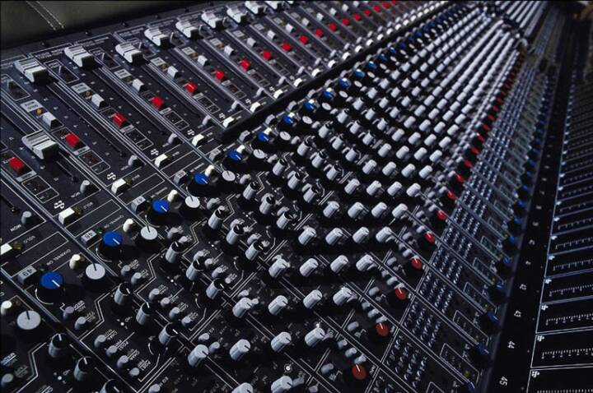
Part-IV : Filter Banks & Time-Frequency Transforms
Filter Bank Preliminaries
Filter Bank Set-Up
Filter Bank Applications
Ideal Filter Bank Operation
Non-Ideal Filter Banks: Perfect Reconstruction Theory
Filter Bank Design
Filter Bank Design Problem Statement
General Perfect Reconstruction Filter Bank Design
Maximally Decimated DFT-Modulated Filter Banks
Oversampled DFT-Modulated Filter Banks
Frequency Domain Filtering
Time-Frequency Analysis & Scaling
Chapter-11
Chapter-12
Chapter-13
Chapter-14

Slide 3
Filter Bank Design Problem Statement
Perfect Reconstruction (PR) condition (D=N and D<N)
(based on polyphase representation of analysis/synthesis bank))
D=4 N=6
4
4
4
4
u[k]
4
4
u[k-3]
+
4
4
4
4
4
4
Beautifully Simple!!
Will use this for Perfect Reconstruction Filter Bank (PR-FB) Design

Slide 4
Filter Bank Design Problem Statement
Two design targets :
✪ Filter specifications, e.g. stopband attenuation,
passband ripple, transition band, etc.
(for each (analysis) filter!)
✪ Perfect reconstruction (PR) property.
Challenge will be in addressing two design targets at once
(e.g. ‘PR only’ (without filter specs) is easy, see ex. Chapter-11)
PS: Can also do ‘Near-Perfect Reconstruction Filter Bank Design’, i.e. optimize filter specifications and at the same time minimize aliasing/distortion (=numerical optimization). Not covered here…

Slide 5
General PR-FB Design: Maximum Decimation (D=N)
(= N-by-N matrices)
Design Procedure:
1. Design all analysis filters (see Part-II).
2. This determines E(z) (=polyphase matrix).
3. Assuming E(z) can be inverted (?), synthesis filters are
(delta to make synthesis causal, see ex. p.7)
Will consider only FIR analysis filters, leading to simple polyphase decompositions (see Chapter-2)
However, FIR E(z) then generally leads to IIR R(z), where stability is a concern…

Slide 6
General PR-FB Design: Maximum Decimation (D=N)
PS: Inversion of matrix transfer functions ?…
The inverse of a scalar (i.e. 1-by-1 matrix) FIR transfer function is always IIR (except for contrived examples)
…but the inverse of an N-by-N (N>1) FIR transfer function can be FIR
PS: Compare this to inversion of integers and integer matrices
…but…

Slide 7
General PR-FB Design: Maximum Decimation (D=N)
all E(z)’s
Question:
Can we build FIR E(z)’s (N-by-N)
that have an FIR inverse?
Answer:
YES, `unimodular’ E(z)’s, i.e. matrices with determinant=constant*z^{d}
e.g.
where the El’s are constant (= not a function of z) invertible matrices
Design Procedure:
Optimize El’s to meet filter specs (ripple, etc.) for all analysis filters (at once)
FIR E(z)’s
FIR unimodular E(z)’s
= not-so-easy but DOABLE !

Slide 8
General PR-FB Design: Maximum Decimation (D=N)
An interesting special case of
this is obtained when the El’s
are orthogonal (=real) matrices
or unitary (=complex) matrices
E(z) and R(z) are then ‘paraunitary’ (definition omitted) and
the analysis and synthesis FB are said to be ‘paraunitary’ FBs
PS: Before proceeding compare formulas with lossless lattice realizations in Chapter-5…
all E(z)’s
FIR E(z)’s
FIR unimodular E(z)’s
FIR paraunitary E(z)’s

Slide 9
General PR-FB Design: Maximum Decimation (D=N)
Paraunitary PR-FBs have great properties: (proofs omitted)
If polyphase matrix E(z) is paranunitary, then
analysis filters are power complementary (=form lossless 1-input/N-output system)
(see Chapter 5)
Synthesis filters are obtained from analysis filters by conjugating the analysis filter coefficients + reversing the order
Hence magnitude response of synthesis filter Fn is the same as
magnitude response of corresponding analysis filter Hn
…and so synthesis filters are also power complementary

Slide 10
General PR-FB Design: Oversampled FBs (D<N)
Design Procedure:
1. Design all analysis filters (see Part-II).
2. This determines E(z) (=polyphase matrix).
3. Find R(z) such that PR condition is satisfied (how? read on…)
Will consider only FIR analysis filters, leading to simple polyphase decompositions (see Chapter-2)
It will turn out that when D<N an FIR R(z) can always be found (except in contrived cases)…
DxN
DxD
NxD
= easy if step-3 is doable…

Slide 11
General PR-FB Design: Oversampled FBs (D<N)
Given E(z) how can R(z) be computed?
Assume every entry in E(z) is L_{E}-th order FIR (i.e. L_{E} +1 coefficients)
Assume every entry in R(z) is L_{R}-th order FIR (i.e. L_{R} +1 coefficients)
Hence number of unknown coefficients in R(z) is D.N.(L_{R} +1)
Every entry in R(z).E(z) is (L_{E}+L_{R})-th order FIR (i.e. L_{E}+L_{R}+1 coefficients) (cfr. polynomial multiplication / linear convolution)
Hence PR condition is equivalent to D.D.(L_{E}+L_{R}+1) linear equations in the unknown coefficients (*)
Can be solved (except in contrived cases) if
➔
(*) Try to write down these equations!
DxN
DxD
NxD

Slide 12
General PR-FB Design: Oversampled FBs (D<N)
Given E(z) how can R(z) be computed?
(continued) …
Can be solved (except in contrived cases) if
➔
If D<N, then L_{R} can be made sufficiently large so that the (underdetermined) set of equations can be solved, i.e. an R(z) can be found (!).
Note that if D=N, then L_{R} in general has to be infinitely large, i.e. R(z) in general has to be IIR (see p.5)
DxN
DxD
NxD

Slide 13
DFT-Modulated FBs
- All design procedures so far involve monitoring of characteristics (passband ripple, stopband suppression,…) of all (analysis) filters, which may be tedious.
- Design complexity may be reduced through usage of
`uniform’ and `modulated‘ filter banks.
DFT-modulated FBs (read on..)
Cosine-modulated FBs (not covered, but interesting design!)
Will consider
Maximally decimated DFT-modulated FBs
Oversampled DFT-modulated FBs

Slide 14
Maximally Decimated DFT-Modulated FBs (D=N)
Uniform versus non-uniform (analysis) filter bank:
N-channel uniform FB:
i.e. frequency responses are uniformly shifted over the unit circle
Ho(z)= `prototype’ filter (=one and only filter that has to be designed)
Time domain equivalent is:
Non-uniform = everything that is not uniform
e.g. for speech & audio applications (cfr. human hearing)
N=4
H0(z)
uniform
H0
H1
H2
H3
IN
H1(z)
H2(z)
non-uniform
H0
H1
H2
H3
H3(z)

Slide 15
Maximally Decimated DFT-Modulated FBs (D=N)
Uniform filter banks can be realized cheaply based on
polyphase decompositions + DFT(FFT) (hence name `DFT-modulated FB)
1. Analysis FB
If
(N-fold polyphase decomposition)
then
N=4
H0(z)
u[k]
H1(z)
H2(z)
H3(z)
i.e.

Slide 16
Maximally Decimated DFT-Modulated FBs (D=N)
where F is NxN DFT-matrix
This means that filtering with the Hn’s can be implemented by first filtering with the polyphase components and then applying an inverse DFT
PS: To simplify formulas the factor N in N.F⁻¹ will be left out from now on
(i.e. absorbed in the polyphase components)
i.e.

Slide 17
Maximally Decimated DFT-Modulated FBs (D=N)
Conclusion: economy in…
Implementation complexity (for FIR filters):
N filters for the price of 1, plus inverse DFT (=FFT) !
Design complexity:
Design `prototype’ Ho(z), then other Hn(z)’s are
automatically `co-designed’ (same passband ripple, etc…) !
i.e.
u[k]
N=4

Slide 18
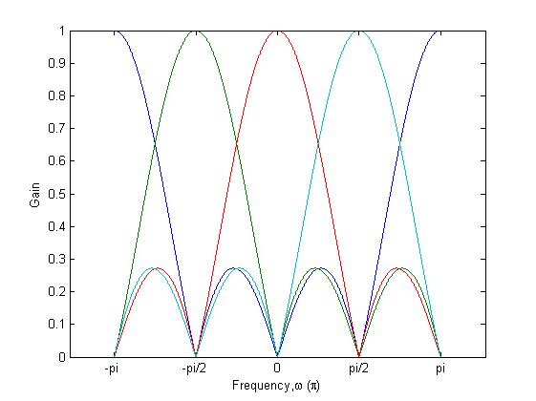
Maximally Decimated DFT-Modulated FBs (D=N)
Special case: DFT-filter bank, if all En(z)=1
Ho(z)
H1(z)
u[k]
N=4

Slide 19
Maximally Decimated DFT-Modulated FBs (D=N)
DFT-modulated analysis FB + maximal decimation
u[k]
N=4
4
4
4
4
u[k]
4
=
4
= efficient realization !
4
4

Slide 20
Maximally Decimated DFT-Modulated FBs (D=N)
2. Synthesis FB
N=4
+
+
phase shift added
for convenience
+
y[k]

Slide 21
Maximally Decimated DFT-Modulated FBs (D=N)
Similarly simple derivation then leads to…
N=4
+
+
+
y[k]

Slide 22
Maximally Decimated DFT-Modulated FBs (D=N)
Expansion + DFT-modulated synthesis FB :
N=4
4
4
+
4
+
4
+
y[k]
4
=
4
+
= efficient realization !
4
+
4
+
y[k]

Slide 23
Maximally Decimated DFT-Modulated FBs (D=N)
How to achieve Perfect Reconstruction (PR)
with maximally decimated DFT-modulated FBs?
Polyphase components of synthesis bank prototype filter are obtained by inverting polyphase components of analysis bank prototype filter
N=4
4
4
u[k]
4
+
4
4
4
+
4
4
+
y[k]

Slide 24
Maximally Decimated DFT-Modulated FBs (D=N)
N=4
4
4
u[k]
4
+
4
4
4
+
4
4
+
y[k]
Design Procedure:
1. Design prototype analysis filter Ho(z) (see Part-II).
2. This determines En(z) (=polyphase components).
3. Assuming all En(z)’s can be inverted (?), choose synthesis filters
Will consider only FIR prototype analysis filter, leading to simple polyphase decomposition (Chapter-2).
However, FIR En(z)’s generally again lead to IIR Rn(z)’s, where stability is a concern…

Slide 25
Maximally Decimated DFT-Modulated FBs (D=N)
This does not leave much design freedom…
FIR & Unimodular E(Z)? ..such that Rn(z) are also FIR
Only obtained when each E_{n}(z) is ‘unimodular’, i.e. E_{n}(z)=constant.z^{d}
Simple example is , where wn’s
are constants, which leads to `windowed’ IDFT/DFT bank, a.k.a. `short-time Fourier transform’ (see Chapter-14)
all E(z)’s
FIR E(z)’s
FIR unimodular E(z)’s
E(z)=F⁻¹.diag{..}

Slide 26
Maximally Decimated DFT-Modulated FBs (D=N)
This does not leave much design freedom…
FIR & Paraunitary E(Z)?
..such that Rn(z) are FIR + power complementary FB’s.
Only obtained when each E_{n}(z) is paraunitary (i.e. all-pass) (and FIR),
i.e. En(z)=±1.z^{d}.
i.e. only trivial modifications of IDFT/DFT filter bank !
all E(z)’s
FIR E(z)’s
FIR unimodular E(z)’s
FIR paraunitary E(z)’s
E(z)=F⁻¹.diag{..}

Slide 27
Maximally Decimated DFT-Modulated FBs (D=N)
Bad news: Not much design freedom for maximally decimated DFT-modulated FB’s…
Good news: More design freedom with...
Cosine-modulated FB’s (not covered, but interesting design!)
Po(z) is prototype lowpass filter, cutoff at for N filters
Then...
etc..
PS: Real-valued filter coefficients here!
Oversampled DFT-modulated FB’s (read on..)
P0
Ho
H1

Slide 28
Oversampled DFT-Modulated FBs (D<N)
In maximally decimated DFT-modulated FB, we had
(N-by-N matrices)
In oversampled DFT-modulated FB, will have
with B(z) (tall-thin) and C(z) (short-fat) structured/sparse matrices
Will give 2 examples in next slides, other cases are similar..
D=4 N=6
4
4
4
4
u[k]
4
4
u[k-3]
+
4
4
4
4
4
4

Slide 29
Oversampled DFT-Modulated FBs (D<N)
Example-1: #channels N = 8 analysis FB Ho(z),H1(z),…,H7(z)
decimation D = 4
prototype analysis filter Ho(z)
will consider N’-fold polyphase expansion, with
PS: A scale factor N will again absorbed in polyphase components (see p.16)
Should not try
to understand this…

Slide 30
Oversampled DFT-Modulated FBs (D<N)
Example-1: Define B(z)… and construct FB as…
Proof is simple…
u[k]
D=4 decimation
N=8 channels

Slide 31
Oversampled DFT-Modulated FBs (D<N)
Example-1: With 4-fold decimation, this is…
u[k]
4
4
4
4

Slide 32
Oversampled DFT-Modulated FBs (D<N)
Example-1: Synthesis FB is similarly derived…
where…
4
4
+
4
+
4
+
y[k]

Slide 33
Oversampled DFT-Modulated FBs (D<N)
Example-1: Perfect Reconstruction?
where…
4
4
u[k]
4
4
u[k-3]
+
4
4
4
4

Slide 34
Oversampled DFT-Modulated FBs (D<N)
Example-1: Perfect Reconstruction?
hence…
4
4
u[k]
4
4
u[k-3]
+
4
4
4
4

Slide 35
Oversampled DFT-Modulated FBs (D<N)
Example-1: Perfect Reconstruction?
Design Procedure :
Design FIR prototype analysis filter Ho(z)
This determines En(z) (=polyphase components)
Compute pairs of FIR Rn(z)’s (L_{R}+1 coefficients each) from pairs of FIR En(z)’s (L_{E}+1 coefficients each)
4
4
u[k]
4
4
u[k-3]
+
4
4
4
4
(*) L_{R}+L_{E}+1 equations in 2(L_{R}+1) unknowns
can be solved if L_{E}-1 ≤ L_{R}
(except in contrived cases)
= EASY !

Slide 36
Oversampled DFT-Modulated FBs (D<N)
Example-1: Perfect Reconstruction?
Design Procedure :
PS: If in addition (n=0,1,2,3) are
designed to be power complementary
(i.e. form a lossless 1 input/2 output system) then the
analysis and synthesis FB are paraunitary, i.e with
power complementary analysis filters and
power complementary synthesis filters (proof omitted)
4
4
u[k]
4
4
u[k-3]
+
4
4
4
4

Slide 37
Oversampled DFT-Modulated FBs (D<N)
Lossless 1-in/2-out
..that is
Design Procedure: Optimize parameters (=angles) of 4 (=D)
FIR lossless lattices (defining polyphase components of Ho(z) )
such that Ho(z) satisfies specifications.
p.30 =
u[k]
4
:
:
4
:
= not-so-easy but DOABLE !

Slide 38
Oversampled DFT-Modulated FBs (D<N)
Example-2 (non-integer oversampling) :
#channels N = 6 analysis filters Ho(z),H1(z),…,H5(z)
decimation D = 4
prototype analysis filter Ho(z)
will consider N’-fold polyphase expansion, with
Should not try
to understand this…

Slide 39
Oversampled DFT-Modulated FBs (D<N)
Example-2: Define B(z)… and construct FB as…
Proof is simple…
u[k]

Slide 40
Oversampled DFT-Modulated FBs (D<N)
Example-2: With 4-fold decimation, this is…
Synthesis FB R(z)=C(z).F similarly derived
PR conditions similarly derived, leading to undetermined sets of equations to compute synthesis prototype from analysis prototype (try it)
Paraunitary (power complementary) analysis and synthesis filter bank also possible (details omitted)
u[k]
4
4
4
4
= EASY !

