Slide 1
DSP-CIS Part-IV : Filter Banks & Time-Frequency Transforms Chapter-11 : Filter Bank Preliminaries
Marc Moonen
Dept. E.E./ESAT-STADIUS, KU Leuven
marc.moonen@kuleuven.be
www.esat.kuleuven.be/stadius/

Slide 2
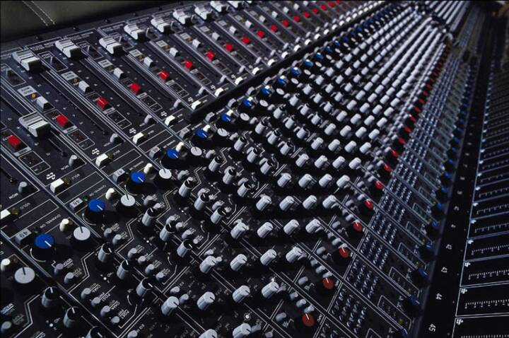
Part-IV : Filter Banks & Time-Frequency Transforms
Filter Bank Preliminaries
Filter Bank Set-Up
Filter Bank Applications
Ideal Filter Bank Operation
Non-Ideal Filter Banks: Perfect Reconstruction Theory
Filter Bank Design
Filter Bank Design Problem Statement
General Perfect Reconstruction Filter Bank Design
Maximally Decimated DFT-Modulated Filter Banks
Oversampled DFT-Modulated Filter Banks
Frequency Domain Filtering
Time-Frequency Analysis & Scaling
Chapter-11
Chapter-12
Chapter-13
Chapter-14

Slide 3
Filter Bank Set-Up
What we have in mind is this… :
- Signals split into frequency channels/subbands
- Per-channel/subband processing
- Reconstruction : synthesis of processed signal
- Applications : see below (audio coding etc.)
- In practice, this is implemented as a multi-rate structure for higher
efficiency (see next slides)
H0(z)
subband processing
IN
H1(z)
subband processing
OUT
+
H2(z)
subband processing
subband filters
H3(z)
subband processing
H0
H1
H2
H3

Slide 4
Filter Bank Set-Up
Step-1: Analysis filter bank
- Collection of N filters (`analysis filters’, `decimation filters’) with a
common input signal
- Ideal (but non-practical) frequency responses = ideal bandpass filters
- Typical frequency responses (overlapping, non-overlapping,…)
H0
H1
H2
H3
N=4
H0(z)
H0
H1
H2
H3
IN
H1(z)
H2(z)
H0
H1
H2
H3
H3(z)

Slide 5
Filter Bank Set-Up
Step-2: Decimators (downsamplers)
- To increase efficiency, subband sampling rate is reduced by factor D
(= Nyquist sampling theorem (for passband signals) )
- Maximally decimated filter banks (=critically downsampled):
# subband samples = # fullband samples
this sounds like maximum efficiency, but aliasing (see below)!
- Oversampled filter banks (=non-critically downsampled):
# subband samples > # fullband samples
D=N
D<N
N=4
D=3
H0(z)
3
IN
H1(z)
3
PS: analysis filters Hn(z) are now also
decimation/anti-aliasing filters
to avoid aliasing in subband signals
after decimation (see Chapter-2)
H2(z)
3
H3(z)
3

Slide 6
Filter Bank Set-Up
Step-3: Subband processing
- Example :
coding (=compression) + (transmission or storage) + decoding
- Filter bank design mostly assumes subband processing has `unit
transfer function’ (output signals=input signals), i.e. mostly ignores
presence of subband processing
N=4
D=3
H0(z)
3
subband processing
IN
H1(z)
3
subband processing
H2(z)
3
subband processing
H3(z)
3
subband processing

Slide 7
Filter Bank Set-Up
Step-4&5: Expanders (upsamplers) & synthesis filter bank
- Restore original fullband sampling rate by D-fold upsampling
- Upsampling has to be followed by interpolation filtering (to ‘fill the
zeroes’ & remove spectral images, see Chapter-2)
- Collection of N filters (`synthesis’, `interpolation’) with summed output
- Frequency responses : preferably `matched’ to frequency responses
of the analysis filters (see below)
F0
F1
F2
F3
N=4
D=3
H0(z)
3
subband processing
3
F0(z)
IN
3
subband processing
3
F1(z)
OUT
H1(z)
+
H2(z)
3
subband processing
3
F2(z)
H3(z)
3
subband processing
3
F3(z)

Slide 8
Filter Bank Set-Up
So this is the picture to keep in mind...
analysis bank
(analysis & anti-aliasing)
downsampling/decimation
upsampling/expansion
synthesis bank
(synthesis & interpolation)
N=4
D=3
H0(z)
3
subband processing
3
F0(z)
IN
3
subband processing
3
F1(z)
OUT
H1(z)
+
H2(z)
3
subband processing
3
F2(z)
H3(z)
3
subband processing
3
F3(z)

Slide 9
Filter Bank Set-Up
A crucial concept concept will be Perfect Reconstruction (PR)
Assume subband processing does not modify subband signals (e.g. lossless coding/decoding)
The overall aim would then be to have PR, i.e. that the output signal is equal to the input signal up to at most a delay: y[k]=u[k-d]
But: downsampling introduces aliasing, so achieving PR will be non-trivial
N=4
D=3
y[k]=u[k-d]?
H0(z)
3
output = input
3
F0(z)
u[k]
3
output = input
3
F1(z)
H1(z)
+
H2(z)
3
output = input
3
F2(z)
H3(z)
3
output = input
3
F3(z)

Slide 10
Filter Bank Applications
Subband coding :
Coding = Fullband signal split into subbands & downsampled
(=analysis filters + decimators)
subband signals separately encoded
(e.g. subband with smaller energy content encoded with fewer bits)
Decoding = reconstruction of subband signals, then fullband
signal synthesis (=expanders + synthesis filters)
Example : Image coding (e.g. wavelet filter banks)
Example : Audio coding
e.g. digital compact cassette (DCC), MiniDisc, MPEG, ...
Filter bandwidths and bit allocations chosen to further
exploit perceptual properties of human hearing
(perceptual coding, masking, etc.)

Slide 11
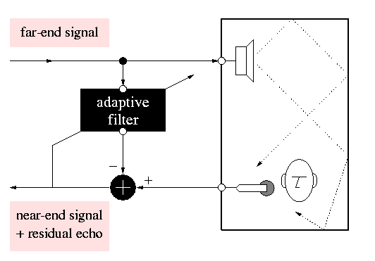
Filter Bank Applications
Subband adaptive filtering :
- Example : Acoustic echo cancellation
Adaptive filter models (time-varying) acoustic echo path and produces
a copy of the echo, which is then subtracted from microphone signal.
= Difficult problem !
✪ long acoustic impulse responses
✪ time-varying

Slide 12
Filter Bank Applications
- Subband filtering = N (simpler) subband modeling problems instead
of one (more complicated) fullband modeling problem
- Perfect Reconstruction (PR) guarantees distortion-free desired
near-end speech signal
N=4
D=3
H0(z)
3
ad.filter
H1(z)
3
ad.filter
H2(z)
3
ad.filter
H3(z)
3
ad.filter
H0(z)
3
+
3
F0(z)
3
3
F1(z)
OUT
H1(z)
+
+
H2(z)
3
+
3
F2(z)
H3(z)
3
+
3
F3(z)

Slide 13
Ideal Filter Bank Operation
With ideal analysis/synthesis filters, filter bank operates as follows (1)
H0(z)
H1(z)
H2(z)
H3(z)
analysis filters
IN
…
…
input signal spectrum
H0(z)
4
subband processing
4
F0(z)
OUT
IN
H1(z)
4
subband processing
4
F1(z)
+
H2(z)
4
subband processing
4
F2(z)
H3(z)
4
subband processing
4
F3(z)
(*) Similar figures for other D=N & for oversampled (D<N) case

Slide 14
Ideal Filter Bank Operation
With ideal analysis/synthesis filters, filter bank operates as follows (2)
H0(z)
H1(z)
H2(z)
H3(z)
x1
…
PS: H0(z) analysis filter
≈ lowpass anti-aliasing filter
…
x1
H0(z)
4
subband processing
4
F0(z)
OUT
IN
H1(z)
4
subband processing
4
F1(z)
+
H2(z)
4
subband processing
4
F2(z)
H3(z)
4
subband processing
4
F3(z)

Slide 15
Ideal Filter Bank Operation
With ideal analysis/synthesis filters, filter bank operates as follows (3)
x’1
…
…
(ideal subband processing)
x’1
x’1
H0(z)
4
subband processing
4
F0(z)
OUT
IN
H1(z)
4
subband processing
4
F1(z)
+
H2(z)
4
subband processing
4
F2(z)
H3(z)
4
subband processing
4
F3(z)

Slide 16
Ideal Filter Bank Operation
With ideal analysis/synthesis filters, filter bank operates as follows (4)
x”1
…
…
x”1
H0(z)
4
subband processing
4
F0(z)
OUT
IN
H1(z)
4
subband processing
4
F1(z)
+
H2(z)
4
subband processing
4
F2(z)
H3(z)
4
subband processing
4
F3(z)

Slide 17
Ideal Filter Bank Operation
With ideal analysis/synthesis filters, filter bank operates as follows (5)
F0(z)
F1(z)
F2(z)
F3(z)
PS: F0(z) synthesis filter
≈ lowpass interpolation filter
x’’’1
…
…
x’’’1
H0(z)
4
subband processing
4
F0(z)
OUT
IN
H1(z)
4
subband processing
4
F1(z)
+
H2(z)
4
subband processing
4
F2(z)
H3(z)
4
subband processing
4
F3(z)

Slide 18
Ideal Filter Bank Operation
With ideal analysis/synthesis filters, FB operates as follows (6)
H0(z)
H1(z)
H2(z)
H3(z)
x2
PS: H1(z) analysis filter
≈ bandpass anti-aliasing filter
…
…
H0(z)
4
subband processing
4
F0(z)
x2
OUT
IN
H1(z)
4
subband processing
4
F1(z)
+
H2(z)
4
subband processing
4
F2(z)
H3(z)
4
subband processing
4
F3(z)

Slide 19
Ideal Filter Bank Operation
With ideal analysis/synthesis filters, filter bank operates as follows (7)
x’2
…
H0(z)
4
subband processing
4
F0(z)
x’2
x’2
OUT
IN
H1(z)
4
subband processing
4
F1(z)
+
H2(z)
4
subband processing
4
F2(z)
H3(z)
4
subband processing
4
F3(z)

Slide 20
Ideal Filter Bank Operation
With ideal analysis/synthesis filters, filter bank operates as follows (8)
IN
x”2
…
…
H0(z)
4
subband processing
4
F0(z)
x”2
OUT
IN
H1(z)
4
subband processing
4
F1(z)
+
H2(z)
4
subband processing
4
F2(z)
H3(z)
4
subband processing
4
F3(z)

Slide 21
Ideal Filter Bank Operation
With ideal analysis/synthesis filters, filter bank operates as follows (9)
F0(z)
F1(z)
F2(z)
F3(z)
x”’2
…
PS: F1(z) synthesis filter
≈ bandpass interpolation filter
…
H0(z)
4
subband processing
4
F0(z)
x”’2
OUT
IN
H1(z)
4
subband processing
4
F1(z)
+
H2(z)
4
subband processing
4
F2(z)
H3(z)
4
subband processing
4
F3(z)

Slide 22
Ideal Filter Bank Operation
With ideal analysis/synthesis filters, filter bank operates as follows (10)
OUT=IN
=Perfect Reconstruction
…
…
H0(z)
4
subband processing
4
F0(z)
OUT
IN
H1(z)
4
subband processing
4
F1(z)
+
H2(z)
4
subband processing
4
F2(z)
H3(z)
4
subband processing
4
F3(z)
Now try this with non-ideal filters…?

Slide 23
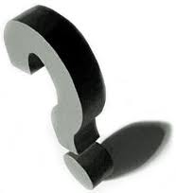
Non-Ideal Filter Bank Operation
Question :
Can y[k]=u[k-d] be achieved with non-ideal filters
i.e. in the presence of aliasing ?
Answer :
YES !! Perfect Reconstruction Filter Banks (PR-FB)
with synthesis bank designed to remove aliasing effects !
N=4
D=3
y[k]=u[k-d]?
H0(z)
3
output = input
3
F0(z)
u[k]
3
output = input
3
F1(z)
H1(z)
+
H2(z)
3
output = input
3
F2(z)
H3(z)
3
output = input
3
F3(z)

Slide 24
Non-Ideal Filter Bank Operation
A very simple PR-FB is constructed as follows
- Starting point is this…
As y[k]=u[k-d] this can be viewed as a (1st) (maximally decimated) PR-FB
(with lots of aliasing in the subbands!)
All analysis/synthesis filters are seen to be pure delays,
hence are not frequency selective (i.e. far from ideal
case with ideal bandpass filters, not yet very interesting….)
0,0,0,u[0],0,0,0,u[4],0,0,0,...
0,0,u[-1],0,0,0,u[3],0,0,0,0,...
4
4
4
4
u[k]
+
u[k-3]
4
4
4
4
0,u[-2],0,0,0,u[2],0,0,0,0,0,...
u[-3],0,0,0,u[1],0,0,0,0,0,0,...
(*) Similar figures for other D=N

Slide 25
Non-Ideal Filter Bank Operation
- Now insert DFT-matrix (discrete Fourier transform)
and its inverse (I-DFT)...
as this clearly does not change the input-output relation (hence PR property preserved)
4
4
u[k]
4
4
u[k-3]
+
4
4
4
4
⬆
⬆

Slide 26
Non-Ideal Filter Bank Operation
- …and reverse order of decimators/expanders and DFT-matrices (not done in an efficient implementation!) :
=analysis filter bank =synthesis filter bank
This is the `DFT/IDFT filter bank’
It is a first (or 2nd) example of a (maximally decimated) PR-FB!
4
4
u[k]
4
4
u[k-3]
+
4
4
4
4

Slide 27
Non-Ideal Filter Bank Operation
What do analysis filters look like? (N-channel case)
This is seen/known to represent a collection of filters Ho(z),H1(z),...,
each of which is a frequency shifted version of Ho(z) :
i.e. the Hn are obtained by uniformly shifting the `prototype’ Ho over the
frequency axis.
N=4
u[k]

Slide 28
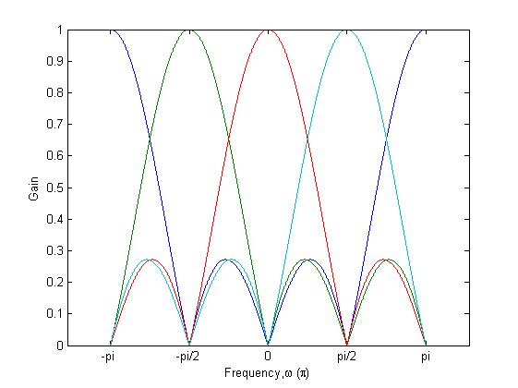
Non-Ideal Filter Bank Operation
The prototype filter Ho(z) is a not-so-great
lowpass filter with significant sidelobes.
Ho(z) and Hi(z)’s are thus far from ideal
lowpass/bandpass filters.
Synthesis filters are shown to be equal to analysis filters (up to a scaling)
Hence (maximal) decimation introduces
significant ALIASING in the decimated
subband signals
Still, we know this is a PR-FB (see construction previous slides), which means the synthesis filters can apparently restore the aliasing distortion.
This is remarkable, it means PR can be achieved even with non-ideal filters!
H2(z)
H3(z)
Ho(z)
H1(z)
N=4

Slide 29
Perfect Reconstruction Theory
Now comes the hard part…(?)
2-channel case:
Simple (maximally decimated, D=N) example to start with…
✪ N-channel case:
Polyphase decomposition based approach

Slide 30
Perfect Reconstruction : 2-Channel Case
It is proved that... (try it!)
U(-z) represents aliased signals (*), hence A(z) is referred to as `alias transfer function’
T(z) referred to as `distortion function’ (amplitude & phase distortion) Note that T(z) is also the transfer function obtained after removing the up- and downsampling (up to a scaling) (!)
y[k]
u[k]
H0(z)
2
2
F0(z)
+
H1(z)
2
2
F1(z)

Slide 31
Perfect Reconstruction : 2-Channel Case
Requirement for `alias-free’ filter bank :
If A(z)=0, then Y(z)=T(z).U(z)
hence the complete filter bank behaves as a LTI system
(despite/without up- & downsampling)!
Requirement for `perfect reconstruction’ filter bank
(= alias-free + distortion-free):
y[k]
u[k]
H0(z)
2
2
F0(z)
+
H1(z)
2
2
F1(z)

Slide 32
Perfect Reconstruction : 2-Channel Case
A solution is as follows: (ignore details) [Smith&Barnwell 1984] [Mintzer 1985]
i)
so that (alias cancellation)
ii) `power symmetric’ Ho(z) (real coefficients case)
iii)
so that (distortion function) ignore the details!
This is a so-called`paraunitary’ perfect reconstruction bank (see below),
based on a lossless system Ho,H1 :
☺
☺
This is already pretty complicated…

Slide 33
Perfect Reconstruction : N-Channel Case
D=N=4
It is proved that... (try it!)
2nd term represents aliased signals, hence all `alias transfer functions’ An(z) should ideally be zero (for all n=1..N-1)
T(z) is referred to as `distortion function’ (amplitude & phase distortion). For perfect reconstruction, T(z) should be a pure delay
H0(z)
4
4
F0(z)
u[k]
H1(z)
4
4
F1(z)
y[k]
+
H2(z)
4
4
F2(z)
H3(z)
4
4
F3(z)
Sigh !!…Too Complicated!!...

Slide 34
Perfect Reconstruction Theory
A simpler analysis results from a polyphase description :
n-th row of E(z) has N-fold (=D-fold)
polyphase components of Hn(z)
n-th column of R(z) has N-fold
polyphase components of Fn(z)
D=N=4
4
4
u[k]
4
4
u[k-3]
+
4
4
4
4
Do not continue until you understand how formulae correspond to block scheme!

Slide 35
Perfect Reconstruction Theory
With the `noble identities’, this is equivalent to:
Necessary & sufficient conditions for
i) alias cancellation
ii) perfect reconstruction
are then derived, based on the product
D=N=4
4
4
u[k]
4
4
u[k-3]
+
4
4
4
4

Slide 36
Perfect Reconstruction Theory
D=N=4
i) Necessary & sufficient condition for alias-free FB is…:
a pseudo-circulant matrix is a circulant matrix with the additional feature
that elements below the main diagonal are multiplied by 1/z, i.e.
& then 1st row of R(z).E(z) are polyphase cmpnts of `distortion function’ T(z)
4
4
u[k]
4
4
u[k-3]
+
4
4
4
4
D=N=4
Read on ➔

Slide 37
Perfect Reconstruction Theory
This can be verified as follows:
First, previous block scheme is equivalent to (cfr. Noble identities)
Then (iff R.E is pseudo-circ.)…
So that finally..
Read on ➔
D=N=4
4
4
u[k]
4
4
+
4
4
4
4
D=N=4
4
4
4
4
T(z)*u[k-3]
+
4
4
u[k]
4
4

Slide 38
Perfect Reconstruction Theory
D=N=4
ii) Necessary & sufficient condition for PR is then…
(i.e. where T(z)=pure delay, hence pr(z)=pure delay=z^{-δ}, and all other pn(z)=0)
In is nxn identity matrix, r is arbitrary
Example (r=0) : for conciseness, will
use this from now on !
➔ PR-FB design in chapter-12
4
4
u[k]
4
4
u[k-3]
+
4
4
4
4
Beautifully simple!! (compared to page 33)

Slide 39
Perfect Reconstruction Theory
A similar PR condition can be derived for oversampled FBs
The polyphase description (compare to p.34) is then…
n-th row of E(z) has D-fold
polyphase components of Hn(z)
n-th column of R(z) has D-fold
polyphase components of Fn(z)
D=4 N=6
4
4
4
4
u[k]
4
4
u[k-3]
+
4
4
4
4
4
4
Note that E is an N-by-D (‘tall-thin’) matrix, R is a D-by-N (‘short-fat’) matrix !

Slide 40
Perfect Reconstruction Theory
Simplified (r=0 on p.38) condition for PR is then…
In the D=N case (p.38), the PR condition has a product of square matrices. PR-FB design (Chapter 11) will then involve matrix inversion, which is mostly problematic.
In the D<N case, the PR condition has a product of a ‘short-fat’ matrix and a ‘tall-thin’ matrix. This will lead to additional PR-FB design flexibility (see Chapter 12).
D=4 N=6
4
4
4
4
u[k]
4
4
u[k-3]
+
4
4
4
4
4
4
DxN
DxD
NxD
Again beautifully simple!! (compared to page 33)

