Slide 1
DSP-CIS
Part-III : Optimal & Adaptive Filters
Chapter-10 : Kalman Filters
Marc Moonen
Dept. E.E./ESAT-STADIUS, KU Leuven
marc.moonen@kuleuven.be
www.esat.kuleuven.be/stadius/

Slide 2

Part-III : Optimal & Adaptive Filters
Chapter-7
Optimal Filters - Wiener Filters
        Introduction : General Set-Up & Applications
        Wiener Filters
        Adaptive Filters - LMS & RLS
        Least Means Squares (LMS) Algorithm
        Recursive Least Squares (RLS) Algorithm
        Square Root & Fast RLS Algorithms
        Square Root Algorithms
        Fast Algorithms
      Kalman Filters
        Introduction – Least Squares Parameter Estimation
        Standard Kalman Filter
        Square-Root Kalman Filter
Chapter-8
Chapter-9
Chapter-10

Slide 3
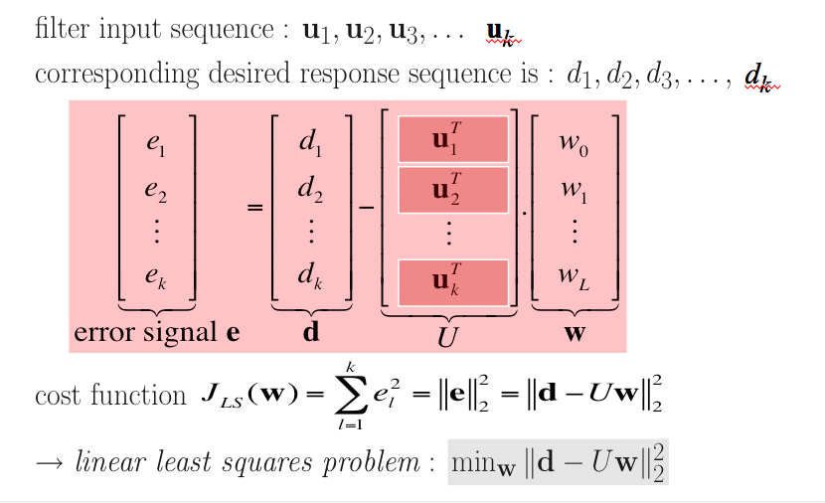
Introduction: Least Squares Parameter Estimation
In Chapter-9, have introduced ‘Least Squares’ estimation as an alternative
(=based on observed data/signal samples) to optimal filter design
(=based on statistical information)…
➔

Slide 4
Introduction: Least Squares Parameter Estimation
Given…
k vectors of input variables (=‘regressors’)
k corresponding observations of a dependent variable
and assume a
linear regression/observation model
where w⁰ is an unknown parameter vector (=‘regression coefficients’)
and e_{l} is unknown additive noise
Then…
the aim is to estimate wº
Least Squares (LS) estimate is (see previous page for definitions of U and d)
‘Least Squares’ approach is also used in parameter estimation in a linear regression model, where the problem statement is as follows…
➔

Slide 5
Introduction: Least Squares Parameter Estimation
If the input variables u_{l} are given/fixed (*) and the additive noise e is a random vector with zero-mean
then the LS estimate is ‘unbiased’ i.e.
If in addition the noise e has unit covariance matrix then the (estimation) error covariance matrix is
(*) Input variables can also be random variables, possibly correlated with the additive
noise, etc... Also regression coefficients can be random variables, etc…etc...
All this not considered here.

Slide 6
Introduction: Least Squares Parameter Estimation
The Mean Squared Error (MSE) of the estimation is
PS: This MSE is different from the one in Chapter-7, check formulas
Under the given assumptions, it is shown that amongst all linear estimators, i.e. estimators of the form
(=linear function of d)
the LS estimator (with Z=(U^{T}U)⁻¹U^{T} and z=0) mimimizes the MSE
i.e. it is the Linear Minimum MSE (MMSE) estimator
Under the given assumptions, if furthermore e is a Gaussian distributed random vector, it is shown that the LS estimator is also the (‘general’, i.e. not restricted to ‘linear’) MMSE estimator.
Optional reading: https://en.wikipedia.org/wiki/Minimum_mean_square_error

Slide 7
Introduction: Least Squares Parameter Estimation
PS1: If noise e is zero-mean with non-unit covariance matrix
where V^{1/2} is the lower triangular Cholesky factor (‘square root’),
the Linear MMSE estimator & error covariance matrix are
which corresponds to the LS estimator for the so-called
pre-whitened observation model
where the additive noise is indeed white..
Example: If V=σ².I then w^ =(U^{T}U)⁻¹U^{T} d with error covariance matrix σ².(U^{T}U)⁻¹

Slide 8
Introduction: Least Squares Parameter Estimation
PS2: If an initial estimate is available (e.g. from previous observations) with error covariance matrix
where P^{1/2} is the lower triangular Cholesky factor (‘square root’),
the Linear MMSE estimator & error covariance matrix are
which corresponds to the LS estimator for the model
Example: P⁻¹=0 corresponds to ∞ variance of the initial estimate, i.e. back to p.7

Slide 9
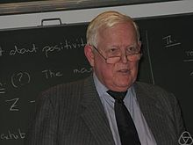
Introduction: Least Squares Parameter Estimation
A Kalman Filter also solves a parameter estimation problem, but now the parameter vector is dynamic instead of static, i.e. changes over time
The time-evolution of the parameter vector is described by the ‘state equation’ in a state-space model, and the linear regression model of p.4 then corresponds to the ‘output equation’ of the state-space model (details in next slides..)
In the next slides, the general formulation
of the (Standard) Kalman Filter is given
In p.16 it is seen how this relates to
Least Squares estimation
Kalman Filters are used everywhere! (aerospace, economics, manufacturing, instrumentation, weather forecasting, navigation, …)
Rudolf Emil Kálmán (1930 -2016 )

Slide 10
Standard Kalman Filter
State space model
of a time-varying discrete-time system
(PS: can also have multiple outputs)
where v[k] and w[k] are mutually uncorrelated, zero mean, white noises
state vector
input signal vector
process noise
state equation
output equation
output signal
measurement noise

Slide 11
Standard Kalman Filter
Example: IIR filter
State space model is
(no process/measurement noise here)
u[k]
+
+
+
+
-a1
-a2
-a3
-a4
x
x
x
x
x₁[k]
x₂[k]
x₃[k]
x₄[k]
bo
b1
b2
b3
b4
x
x
x
x
x
+
+
+
+
y[k]

Slide 12
Standard Kalman Filter
State estimation problem
Given… A[k], B[k], C[k], D[k], V[k], W[k], k=0,1,2,... and input/output observations u[k],y[k], k=0,1,2,...
Then… estimate the internal states x[k], k=0,1,2,...
state vector

Slide 13
Standard Kalman Filter
Definition: = Linear MMSE-estimate of xk using all
available data up until time l
`FILTERING’ = estimate
`PREDICTION’ = estimate
`SMOOTHING’ = estimate
PS: will use shorthand notation xk, yk ,.. instead of x[k], y[k],.. from now on

Slide 14
Standard Kalman Filter
The ‘Standard Kalman Filter’ (or ‘Conventional Kalman Filter’)
operation @ time k (k=0,1,2,..) is as follows:
Given a prediction of the state vector @ time k
based on previous observations (up to time k-1)
with corresponding error covariance matrix
Step-1: Measurement Update
=Compute an improved (filtered) estimate
based on ‘output equation’ @ time k (=observation y[k])
Step-2: Time Update
=Compute a prediction of the next state vector
based on ‘state equation’

Slide 15
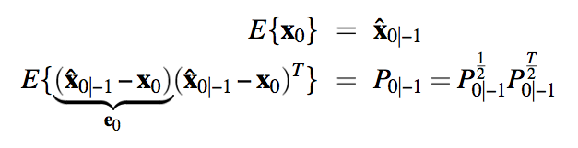
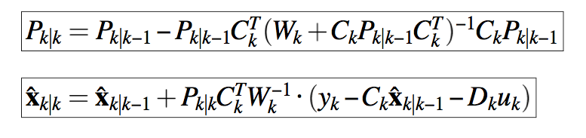
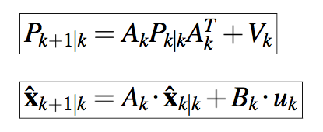
Standard Kalman Filter
The ‘Standard Kalman Filter’ formulas are as follows (without proof)
Initalization:
For k=0,1,2,…
Step-1: Measurement Update
Step-2: Time Update
⬅compare to standard RLS!
(consider W_{k}=1)
⬅Try to derive this from state equation

Slide 16
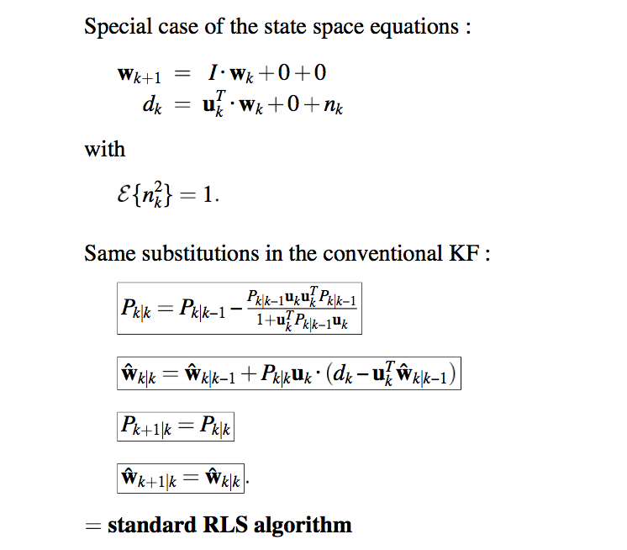
Standard Kalman Filter
PS: ‘Standard RLS’ is a special case of ‘Standard KF’
⬅
Internal state vector is FIR filter
coefficients vector, which is
assumed to be time-invariant
} ‘void’

Slide 17
Standard Kalman Filter
PS: ‘Standard RLS’ is a special case of ‘Standard KF’
Standard RLS is not numerically stable (see Chapter-8),
hence (similarly) the Standard KF is not numerically stable
(i.e. finite precision implementation diverges from infinite precision implementation)
Will therefore again derive an alternative
Square-Root Algorithm
which can be shown to be numerically stable
(i.e. distance between finite precision implementation and infinite precision implementation is bounded)

Slide 18
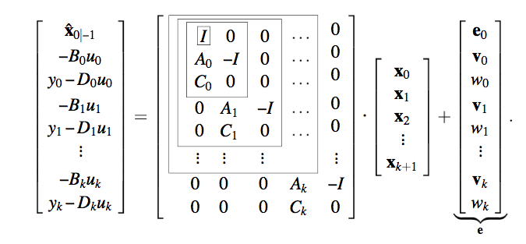
Square-Root Kalman Filter
The state estimation/prediction @ time k corresponds to a parameter estimation problem in a linear regression model (p.4), where the parameter vector contains all previous state vectors…

Slide 19
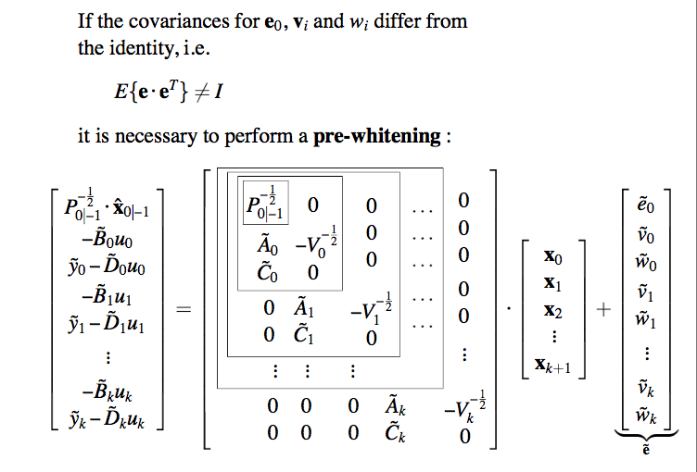
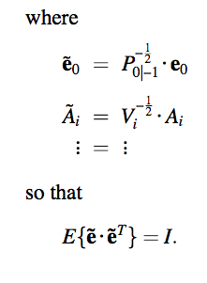
Square-Root Kalman Filter
⬅compare to p.7
Similar derivation, but not considered here for clarity…
(i.e. stick to previous page)

Slide 20
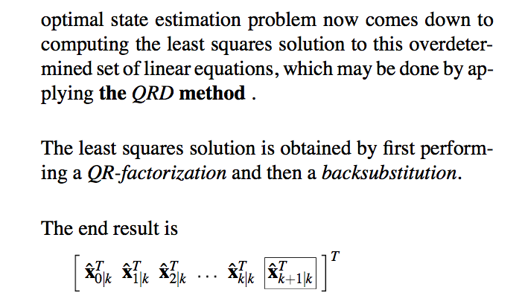
Square-Root Kalman Filter
Linear MMSE
explain subscript

Slide 21
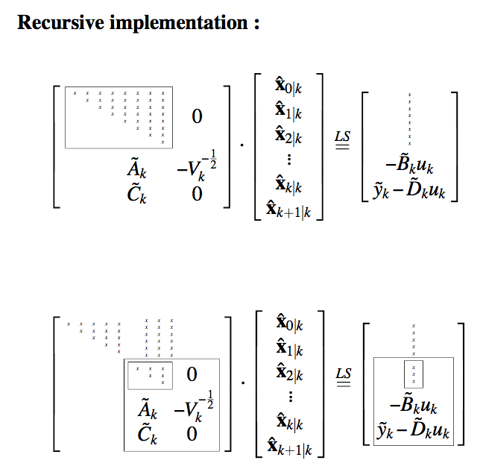

Square-Root Kalman Filter
Triangular factor & right-hand side propagated from time k-1 to time k
is then developed as follows
⬅
..hence requires only lower-right/lower part ! (explain)

Slide 22
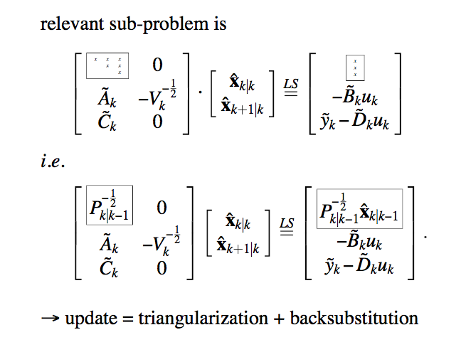
Square-Root Kalman Filter
Propagated from
time k-1 to time k
⬅
compare to p.8➔

Slide 23
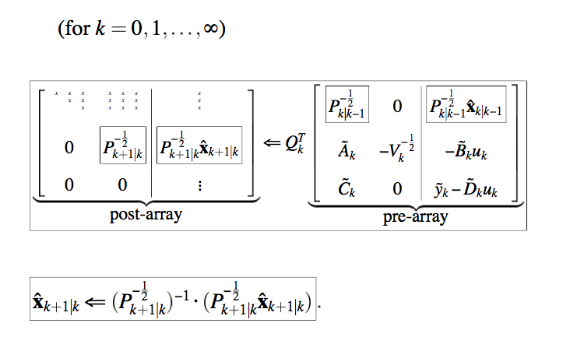
Square-Root Kalman Filter
Final algorithm is as follows:
Propagated from
time k-1 to time k
Propagated from
time k to time k+1
⬅
⬅
⬅
⬅
⬅backsubstitution

Slide 24
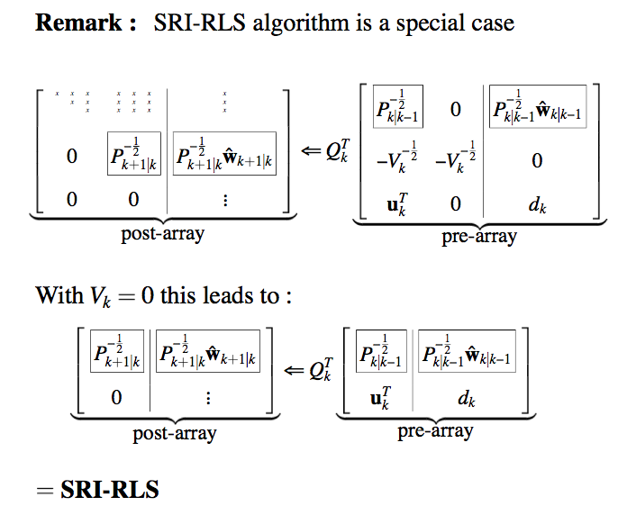
Square-Root Kalman Filter
QRD-
of square-root KF
See p.16 and 19
=QRD-

Slide 25
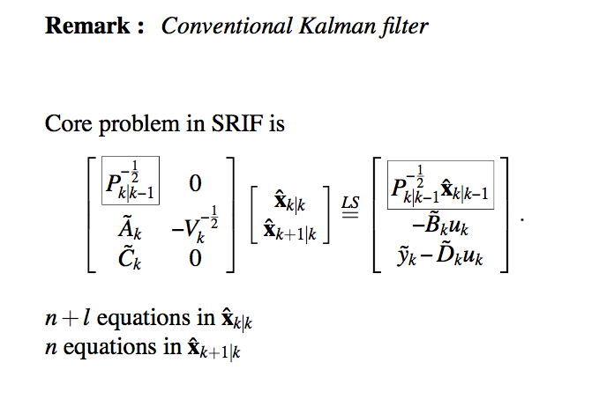
Standard Kalman Filter (revisited)
can be derived from square-root KF equations
is .
: can be worked into measurement update eq.
: can be worked into state update eq.
[details omitted]

