Slide 1
DSP-CIS
Part-III : Optimal & Adaptive Filters
Chapter-10 : Kalman Filters
Marc Moonen
Dept. E.E./ESAT-STADIUS, KU Leuven
marc.moonen@kuleuven.be
www.esat.kuleuven.be/stadius/

Slide 2

Part-III : Optimal & Adaptive Filters
Chapter-7
Optimal Filters - Wiener Filters
        Introduction : General Set-Up & Applications
        Wiener Filters
        Adaptive Filters - LMS & RLS
        Least Means Squares (LMS) Algorithm
        Recursive Least Squares (RLS) Algorithm
        Square Root & Fast RLS Algorithms
        Square Root Algorithms
        Fast Algorithms
      Kalman Filters
        Introduction – Least Squares Parameter Estimation
        Kalman Filter Basics
        Kalman Filter Algorithms
Chapter-8
Chapter-9
Chapter-10

Slide 3
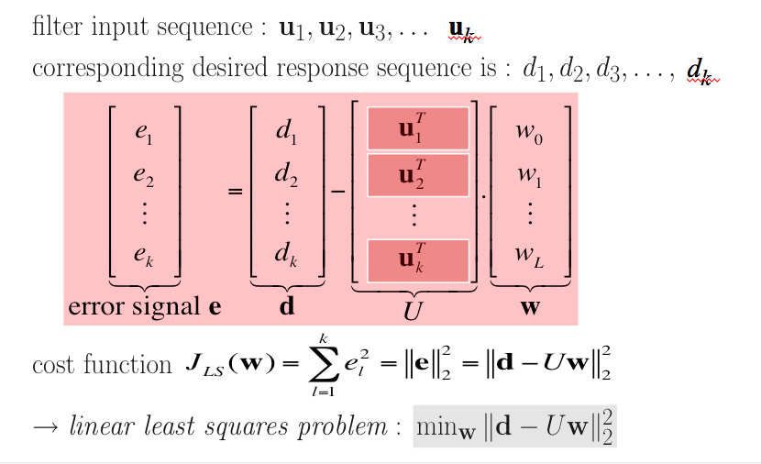
Introduction: Least Squares Parameter Estimation
In Chapter-9, have introduced ‘Least Squares’ estimation as an alternative
(=based on observed data/signal samples) to optimal filter design
(=based on statistical information)…
➔

Slide 4
Introduction: Least Squares Parameter Estimation
Given…
k vectors of input variables (=‘regressors’)
k corresponding observations of a dependent variable
and assume a
linear regression/observation model =
where w⁰ is an unknown parameter vector (=‘regression coefficients’)
and e is unknown additive observation/measurement noise
(see p.3 for definition of U and d)
Then the aim is to estimate wº
Q: Can Least Squares (LS) estimate be reused here?
‘Least Squares’ approach is also used in parameter estimation in a
linear regression model, where the problem statement is as follows…
➔

Slide 5
Introduction: Least Squares Parameter Estimation
If the input variables u_{l} are given/fixed (*) and the additive noise e is a random vector with zero-mean
then the LS estimate is ‘unbiased’ i.e.
If in addition the noise e has unit covariance matrix then the (estimation) error covariance matrix is
(*) Input variables can also be random variables, possibly correlated with the additive
noise, etc... Also regression coefficients can be random variables, etc…etc...
All this not considered here.
✪

Slide 6
Introduction: Least Squares Parameter Estimation
The Mean Squared Error (MSE) of the estimation is defined as
PS: This MSE is different from the one in Chapter-7, check formulas
Under the given assumptions, it is shown that amongst all linear estimators, i.e. estimators of the form
(=linear function of d)
the LS estimator (with Z=(U^{T}U)⁻¹U^{T} and z=0) mimimizes the MSE
i.e. it is the Linear Minimum MSE (MMSE) estimator
Under the given assumptions, if furthermore e is a Gaussian distributed random vector, it is shown that the LS estimator is also the (‘general’, i.e. not restricted to ‘linear’) MMSE estimator
Optional reading: https://en.wikipedia.org/wiki/Minimum_mean_square_error

Slide 7
Introduction: Least Squares Parameter Estimation
PS: If noise e is zero-mean with non-unit covariance matrix
where V^{1/2} is the upper triangular Cholesky factor (‘square root’)
the Linear MMSE estimator & error covariance matrix are
which corresponds to the LS estimator for the so-called
pre-whitened observation model
where the additive noise is indeed white..
Example: If V=σ².I then w^ =(U^{T}U)⁻¹U^{T} d with error covariance matrix σ².(U^{T}U)⁻¹

Slide 8
Introduction: Least Squares Parameter Estimation
PS: If an initial estimate is available (e.g. from previous observations) with error covariance matrix
where P^{1/2} is the upper triangular Cholesky factor (‘square root’),
the Linear MMSE estimator & error covariance matrix are
which corresponds to the LS estimator for the model
Example: P⁻¹=0 corresponds to ∞ variance of the initial estimate, i.e. back to p.7

Slide 9
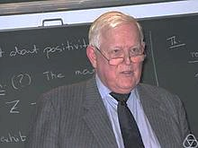
Kalman Filter Basics
A Kalman Filter also solves a parameter estimation problem, but now the parameter vector is dynamic instead of static, i.e. changes over time
The time-evolution of the parameter vector is described by the ‘state equation’ in a state-space model, and the linear regression model of p.4 then corresponds to the ‘output equation’ of the state-space model (details in next slides..)
In the next slides, the general
Kalman Filter problem statement is given
In p.14 it is seen how this relates to
previous fixed parameter estimation problem
Kalman Filters are used everywhere! (aerospace, economics, manufacturing, instrumentation, weather forecasting, navigation, …)
Rudolf Emil Kálmán (1930 -2016 )

Slide 10
Kalman Filter Basics
State space model
of a time-invariant discrete-time system
  This is single-input/single-output (‘SISO’), can also have multiple inputs and multiple outputs (‘MIMO’)
  For L-th order system, x[k] is L-vector (then A=LxL, B=Lx1, C=1xL, D=1x1)
  State-space model describes input-output behavior, and is equivalent to transfer function:
state vector
input signal
state equation
output equation
output signal

Slide 11
Kalman Filter Basics
Example: IIR filter
State space model is
u[k]
+
+
+
+
-a1
-a2
-a3
-a4
x
x
x
x
x₁[k]
x₂[k]
x₃[k]
x₄[k]
bo
b1
b2
b3
b4
x
x
x
x
x
+
+
+
+
y[k]
PS: Remember we mostly use shorthand notation, i.e. x_{k}, y_{k} ,.. instead of x[k], y[k],..

Slide 12
Kalman Filter Basics
Will consider a more general
State space model
of a time-varying discrete-time system + noise
where v_{k} and w_{k} are mutually uncorrelated, zero mean, white noises
process noise
state equation
output equation
measurement noise

Slide 13
Kalman Filter Basics
State estimation problem
Given… A_{k}, B_{k}, C_{k}, D_{k}, V_{k}, W_{k}, k=0,1,2,...
and input/output observations u_{k},y_{k}, k=0,1,2,...
Then… estimate the internal state vectors x_{k}, k=0,1,2,...
state vector

Slide 14
Kalman Filter Basics
Fixed parameter estimation (see p.4) is seen to be a special case, with
State space model
With the above substitutions, Kalman filter algorithms will be turned into Recursive Least Squares algorithms (standard (p. 25) & square-root (p. 22)) …
Parameter vector wº takes the place of the state vector, but is assumed to be time-invariant
wº_{k+1}=wº_{k}
⬅
⬅
u^{T}_{k} takes the place of C_{k} !

Slide 15
Kalman Filter Basics
Definition: = Linear MMSE-estimate of xk using all
available data up until time l
`FILTERING’ = estimate
`PREDICTION’ = estimate
`SMOOTHING’ = estimate
Kalman filter will compute @ time k
For every estimate, a corresponding error covariance
matrix will be defined/computed, i.e.

Slide 16
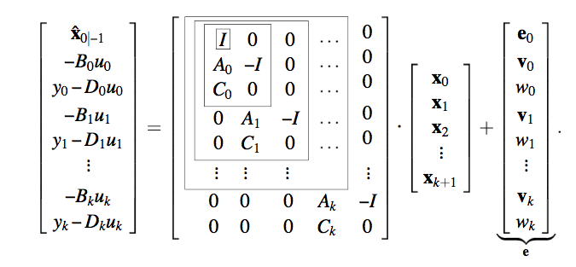
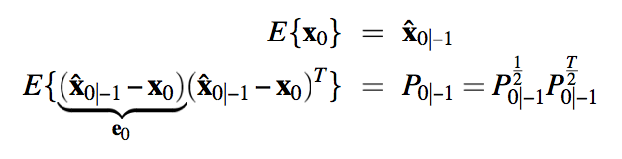
Kalman Filter Algorithms
First, the state estimation @ time k corresponds to a (large) parameter estimation problem in a linear regression model (see p.4), where the parameter vector contains all state vectors x₀… x_{k+1} ,i.e.
PS: x^_{0|-1} is initial estimate in the sense of p.8

Slide 17
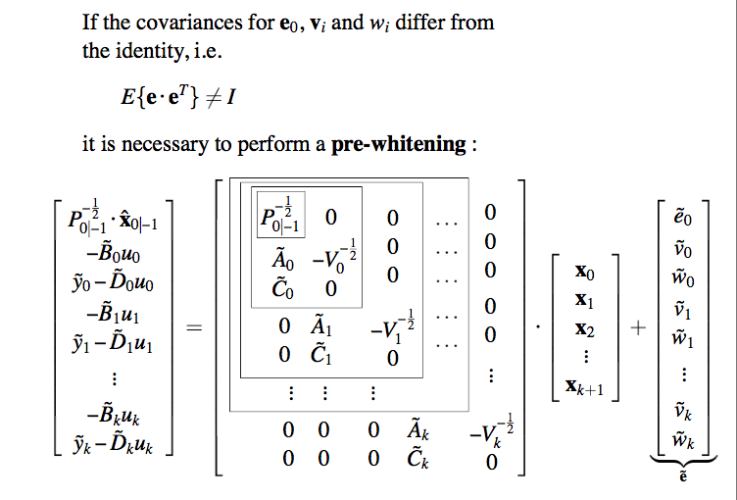
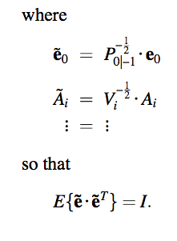
Kalman Filter Algorithms
See p.7 !
Similar derivation, but not considered here (except p.22) for clarity…
(i.e. stick to previous page)

Slide 18
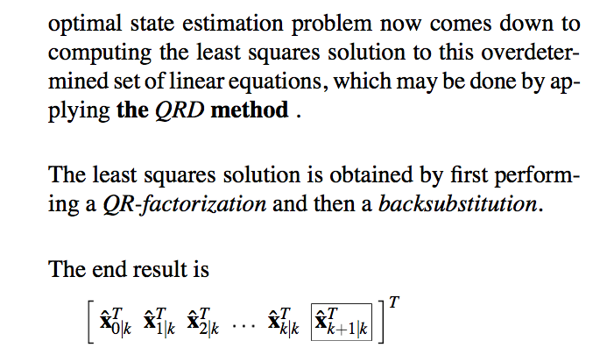
Kalman Filter Algorithms
Linear regression model (p.16 or 17) has L+(k+1).(L+1) equations in (k+1).L unknowns, i.e. corresponds to an overdetermined set of linear equations
.
Note that # equations as well as # unknowns grows with time, hence
need (cheaper) recursive algorithm (with QRD updating as in Chapter-9) !
Linear MMSE
explain subscripts

Slide 19
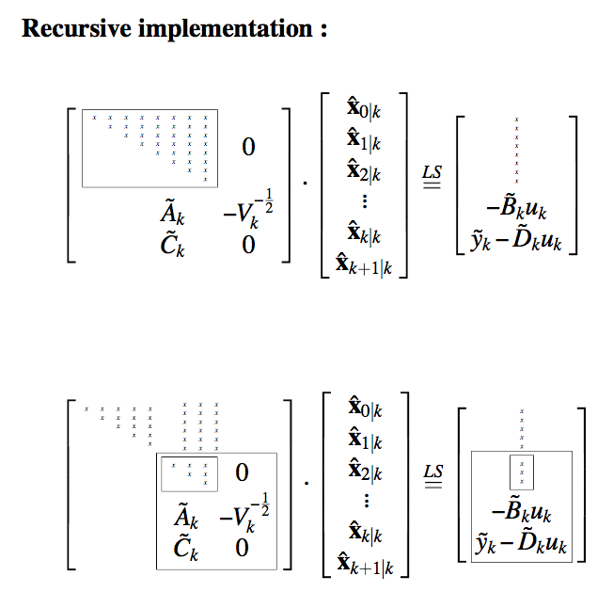

Kalman Filter Algorithms
Triangular factor & right-hand side propagated from time k-1 to time k
A RECURSIVE implementation
is then developed as follows
⬅
…is seen to require only lower-right/lower part ! (explain)

Slide 20
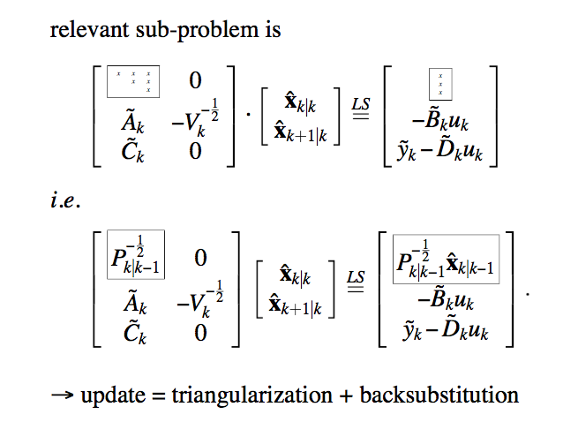
Kalman Filter Algorithms
LxL triangular factor & right-hand side propagated from time k-1 to time k
⬅
Explain! ➔
(compare to p.8
and ✪ p.5)

Slide 21
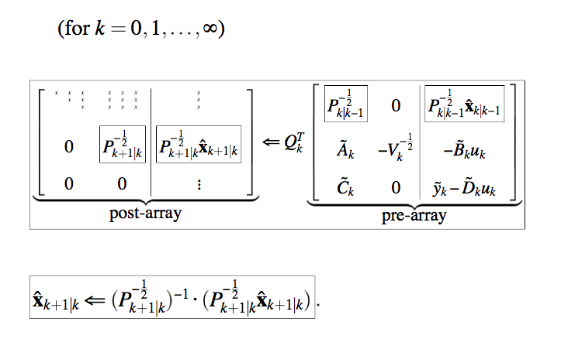
Kalman Filter Algorithms
..
Recursive algorithm is then as follows (‘Square-Root Kalman Filter’):
Propagated from
time k-1 to time k
Propagated from
time k to time k+1
⬅
⬅
⬅
⬅
⬅ backsubstitution

Slide 22
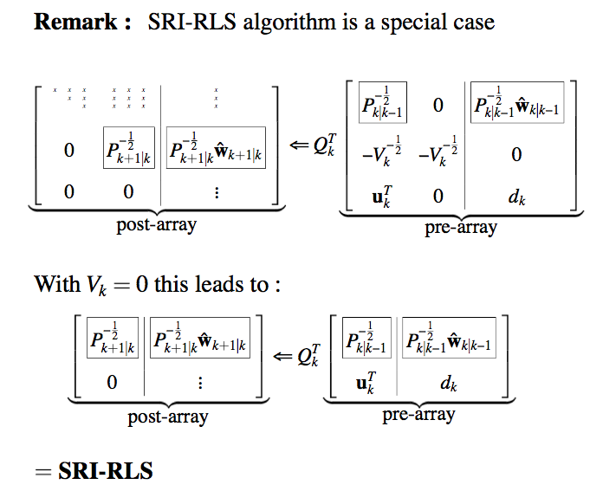
Kalman Filter Algorithms
For special case of fixed parameter estimation (p.14)
‘Square-Root RLS’ formulas (Chapter-9) can be derived as a
special case of ‘Square-Root Kalman Filter’ formulas (p.21) :
QRD-
of square-root KF
See p.14 and 17
= QRD-RLS algorithm

Slide 23
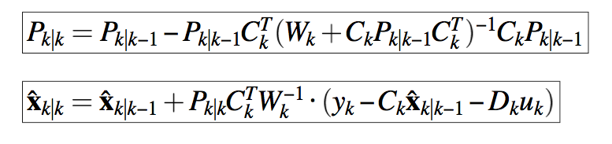
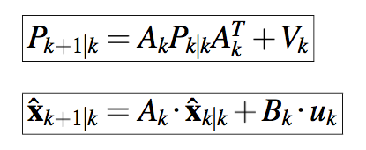
Kalman Filter Algorithms
In textbooks, mostly ‘Standard (a.k.a. conventional) Kalman Filter’
formulas are given, i.e.
Initialization:
For k=0,1,2,…
Step-1: Measurement Update (corresponding to output equation)
Step-2: Time Update (corresponding to state equation)
read on ➔

Slide 24
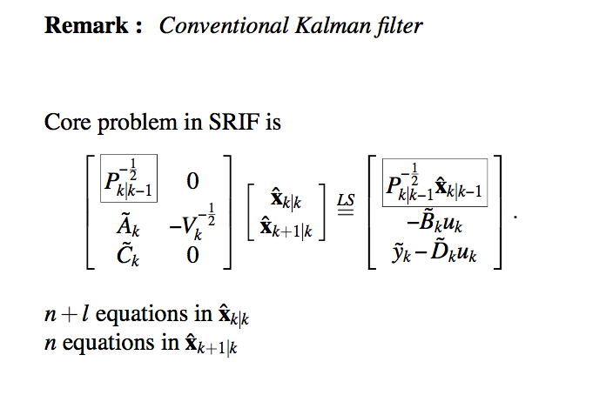
Kalman Filter Algorithms
‘Standard Kalman Filter’ formulas (p.23) are straightforwardly
derived from ‘Square-Root Kalman Filter’ formulas (p.21) :
can be derived from square-root KF equations
is .
L+1
can be worked into measurement update eq.
L
can be worked into state update eq.
[details omitted]
In infinite precision, algorithms are equivalent
In finite precision, square-root algorithm is preferred

Slide 25
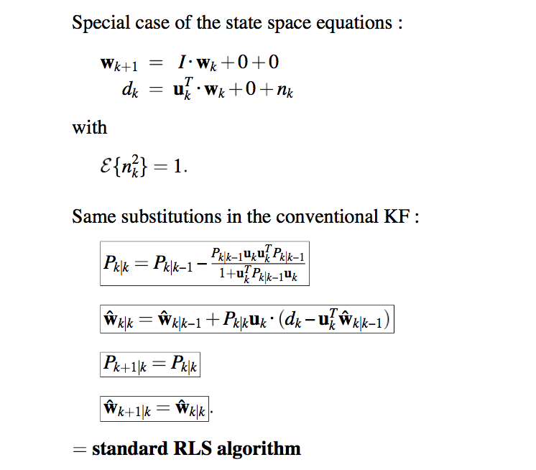
Kalman Filter Algorithms
For special case of fixed parameter estimation (p.14)
‘Standard RLS’ formulas (Chapter-8) are straightforwardly derived
as a special case of ‘Standard Kalman Filter’ formulas (p.23) :
} ‘void’

