Slide 1
Digital Signal Processing for Communication and Information Systems
DSP-CIS
Chapter-1 : Introduction
Marc Moonen
Dept. E.E./ESAT-STADIUS, KU Leuven
marc.moonen@kuleuven.be
www.esat.kuleuven.be/stadius/

Slide 2
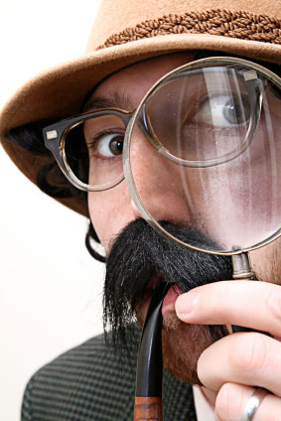
Chapter-1 : Introduction
Aims/Scope
Why study DSP ?
DSP in applications : Mobile communications example
DSP in applications : Hearing aids example
Overview
  Filter design & implementation
  Optimal and adaptive filters
  Filter banks and time-frequency transforms
Lectures/course material/literature
Exercise sessions/project
Exam

Slide 3
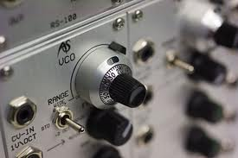
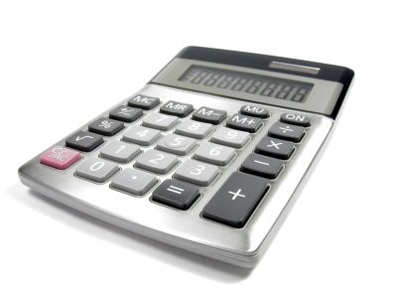
Why study DSP ?
Analog Systems vs. Digital Systems
- Can translate (any) analog (e.g. filter) design into digital
- Going `digital’ allows to expand functionality/flexibility/…
(e.g. speech recognition, audio compression… )
IN
OUT
IN
2
OUT
A/D
+2
D/A
=4

Slide 4
Why study DSP ?
Start with two `DSP in applications’ examples:
  - DSP in mobile communications
  - DSP in hearing aids
Main message:
Consumer electronics products (and many other systems) have become (embedded) ‘supercomputers’ (Mops…Gops/sec), packed with mathematics & DSP functionalities…

Slide 5
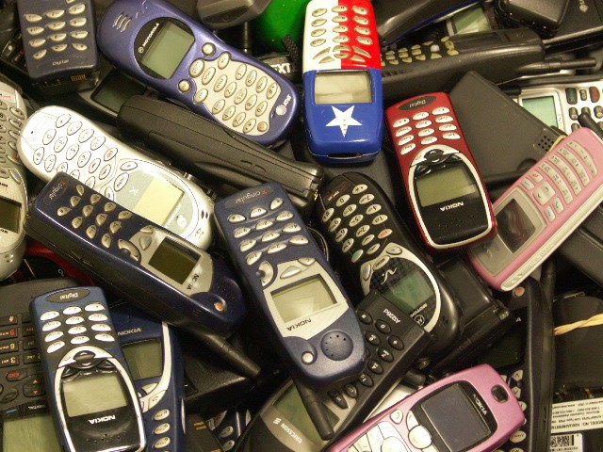
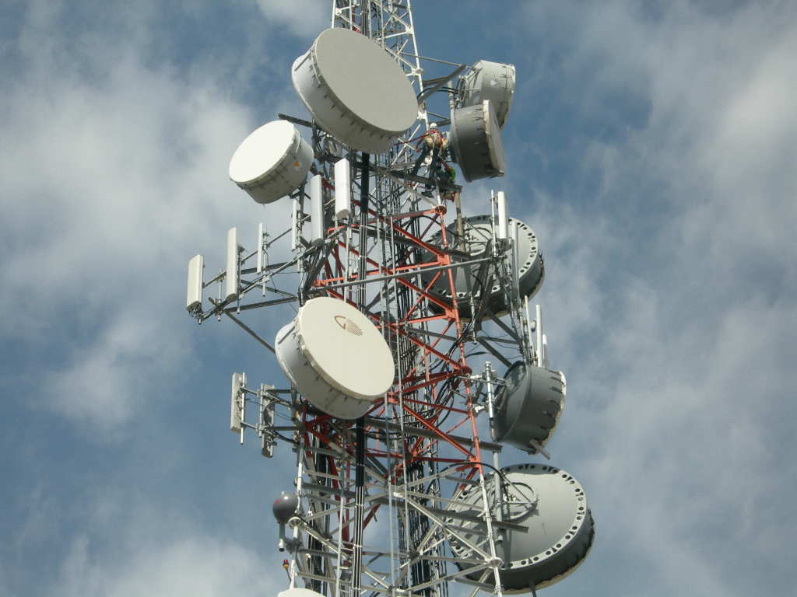
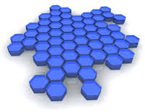
DSP in applications: Mobile Communications 1/10
Cellular Mobile Communications (e.g. GSM/3G/4G/...)
Basic network architecture :
  Area covered by a grid of cells
  Each cell has a base station
  Base station connected to land telephone network and communicates with mobiles via a radio interface
  Digital communication format

Slide 6
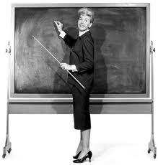
DSP in applications: Mobile Communications 2/10
DSP for Digital Communications (`physical layer’ ) :
  A common misunderstanding is that digital communications
  is `simple’….
  While in practice…
PS: This is a discrete-time system representation, see Chapter-2 for review on signals&systems
.99,.01,.96,.95,.07,…
Transmitter
1,0,1,1,0,…
Channel
Receiver
x
+
x
decision
1,0,1,1,0,…
a
1/a
noise

Slide 7
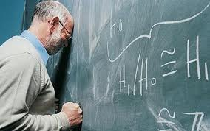
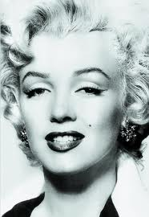
DSP in applications: Mobile Communications 3/10
DSP for Digital Communications (`physical layer’ ) :
  While in practice…
  This calls for channel model + compensation (equalization)
!!
.59,.41,.76,.05,.37,…
Transmitter
1,0,1,1,0,…
`Multipath’
Channel
Receiver
??
+
1,0,1,1,0,…
noise

Slide 8
DSP in applications: Mobile Communications 4/10
DSP Challenges: Channel Estimation/Compensation
  Multi-path channel can (e.g.) be modeled with short (3…5 taps) FIR filter
H(z)= a+b.zˉ¹+c.z ˉ²+d.z ˉ³+e.z ˉ (interpretation?)
PS: zˉ¹ or Δ represents a sampling period delay, see Chapter-2 for review on z-transforms
4
a
`Multipath’
Channel
b
Δ
≈
c
+
Δ
Δ
+
d
Δ
Δ
Δ
e
Δ
Δ
Δ
Δ

Slide 9
DSP in applications: Mobile Communications 5/10
DSP Challenges: Channel Estimation/Compensation
  Multi-path channel can (e.g.) be modeled with short (3…5 taps) FIR filter
H(z)= a+b.zˉ¹+c.z ˉ²+d.z ˉ³+e.z ˉ
4
a
b
Δ
IN[k]
c
OUT[k]
Δ
Δ
+
d
Δ
Δ
Δ
e
Δ
Δ
Δ
Δ
=convolution

Slide 10
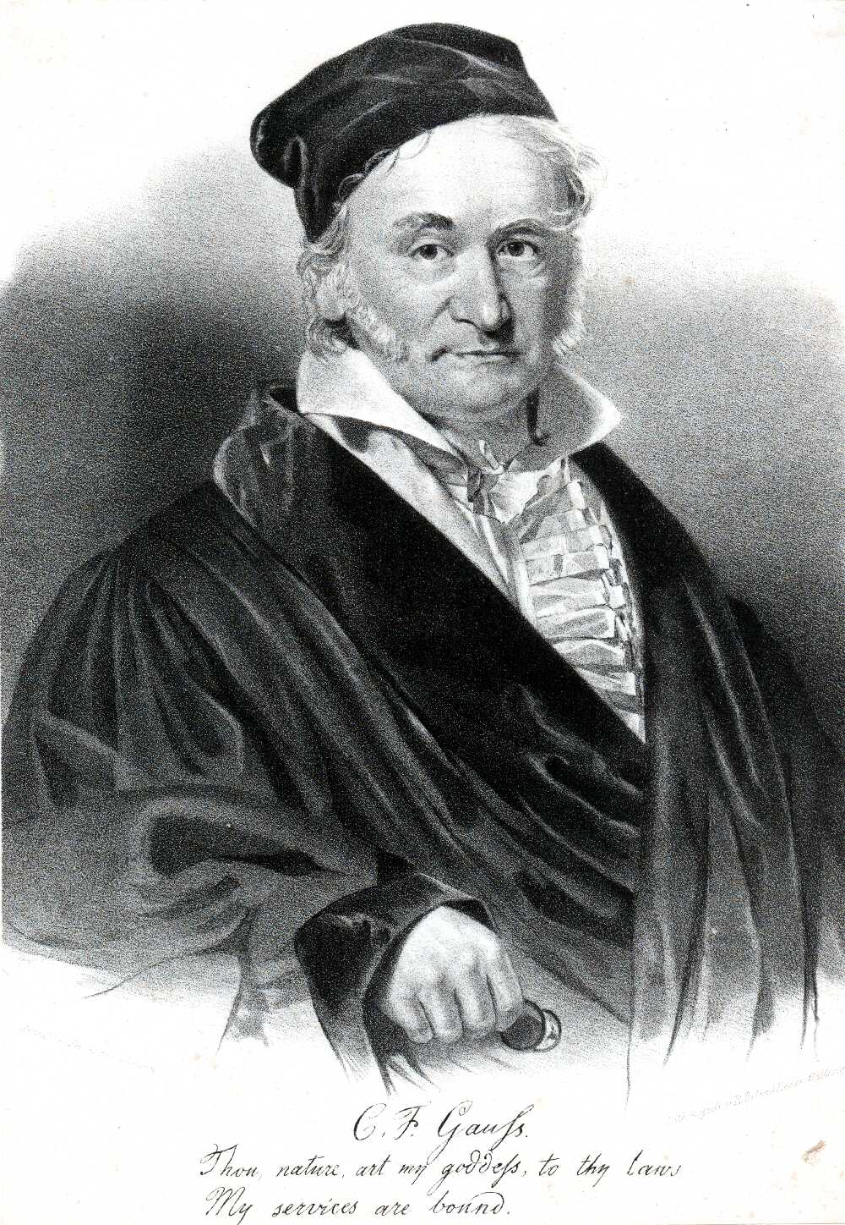
DSP in applications: Mobile Communications 6/10
DSP Challenges: Channel Estimation/Compensation
Channel coefficients (a,b,c,d,e) are identified in receiver based on
  transmission of pre-defined training sequences (TS)
  Problem to be solved at receiver is: `Given channel input (=TS) and channel
  output (=observed), compute channel coefficients’
This leads to a least-squares parameter estimation
  See PART-III on ‘Optimal & Adaptive Filtering’
Carl Friedrich Gauss (1777 – 1855)

Slide 11
DSP in applications: Mobile Communications 7/10
DSP Challenges: Channel Estimation/Compensation
  Channel coefficients (cfr. a,b,c,d,e) are identified in receiver based on transmission of pre-defined training sequences (TS)
  Channel model is then used to design suitable equalizer (`channel inversion’), or (better) to reconstruct transmitted data bits based on maximum-likelihood sequence estimation (e.g. `Viterbi decoding’)
  (details omitted)
  Channel is highly time-varying (e.g. terminal speed 120 km/hr !)
  => All this is done at `burst-rate’ (e.g. 100’s times per sec)
= SPECTACULAR !!

Slide 12
DSP in applications: Mobile Communications 8/10
DSP Challenges: Speech Coding
  Original PCM-signal has 64kbits/sec =8 ksamples/sec*8bits/sample
  Aim is to reduce this to <<64kbits/sec, while preserving quality
  Coding based on speech generation model (vocal tract,…), where model coefficients are identified for each new speech segment (e.g. 20 msec)

Slide 13
DSP in applications: Mobile Communications 9/10
DSP Challenges: Speech Coding
  Original PCM-signal has 64kbits/sec =8 ksamples/sec*8bits/sample
  Aim is to reduce this to <<64kbits/sec, while preserving quality
  Coding based on speech generation model (vocal tract,…), where model coefficients are identified for each new speech segment (e.g. 20 msec)
  This leads to a least-squares parameter estimation (again), executed +/- 50 times per second. Fast algorithm is used, e.g. `Levinson-Durbin’ algorithm
  See PART-III on ‘Optimal & Adaptive Filtering’
  Then transmit model coefficients instead of signal samples (!!!)
  Synthesize speech segment at receiver (should `sound like’ original speech segment)
= SPECTACULAR !!

Slide 14
DSP in applications: Mobile Communications 10/10
DSP Challenges: Multiple Access Schemes
  Accommodate multiple users by time & frequency `multiplexing’
  FDMA: frequency division multiple access
  OFDMA: orthogonal frequency division multiple access
  TDMA: time division multiple access
  CDMA: code division multiple access
  See PART-IV on ‘Filter Banks & Time-Frequency Transforms’
Etc..
= BOX FULL OF DSP/MATHEMATICS !!
(for only €25)

Slide 15
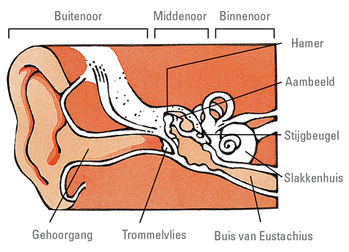
DSP in applications: Hearing Aids 1/10
Hearing
Outer ear/middle ear/inner ear
Tonotopy of inner ear: spatial arrangement of where sounds of different frequency are processed
Low-freq tone
© www.cm.be
= Cochlea
Neural activity
for low-freq tone
High-freq tone
Neural activitity
for high-freq tone
Notes:
15

Slide 16
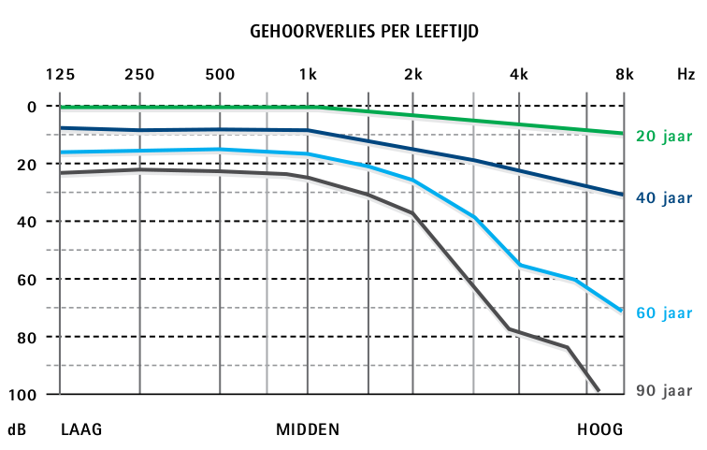
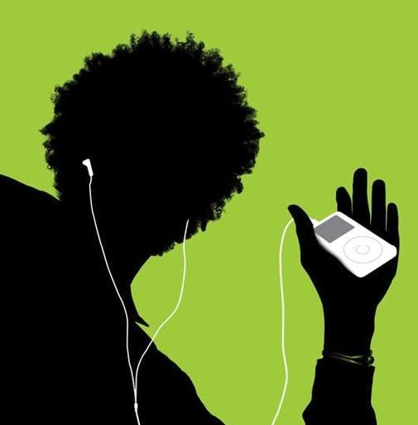
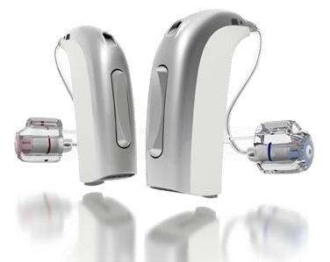
DSP in applications: Hearing Aids 2/10
Hearing loss types
  Conductive (~outer/middle ear)
  Sensorineural (~inner ear)
  Mixed
One in six adults (Europe) suffers from hearing loss
…and still increasing
Typical causes
  Aging
  Exposure to loud sounds
  …
Hearing Instruments
  Hearing aids: audio output
  Bone anchored hearing aids: vibration output
  Cochlear implants: electrical stimulation output
  …
[Source: Lapperre]

Slide 17
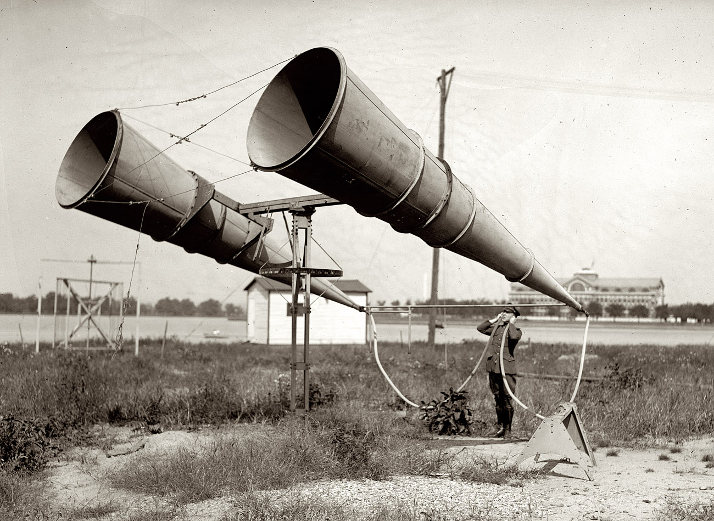
DSP in applications: Hearing Aids 3/10
➔Hearing Aids (HAs)
Audio input/audio output (`microphone-processing-loudspeaker’)
‘Amplifier’, but so much more than an amplifier!!
History:
  Horns/trumpets/…
  `Desktop’ HAs (1900)
  Wearable HAs (1930)
  Digital HAs (1980)
State-of-the-art:
  MHz’s clock speed
  Millions of arithmetic operations/sec, …
  Multiple microphones
1921
2007 (Oticon)
= BOX FULL OF DSP/MATHEMATICS !!

Slide 18
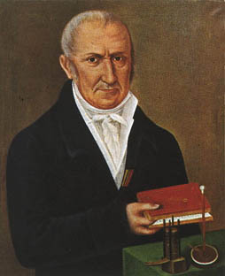
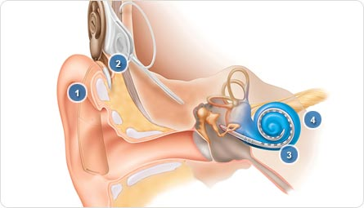
DSP in applications: Hearing Aids 4/10
➔Cochlear Implants (CIs)
Audio input/electrode stimulation output
  Stimulation strategy + preprocessing similar to HAs
History:
  Volta’s experiment…
  First implants (1960)
  Commercial CIs (1970-1980)
  Digital CIs (1980)
State-of-the-art:
  MHz’s clock speed, Mops/sec, …
  Multiple microphones
Alessandro Volta 1745-1827
Intra-cochlear electrode
© Cochlear Ltd
Electrical stimulation
for low frequency
Electrical stimulation
for high frequency
= BOX FULL OF DSP/MATHEMATICS !!

Slide 19
DSP in applications: Hearing Aids 5/10
DSP Challenges: Dynamic range compression
Dynamic range & audibility
Normal hearing Hearing impaired
subjects subjects
Level
100dB
0dB

Slide 20
DSP in applications: Hearing Aids 5/10
DSP Challenges: Dynamic range compression
Dynamic range & audibility
need `signal dependent amplification’
Level
100dB
100dB
Output Level (dB)
0dB
0dB
100dB
0dB
Input Level (dB)
Design: multiband DRC, attack time, release time, …
See PART-IV on ‘Filter Banks & Time-Frequency Transforms’

Slide 21
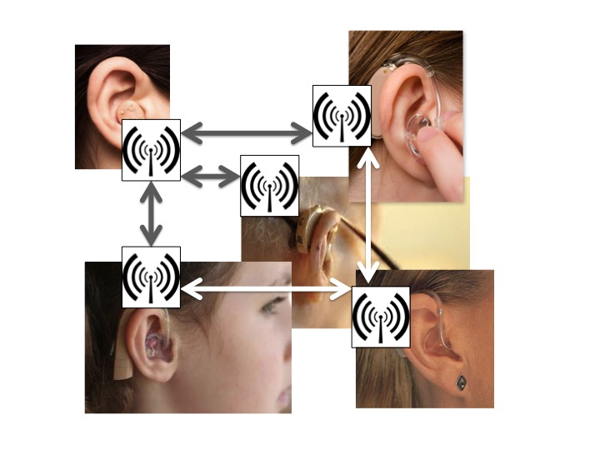
DSP in applications: Hearing Aids 6/10
However: Audibility does not imply intelligibility
Hearing impaired subjects need 5..10dB larger signal-to-noise ratio (SNR) for speech understanding in noisy environments
Need for noise reduction (=speech enhancement) algorithms:
  State-of-the-art: monaural 2-microphone adaptive noise reduction
  Near future: binaural noise reduction (see below)
  Not-so-near future: cooperative HAs with multi-node noise reduction
SNR
20dB
0dB
30 50 70 90
Hearing loss (dB, 3-freq-average)

Slide 22
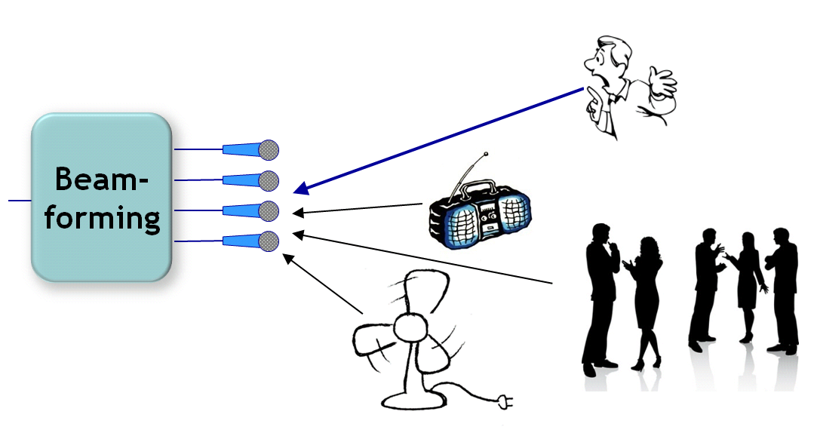
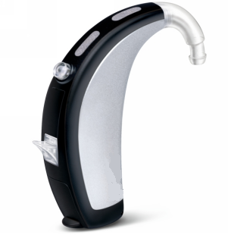




DSP in applications: Hearing Aids 7/10
DSP Challenges: Noise reduction
Multimicrophone ‘beamforming’, typically with 2 microphones,
e.g. ‘directional’ front microphone + ‘omnidirectional’ back microphone
  See PART-II on ‘Filter Design & Implementation’
“filter-and-sum” microphone signals

Slide 23

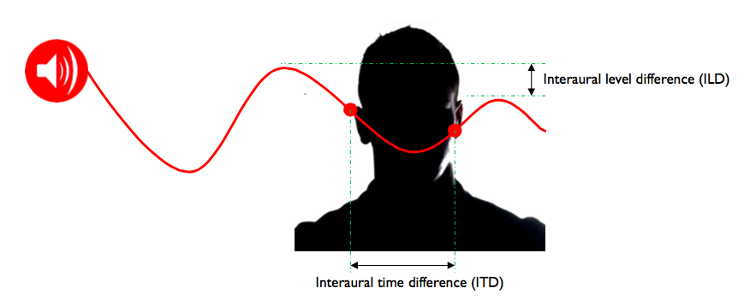
DSP in applications: Hearing Aids 8/10
Binaural hearing based on binaural auditory cues
ITD (interaural time difference)
ILD (interaural level difference)
Binaural cues (ITD: f < 1500Hz, ILD: f > 2000Hz) used for
  Sound localization
  Noise reduction
  =`Binaural unmasking’ (‘cocktail party’ effect) : 0-5dB

Slide 24
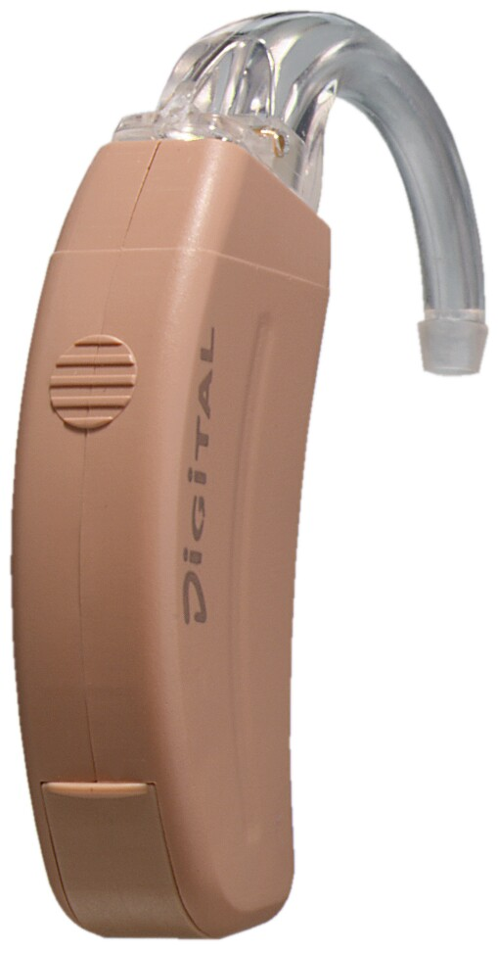
DSP in applications: Hearing Aids 9/10
DSP Challenges: Binaural hearing aids
Two hearing aids (L&R) with wireless link & cooperation
Opportunities:
  More signals (e.g. 2*2 microphones)
  Better sensor spacing (17cm i.o. 1cm)
Constraints: power/bandwith/delay of wireless link
Challenges:
  Improved localization through ‘localization cue’ preservation
  Improved noise reduction + benefit from ‘binaural unmasking’
  Signal selection/filtering, audio coding, synchronisation, …
= SPECTACULAR !!

Slide 25
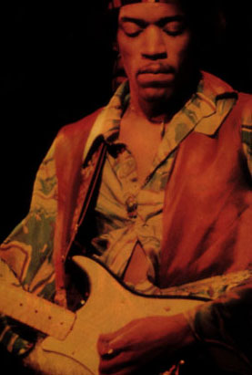
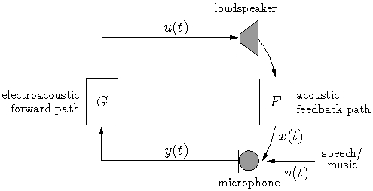
DSP in applications: Hearing Aids 10/10
DSP Challenges: Feedback cancellation
Problem statement: Loudspeaker signal is fed back into microphone, then amplified and played back again
Closed loop system may become unstable (howling)
Similar to feedback problem in public address systems (for the musicians amongst you)
  See PART-III on
  ‘Optimal & Adaptive Filtering’
Similar to echo cancellation in GSM handsets, Skype,…
but more difficult due to signal correlation
Model
F
-
= SPECTACULAR !!

Slide 26
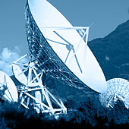
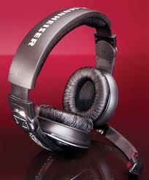

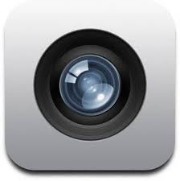
DSP in applications : Other…
Digital Communications
Wireline (xDSL,Powerline), Wireless (GSM, 3G, 4G, Wi-Fi, WiMax
CDMA, MIMO-transmission,..)
Speech
Speech coding (GSM, DECT, ..), Speech synthesis (text-to-speech),
Speech recognition
Audio Signal Processing
Audio Coding (MP3, AAC, ..), Audio synthesis
Editing, Automatic transcription, Dolby/Surround, 3D-audio,.
Image/Video
…

Slide 27
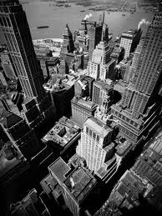
Aims/Scope
Basic signal processing theory/principles
Filter design, filter banks, optimal filters & adaptive filters
…as well as…
Recent/advanced topics
Robust filter realization, perfect reconstruction filter banks,
fast adaptive algorithms, ...
Often ` bird’s-eye view ’
Skip many mathematical details (if possible… ☺ )
Selection of topics (non-exhaustive)
Prerequisites: Signals & Systems (sampling, transforms,..)

Slide 28
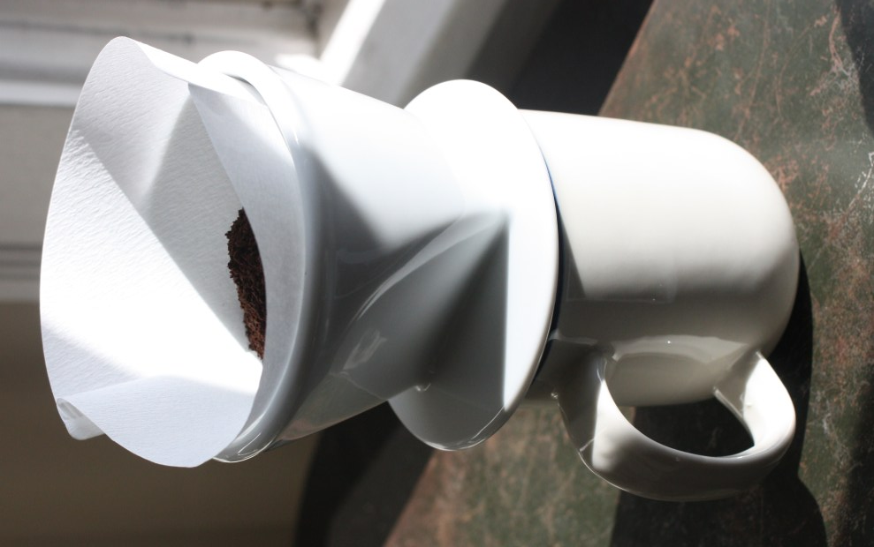
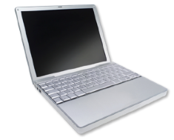
Overview
Part I : Introduction
Chapter-1: Introduction
Chapter-2: Signals and Systems Review
Chapter-3: Acoustic Modem Project
Part II : Filter Design & Implementation
  Chapter-3: Filter Design
  Chapter-4: Filter Realization
  Chapter-5: Filter Implementation

Slide 29
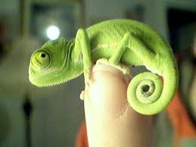
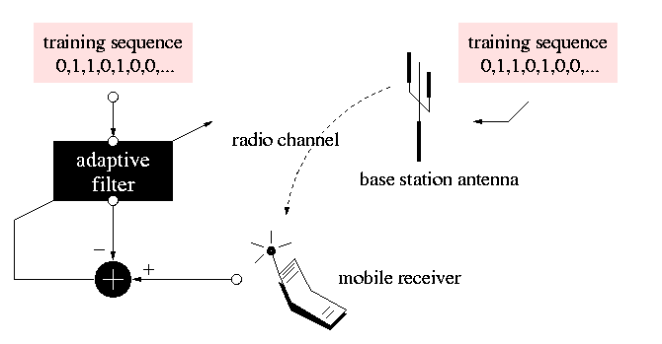
Overview
Part III : Optimal & Adaptive Filtering
  Chapter-7: Wiener Filters & the LMS Algorithm
  Chapter-8: Recursive Least Squares Algorithms
  Chapter-9: Fast Recursive Least Squares Algorithms
  Chapter-10: Kalman Filters

Slide 30
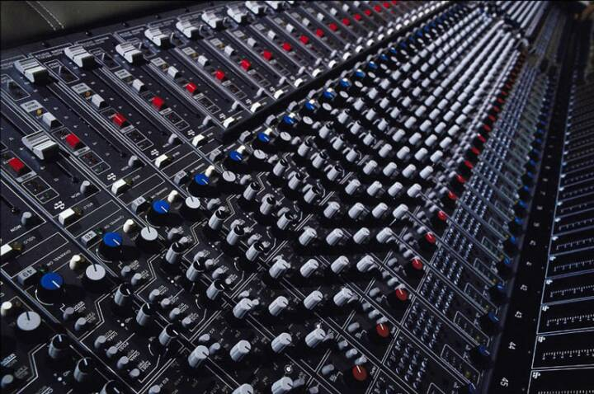
Overview
Part IV : Filter Banks & Time-Frequency Transforms
  Chapter-11: Filter Bank Preliminaries/Applications
  Chapter-12: Filter Bank Design
  Chapter-13: Frequency Domain Filtering
  Chapter-14: Time-Frequency Analysis & Scaling
Part V : Outro
  Chapter-15: DSL Technologies (Nokia Guest Lecture)
H1(z)
3
subband processing
3
G1(z)
IN
3
subband processing
3
G2(z)
OUT
H2(z)
+
H3(z)
3
subband processing
3
G3(z)
H4(z)
3
subband processing
3
G4(z)

Slide 31
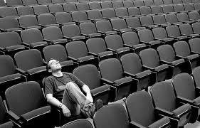
Lectures
Lectures: 15 * 2 hrs
PS: Time budget = (15*2hrs)*4 = 120 hrs
Course Material:
Part I-V: Slides (use version 2019-2020 !!)
Download from DSP-CIS webpage
Master copy available @ ESAT B00.10 (Ida Tassens)
Part III: `Introduction to Adaptive Signal Processing‘
(Marc Moonen & Ian.K. Proudler)
= optional reading
Download from DSP-CIS webpage (if needed)

Slide 32

Lectures
Lectures: 15 * 2 hrs
PS: Time budget = (15*2hrs)*4 = 120 hrs
‘Web Lectures’
Slides with audio
Date/Time: See schedule (!)
Place: Your place instead of lecture room
Support: See page 40

Slide 33
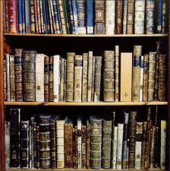
Literature / Campus Library Arenberg
A. Oppenheim & R. Schafer (*)
`Digital Signal Processing’ (Prentice Hall 1977)
L. Jackson
`Digital Filters and Signal Processing’ (Kluwer 1986)
Simon Haykin
`Adaptive Filter Theory’ (Pearson Education 2014)
P.P. Vaidyanathan
`Multirate Systems and Filter Banks’ (Dorling Kindersley 1993)
M. Bellanger
`Digital Processing of Signals’ (Kluwer 1986)
etc...
Part-I
Part-II
Part-III
Part-IV
(*) MOOC www.edx.org/course/discrete-time-signal-processing-mitx-6-341x-1

Slide 34
Literature / DSP-CIS Library
Collection of books is available to support course material
List/reservation via DSP-CIS webpage
Contact: amin.hassani@esat.kuleuven.be

Slide 35
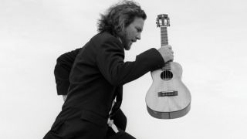
Exercise Sessions: Acoustic Modem Project
  Digital communication over an acoustic channel
  (from loudspeaker to microphone)
  FFT/IFFT-based modulation format : OFDM
  (as in ADSL/VDSL, WiFi, DAB, DVB,…)
  Channel estimation, equalization, etc…
Digital Picture (IN)
Tx
D-to-A
A-to-D
Rx
+filtering
+amplif.
+filtering
+…
Digital Picture (OUT)

Slide 36
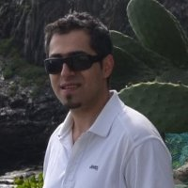


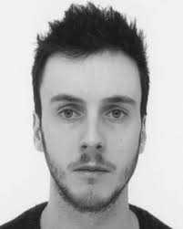
Exercise Sessions: Acoustic Modem Project
Runs over 8 weeks
Each week
  1 PC/Matlab session (supervised, 2.5hrs)
  2 ‘Homework’ sesions (unsupervised, 2*2.5hrs)
PS: Time budget = 8*(2.5hrs+5hrs) = 60 hrs
‘Deliverables’ after week 2, 4, 6, 8
Grading: based on deliverables, evaluated during sessions
main part=80%, optional part=20%
TAs: amin.hassani@kuleuven.be (English+Persian)
mohit.sharma@kuleuven.be (English+Hindi)
robbe.vanrompaey@kuleuven.be (Dutch+English+French)
jeroen.verdyck@kuleuven.be (Dutch+English+French)
PS: groups of 2

Slide 37
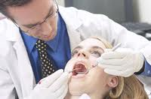
Exam
Oral exam, with preparation time
Open book
Grading :
5 pts for question-1
5 pts for question-2
5 pts for question-3
+5 pts for Acoustic Modem Project evaluation (p.36) ___
= 20 pts

Slide 38
September Retake Exam
Oral exam, with preparation time
Open book
Grading :
5 pts for question-1
5 pts for question-2
5 pts for question-3
+5 pts for question-4 on Acoustic Modem Project ___
= 20 pts

Slide 39
Website
TOLEDO
2) homes.esat.kuleuven.be/~dspuser/DSP-CIS
Contact: robbe.vanrompaey@kuleuven.be
Slides
Project info/schedule
DSP-CIS Library
FAQs (send questions to
robbe.vanrompaey@kuleuven.be
or marc.moonen@kuleuven.be)

Slide 40

Questions?
Ask Teaching Assistants (during exercises sessions)
E-mail questions to
TA’s
or marc.moonen@esat.kuleuven.be
3) Make appointment
marc.moonen@esat.kuleuven.be
ESAT Room B00.14

