Slide 1


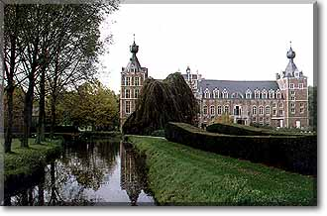
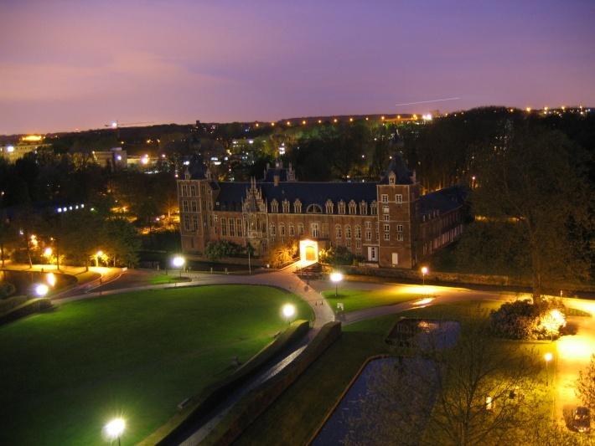
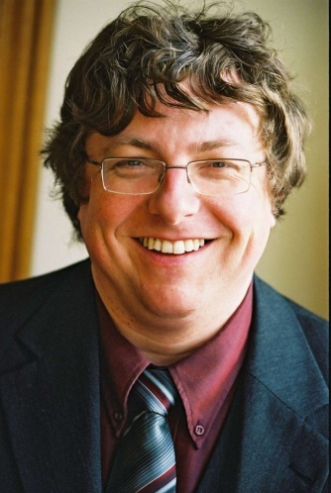
ASTP Site Visit – Leuven 11/10/2008
Case study and testimony
Bart De Moor
ESAT-SCD
Katholieke Universiteit Leuven
Bart.DeMoor@esat.kuleuven.be
www.esat.kuleuven/be/~demoor

Slide 2
Contents
Where are we ?
From research to spinoff
Environment and networks
Afterthoughts

Slide 3

Katholieke Universiteit Leuven
Founded 1425
3 groups (Humanities, S&T, Biomedical), 12 Faculties
People
  Academic staff: 1400 professors, 4000 researchers
  Administrative and technical staff: 2750
  Students: 33.000 (3.700 international students)
Total budget: 1.3 billion euro
University Hospital, Personnel: 8100

Slide 4
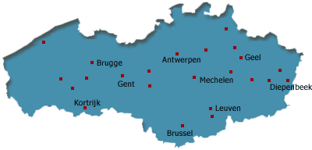

1985 :
38 European
long-estbablished
multidisciplinary
universities
2002:
12 European
research-
intensive
universities

Slide 6
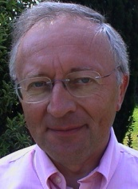
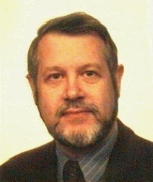
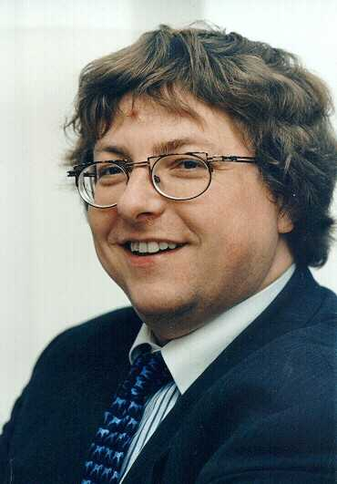
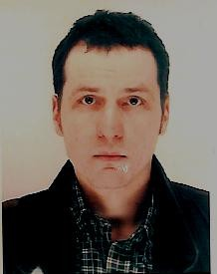
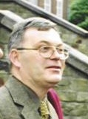
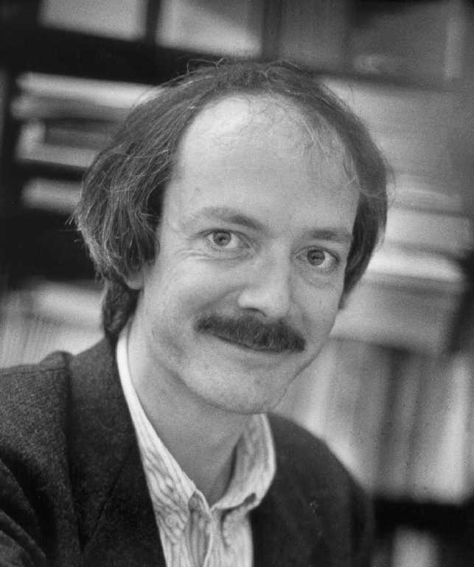
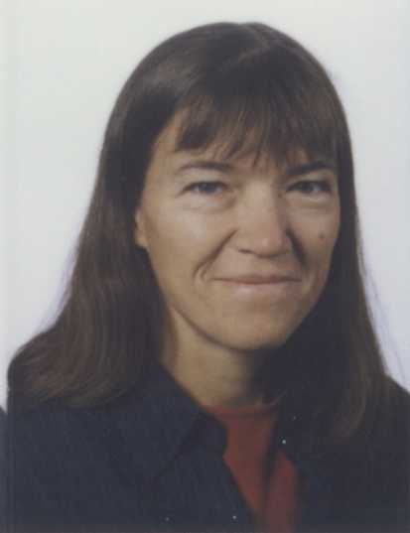
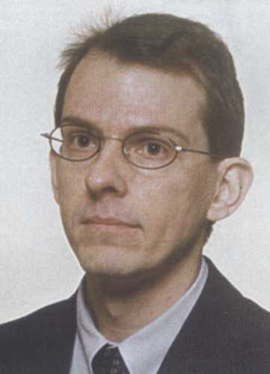
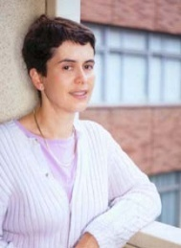

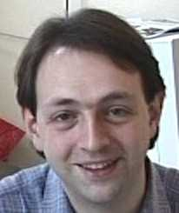
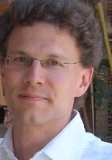
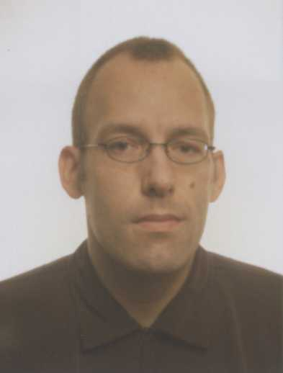
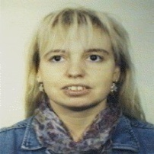
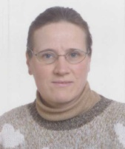
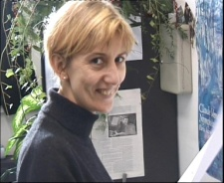
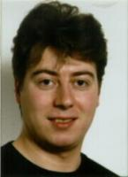
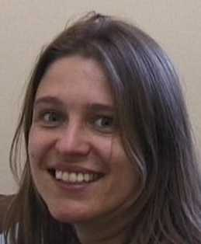
Ida Tassens, Pela Noe,
Jacqueline Debruyn
Secretary
Bart Motmans
Project Coordinator
Lieven De Lathauwer
(KULAK)
Multilinear Algebra
Kathleen Marchal
(BIW)
Bioinformatics
Ilse Pardon, Elvira Wouters, Veerle Duchateau
Accountant

Slide 8
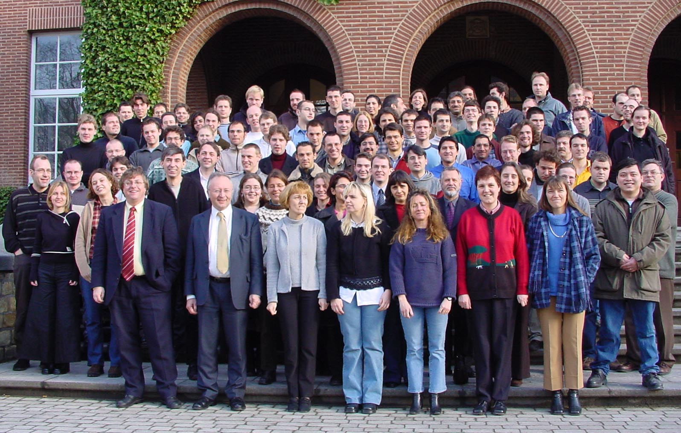

Slide 9









Funding
Research
Basic
BOF
Strategic
IOF
FP6/7
Hercules
Valorisation
SME

Slide 10






All bdm projects
K.U.Leuven
Flanders
Belgium
Europe
VitaminD,
Clin. Proteomics
Endometriosis
Fun. Genomics
Rob. Statistics
Swine-Aging
Subfunct
SVM
Glycemia I, II
Netw. Inference
Micro-arrays I,II,III
Ontologies
Id.Nonlinear/HighFreq
Kernel Based Methods
QuantumAlgo’s
SysId/Crypto
QuantumInform
Energy Islands
Adv. Num.Methods
Multilin SVD
Basic Research
GOA-MEFISTO
GOA-AMBioRICS
IDO-Gen.Netw.
EF-SymBioSys
EF-OPTEC
PODO-Traffic Mgmt I, II
IAP-P4-Mod, Id, Control
IAP-P5-Dyn.Systems
IAP-P6-Dysco
IAP-P6-BioMAGNet
Strategical research
IOF-Scores4Chem
EC-FP6, FP7:
Quantum Info Systems
CAGE
Strokemap
BioPattern
Bioptrain
GBOU-McKnow
GBOU-SQUAD
STWW-GenProm
SBO-MOKA
SBO-BioFrame
TBM-Endometriosis
ITEA-Flite
ITEA-Flite+
Valorisation/
Industrial/
Services
PROMETA
Soft4S
McKnow-E
BioScopeIT
Spin Offs:
IPCOS (ISMC), TMLeuven, Norkom (DATA4S), SILICOS, Dsquare, Cartagenia, ICMS (spin-in)
Contract research:
Monsanto, Electrabel, ELIA, Mastercard, Bauknecht

Slide 12
Projects BDM: SCD funding (2002-2008) (k€)
All bdm projects; only project budgets are shown;
no person-related grants, no income from spin-offs

Slide 13
Publish or perish

Slide 14




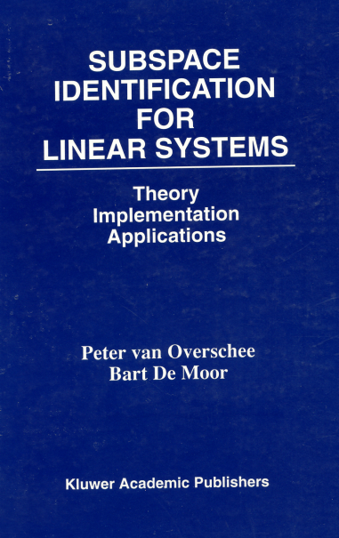

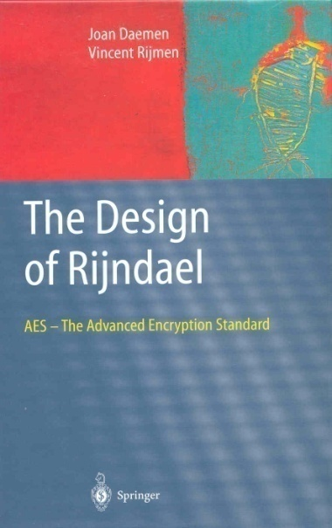

Slide 15
Impact factors : pushing for quality

Slide 16
Contents
Where are we ?
From research to spinoff
Environment and networks
Afterthoughts

Slide 17








Research and spinoffs
Systems and control
Datamining
Systems Biology
Bioinformatics

Slide 18
Systems and control

Slide 19
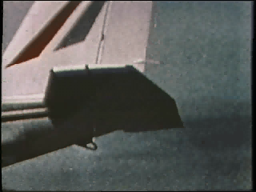
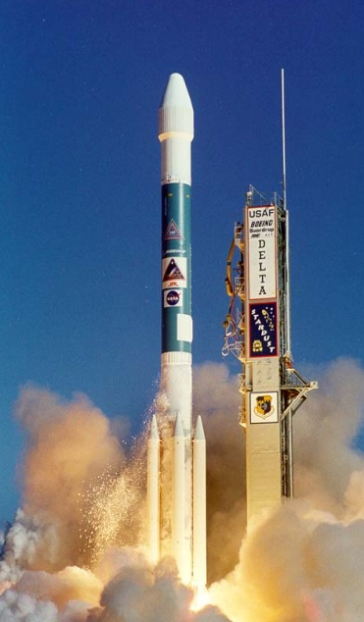
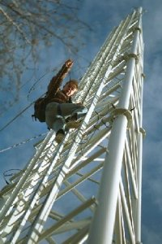
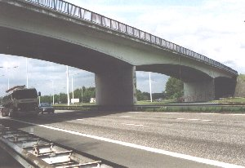


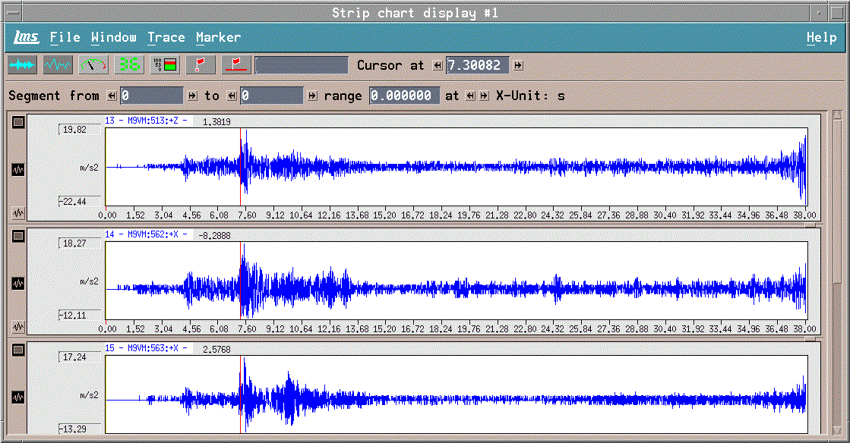
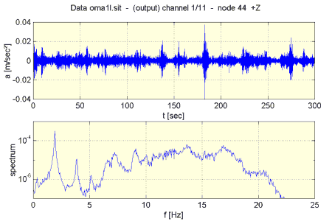
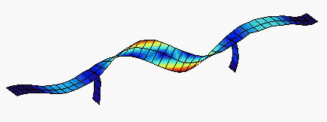

Slide 20
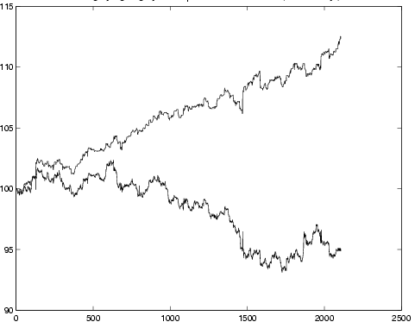
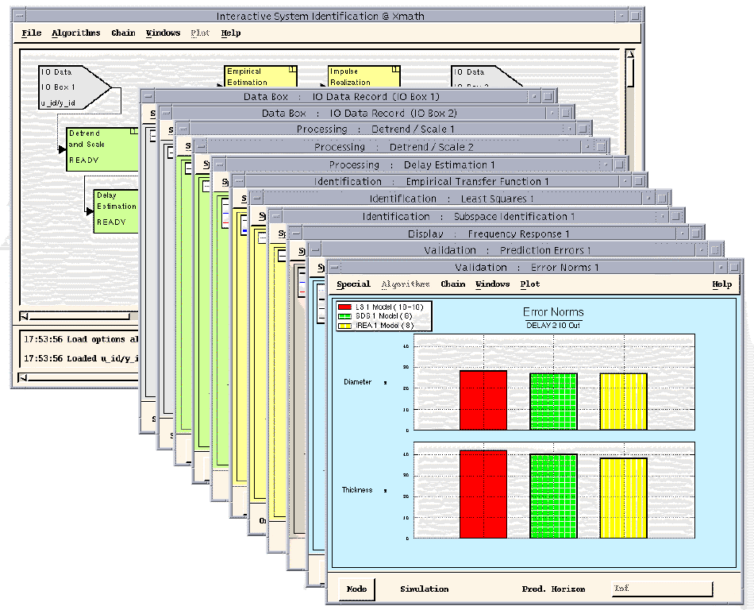
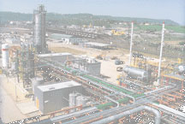
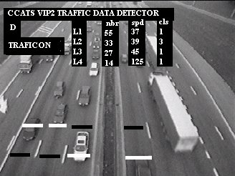
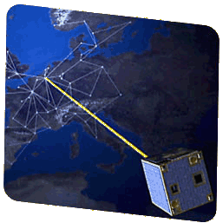
SMC
Identification and prediction of
time series (stock exchange, physical
phenomena, …)
MV
CV
Control
horizon
MODEL
Y(t)
U(t)
Y_{d}(t)
Y(t)
^
Y(t)
^
U(t)
Traffic modelling and
control
PAST
FUTURE
Satellite control
Model Predictive Control

Slide 21
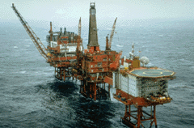
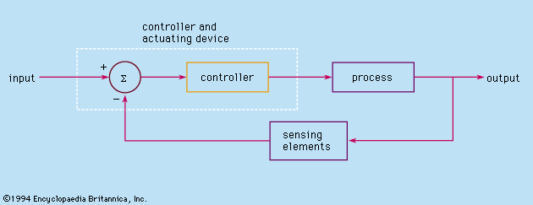
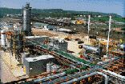
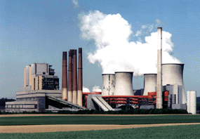
Optimized Grade Change Trajectory
100
Histograms
No control, Quasi steady state and fast control
903
902
No control
901
GRADE B
GRADE B
900
903
902
Quasi steady
control
901
900
Off-spec
GRADE A
903
902
Fast dynamic
control
901
900
100
200
300
400
500
600
700
800
900
0
10
20
30
40
50
60
70
80
90
100
1000

Slide 22
Datamining

Slide 23
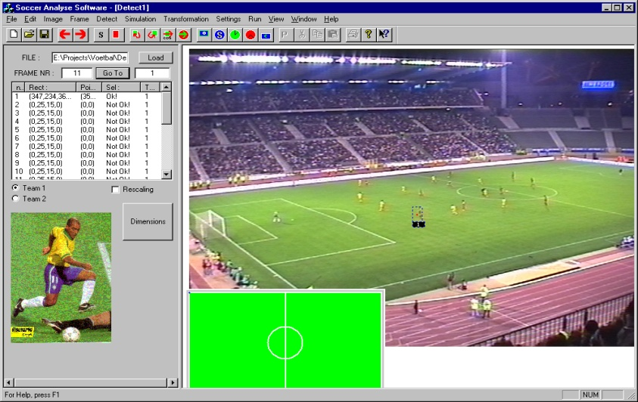
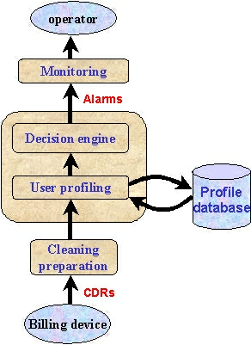
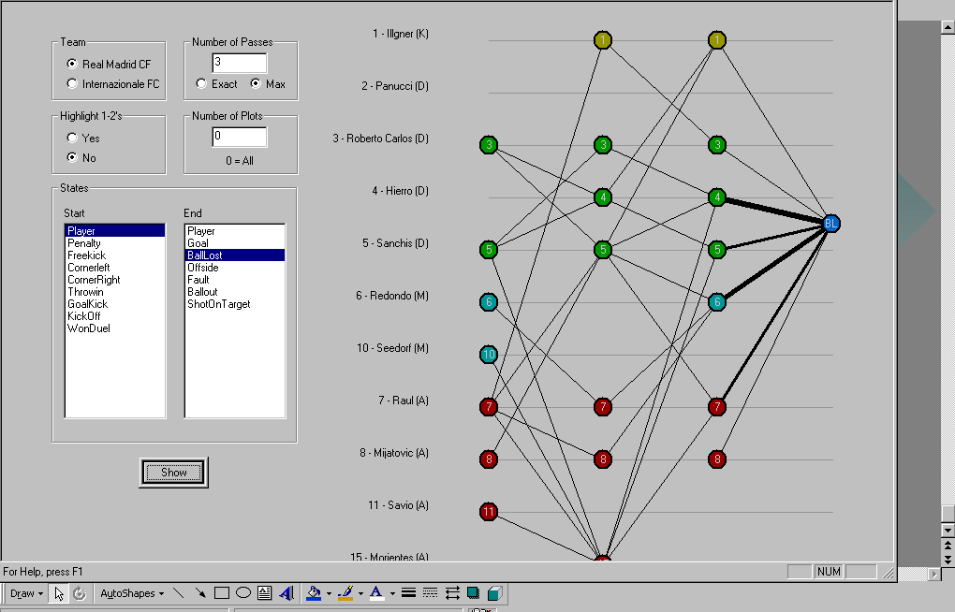
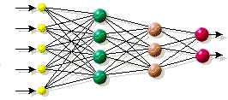
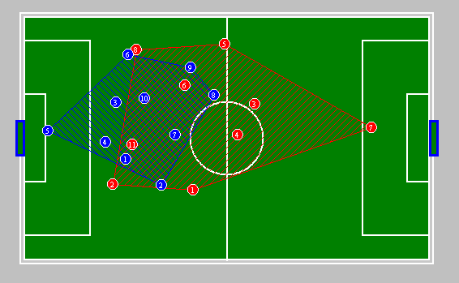
Average call duration
Call frequency

Slide 24
Systems Biology
Bioinformatics
24

Slide 25
Making Sense of the 1000$ Genome
Human genome project
  Initial draft: June 2000
  Final draft: April 2003
  13 year project
  $300 million value
  with 2002 technology
Personal genome
  June 1, 2007
  Genome of James Watson, co-discoverer of DNA double helix, is sequenced
    $1.000.000
    Two months
€1000-genome
  Expected 2012-2020
Year | Cost per base pair | Genome cost
1990 | 10 | 3E+10
1995 | 1 | 3.000.000.000
2000 | 0.2 | 600.000.000
2002 | 0.09 | 270.000.000
2005 | 0.03 | 90.000.000
2007 | 0.000333333 | 1.000.000
2010 | 3.33333E-06 | 10000
2015 | 0.0000001 | 300

Slide 26
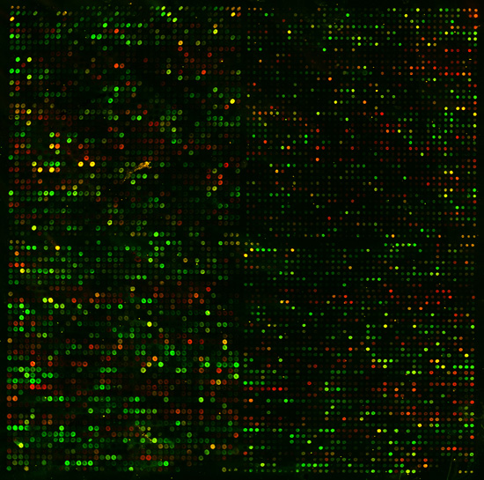
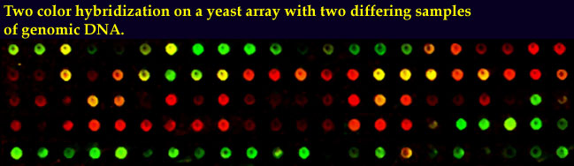
 | Test | Ref.
 | High | Low
 | Low | High
 | High | High
 | Low | Low

Slide 27
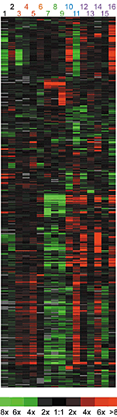
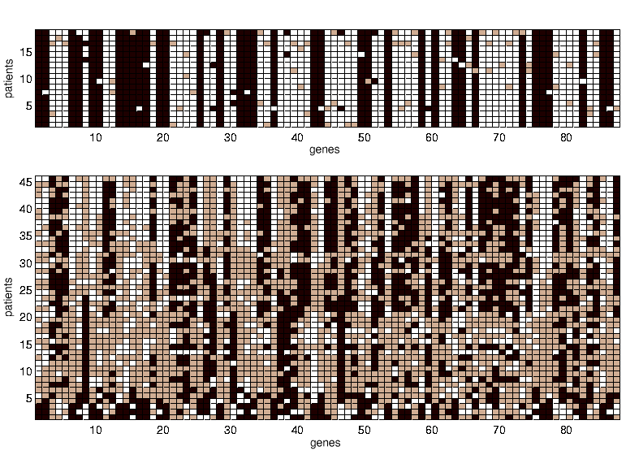
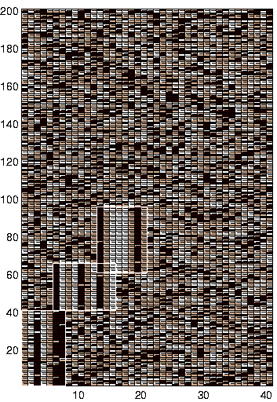

Data matrix
Find the pattern
Hidden pattern
Pattern validation

Slide 28


PCA
© Armstrong SA et al. Nat Genet. 2002 Jan;30(1):41-7.
12 600 genes
72 patients:
- 28 Acute Lymphoblastic Leukemia (ALL)
- 24 Acute Myeloid Leukemia (AML)
- 20 Mixed Linkage Leukemia (MLL)
3 patients for each class used as test set

Slide 29
Context: biomedical/biological research: 4M
Biological problem
Experiment design
Biological data
Data analysis
Biological validation
Improved method
New biology
Models: used to formulate hypotheses;
Manipulate: experiment design to generate data; wet lab; clinical;
Measure: technology boosts number of data;
Mine: (in-)validate biological hypotheses;

Slide 30
Trends in bio
Interpretability
Complexity
# Genetic data
Analysis bottleneck
Price pbp

Slide 31
Context: Dynamics in bio-science fields

Slide 32









Context: integration of heterogeneous data sources
Wetlab data validation
-omics data generation
Candidate
genes
Information sources
Candidate prioritization
?
Validation
Bayesian inference
Kernel methods
Component models
Simultaneous optim.

Slide 33
Context: A wealth of potential applications
Areas: food, health, farma, agro, environment, sustainability
Examples:
  Science: biological systems understanding
  Health: disease management
  Farma: in silico drugs discovery – customized medicine
  Food/health: nutraceuticals – functional food
  Safety: biofilms, infectious disease management (bird flu, malaria,..)
  Environment: microbial ecology
  Energy: biofuels
  Ecology: protected area conservation, integrated forest management
  Agro: novel crop design
  ….

Slide 34
Research and spinoffs
Systems and control
Datamining
Systems Biology
Bioinformatics

Slide 35

(previously ISMC - Intelligent System Modeling and Control) is an engineering company that offers products and engineering services in advanced process control for the chemical, glass, power and oil industry. The company offers complete solutions for an optimal plant performance. www.ipcos.be
In November 2004, Norkom Technologies acquired all Data4s shares. Norkom Technologies is a European leader in Risk Management and Compliance software to detect and combat different types of financial crime for the Retail Banking, Insurance and Investment Banking sector. Based on Norkom's award winning technology platform, Alchemist(tm), application areas include anti money laundering, cheque and debit/credit card fraud, identity theft, and the illegal transfer of funds to named individuals and organisations. www.norkom.com
Silicos is a chemo-informatics-based biotechnology company empowering proprietary multi-target virtual screening technologies for the discovery of novel and high-quality lead compounds for the treatment of a large variety of diseases, such as cancer, infectious diseases, central nervous system and immunodeficiency diseases. www.silicos.com
Transport and Mobility Leuven develops advanced models and offers advice in the areas of transport economy, traffic analysis and management, strategic transport policies, new transport technologies, freight models and spatial development issues.
www.tmleuven.be

Slide 36
Dsquare offers datamining solutions for the process and manufacturing industry with software products and services. Our mission:” Exploiting all availabledata sources to gain process insight, using top of class technology and people”. www.dsquare.be
Cartagenia will offer a collaborative lab web tool set, supporting genetic diagnostics in clinical practice & research, storage of patient and experiment data, search, reporting, data mining, visualization, intelligent diagnosis support, Genome Annotation and significantly increase lab workflow speed; Services and support will include Distributed Hosting, Secure Storage, Data Protection, Backup and Recovery Expertise and support in genetic analysis pipeline setup and management. www.cartagenia.com
Spin-in company: TT (text-mining technology) for shares.
ICMS is a text-mining and information management, processing and retrieval company. www.icms.be

Slide 37
Direct employment
IPCOS (Belgium, Netherlands) 50
NORKOM (Belgium) 40
TML 10
SILICOS 5
DSQUARE 5
Total 2008 110

Slide 38
How to start up a start-up ?
Private partners
Cash
Professor(s)
PhDs/Postdoc
External people
Friends, family
University
Cash
IP - Inventors
Professor(s)
Inventors
LRD Research division
VC/Seed Money
Cash
Gemma Frisius
Other Equity Funds
Start-up process and ingredients different for every start-up !

Slide 39
Contents
Where are we ?
From research to spinoff
Environment and networks
Afterthoughts

Slide 40
Environment
Research climate @ university
  Major funding sources: IAP, GOA, CoE, Methusalem (?)
  IOF
  Networks: BioSCENTer
LRD
  TTO
  Spinoff tradition (I was part of the learning process)
  Gemma Frisius
  Entrepreneurial: University wide master course: ‘Initiatie tot ondernemen’
Leuven High-Tech Valley
    Local networks: L.inc, DSP Valley, L-SEC, …
    Interregional: ELAT,…
Flanders
  Science policy: Budget growing since 1995
  Strategic Research Institutes: IMEC (nano), VIB (biotech), IBBT (broadband)
  Competence poles: FMTC (Mechatronics), Flanders Drive, Flanders-Bio,…
  role of IWT: spinoff kick-off projects (up to 65 % funding)
  government seed-money/VC incentives
Belgium
- ‘defiscalisation’-measures for R&D in companies

Slide 41

development of business plan
protection and exploitation of intellectual property
finding investors
negotiation & legal support
finding infrastructure
management of growth of the spin-off company
stimulating networking & clustering
IOF Industrial Research Fund
A bridge between university and industry
Project types:
- leverage platforms
- knowledge building platforms
People:
- industrial research fellows
- evaluated every 5 years

Slide 42






Flanders in action (VIA)
People and talents
Geography/logistics
governments
Innovation as a culture

Slide 43


Slide 44
(groen=1°kwartiel groep 125 regio’s) | EU-25 Gemidd. | Vlaanderen | Baden-Würt | positie t.o.v. 125
BBP/inw | 21.738 | 25.405 | 26.691 | 32
werkgelegenheidsgraad (in %) | 64,90 | 60,1 | 75,2 | 85
werkloosheidsgraad(in %) | 9,00 | 5,4 | 7,1 | 32
arbeidsproductiviteit (in euro) | 49.896 | 64.202 | 52.984 | 10
arbeidseenheidkost (in euro) | 29.655 | 40.541 | 35.280 | 119
loonkost per eenheid product | 0,56 | 0,57 | 0,6 | 75
aandeel werkenden in (M)HT industrie en KI diensten | 10 | 11,9 | 21,5 | 25
aandeel werkenden met hoger opleidingsniveau (in%) | 29,2 | 35,5 | 26,6 | 10
aandeel levenslang leren (in %) | 8,6 | 9,8 | 8,5 | 26
aantal patentaanvragen per milj inwoners | 131 | 161 | 600 | 23
totale O&O uitgaven in %BBP | 1,8 | 2,08 | 3,88 | 21
aandeel werkenden in creatieve beroepen (in %) | 38 | 42,1 | 40,6 | 21
afhankelijkheidsratio | 64 | 66,3 | 63,3 | 78

Slide 45
Lissabon norm: R&D / GRP
1%
2%
Public O&O spending in % GNP
Industry O&O spending in % GNP
Flanders O&O budget 1995-2006

Slide 46
Human potential
Researchers per 1000 employed (2003)
Higher education / 100 25-64 year old (2003)
S&T masters / 1000 20-29 year old (2003)

Slide 47
Benchmarking entrepreneurship
Broadband penetration (bb-lines / 100 people) (2003)
‘Early stage’ venture capital (% GNP) (2003)
Patents per mio people (2000)
High-tech share in export (2003)

Slide 48
Benchmarking entrepreneurship
Total Entrepreneurial Activity (GEM)
European paradox:
Research excellent
S&T transfer insufficient

Slide 49
Financing entrepreneurship
Hoog risico
Seed money uniefs + research-instellingen
Gemma-Frisius (KUL) Baekelandt (UG) E-capital (IMEC)
ARKIMEDES
> 250.000 Euro
VLAAMS INNOVATIEFONDS
100.000-500.000 Euro
MARKT
WINWIN-
LENING
< 75.000 Euro
BUSINESS ANGEL NETWORK
50.000- 100.000 Euro
Laag risico
PRE-SEED
SEED
START-UP
EARLY-STAGE
EXPANSIE

Slide 50
Contents
Where are we ?
From research to spinoff
Environment and networks
Afterthoughts

Slide 51
Afterthoughts
Research group size matters in creating research driven start-up
  Law of large numbers (# entrepreneurs / # PhDs)
  Critical mass for research impact and support
Declining number of engineering students is a serious problem
Underrepresentation of women in engineering is a brain waste worse than brain drain
Correlation between / reinforcement of
scientific quality (‘push’) and industrial oriented research (‘pull’)
Entrepreneurial climate: we still have to do much better !!
  Professors
  Bachelor/masters
  PhDs
The start-up process is different for every start-up
Slow growth of engineering companies not a problem per se
Environment and networks important: university, local, regional, government

